Slide 1





Intercomparison of Lightning Measurements in Tornadic QLCS Storms
How Different Lightning Networks Behave Surrounding Tornadoes
Authors: Jacquelyn Ringhausen^{1,2,3}, Vanna Chmielewski¹, Kristin Calhoun¹
¹NOAA / OAR National Severe Storms Laboratory
²Cooperative Institute for Severe and High-Impact Weather Research and Operations
³University of Oklahoma
Contact email: jacquelyn.ringhausen@noaa.gov
Funding Source: VORTEX-USA

Slide 2
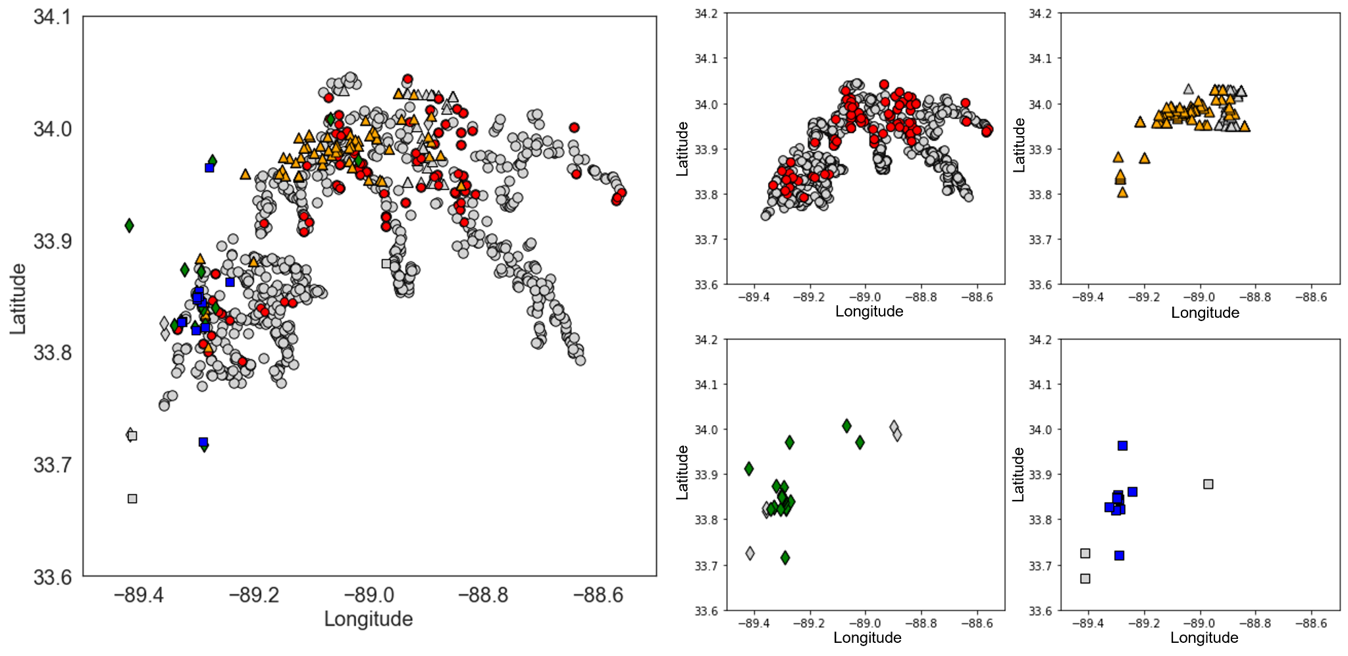
Motivation
Lightning location networks differ in their methods of lightning detection based on:
– network detection efficiency
– flash sorting algorithms
– methods of detection
Due to these differences, each network can provide unique information about not only the lightning occurring, but their contrast can imply something about the meteorological environment.
Thus, combining networks provides more information than any single network can alone.
LMA
GLM
ENTLN
NLDN
Unmatched

Slide 3
Motivation
Lightning location networks differ in their methods of lightning detection based on:
– network detection efficiency
– flash sorting algorithms
– methods of detection
Due to these differences, each network can provide unique information about not only the lightning occurring, but their contrast can imply something about the meteorological environment.
Thus, combining networks provides more information than any single network can alone.
LMA
GLM
ENTLN
NLDN
Unmatched

Slide 4
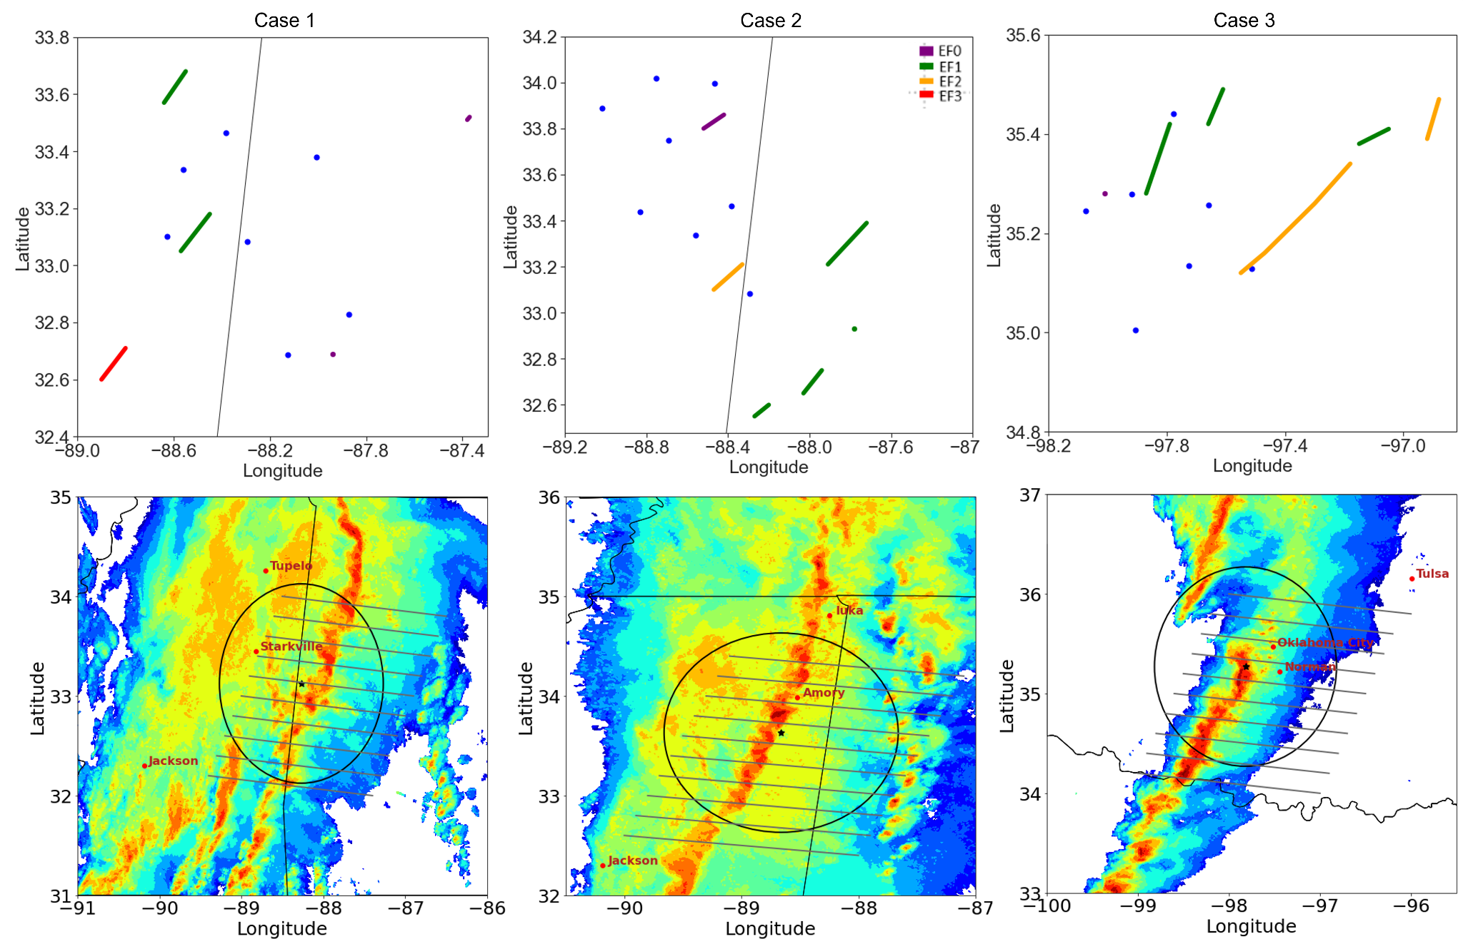
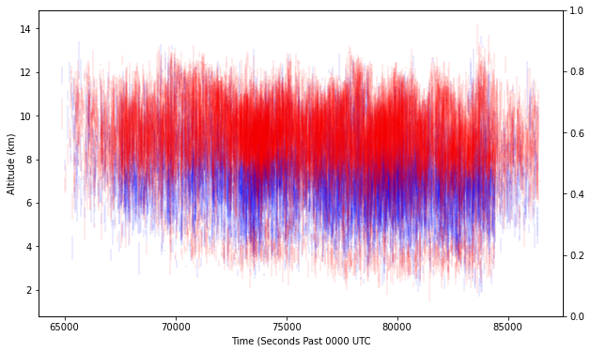
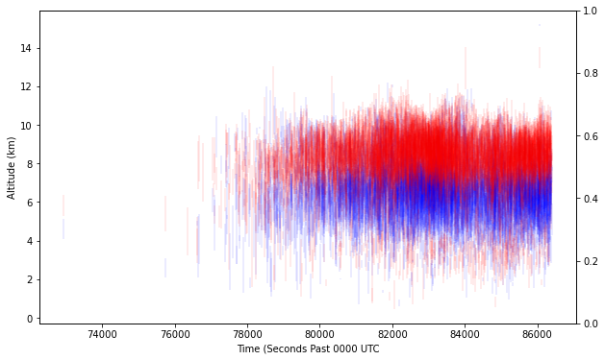
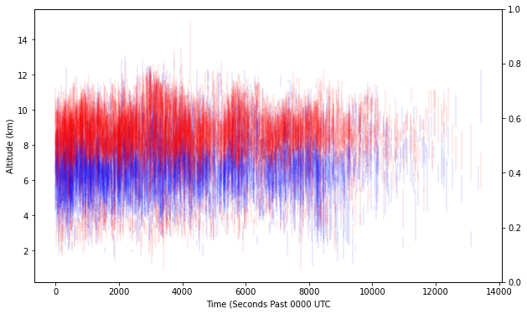
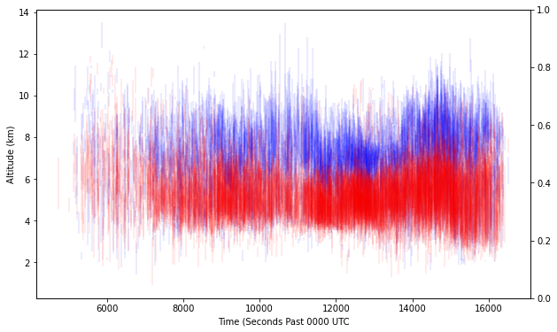
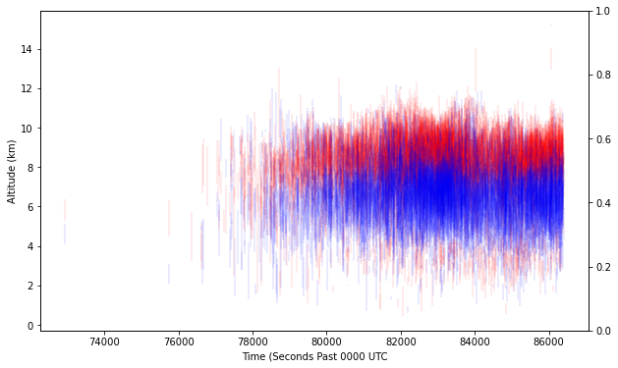
Data
Want to compare how lightning networks behave during tornadoes
4 Lightning Networks:
Lightning Mapping Array (LMA)
Earth Networks Total Lightning Network (ENTLN)
National Lightning Detection Network (NLDN)
Geostationary Lightning Mapper (GLM)
3 QLCSs:
Case 1: IOP1 March 22, 2022
Case 2: IOP2 March 30, 2022
Case 3: OK February 26, 2023
17 Tornadoes:
Tracked ten minutes prior, tornado duration, and ten minutes following

Slide 5
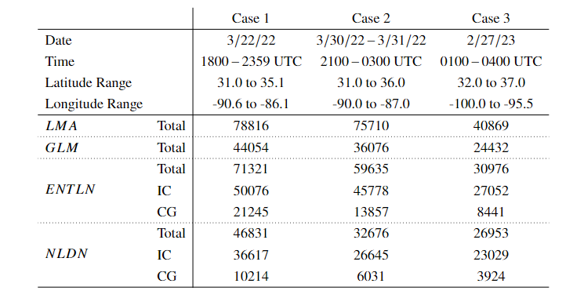
Data
Case 1
Case 2
Case 3
Want to compare how lightning networks behave during tornadoes
4 Lightning Networks:
Lightning Mapping Array (LMA)
Earth Networks Total Lightning Network (ENTLN)
National Lightning Detection Network (NLDN)
Geostationary Lightning Mapper (GLM)
3 QLCSs:
Case 1: IOP1 March 22, 2022
Case 2: IOP2 March 30, 2022
Case 3: OK February 26, 2023

Slide 6
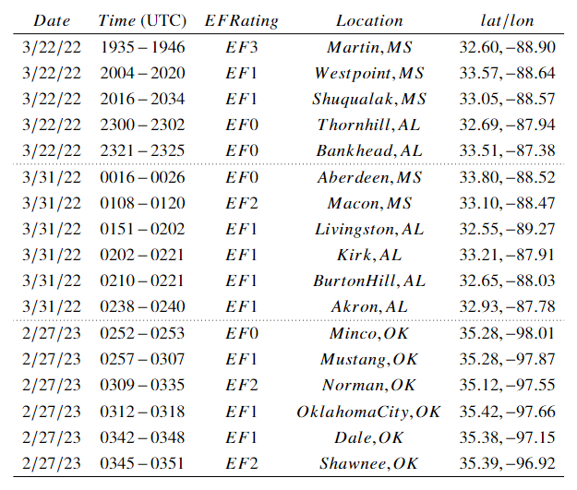
Data
Case 1
Case 2
Case 3
Want to compare how lightning networks behave during tornadoes
4 Lightning Networks:
Lightning Mapping Array (LMA)
Earth Networks Total Lightning Network (ENTLN)
National Lightning Detection Network (NLDN)
Geostationary Lightning Mapper (GLM)
3 QLCSs:
Case 1: IOP1 March 22, 2022
Case 2: IOP2 March 30, 2022
Case 3: OK February 26, 2023
17 Tornadoes:
Tracked ten minutes prior, tornado duration, and ten minutes following, radius of 25 km
tornadoes provide a clear signature/reference point for analysis, which may be tied to updraft variations

Slide 7
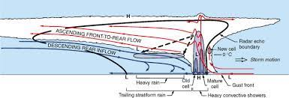
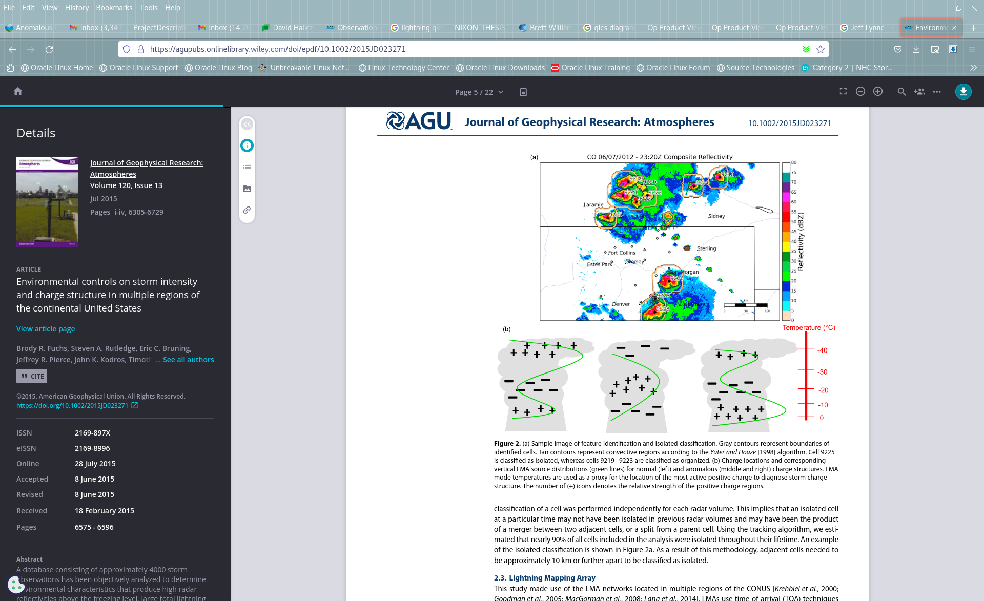
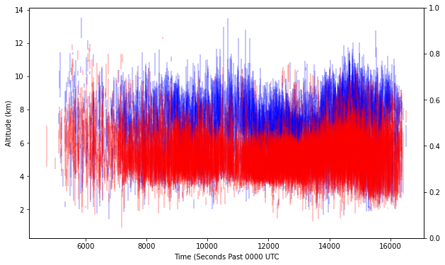
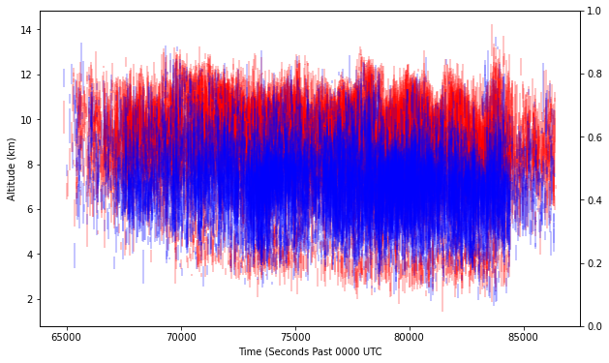
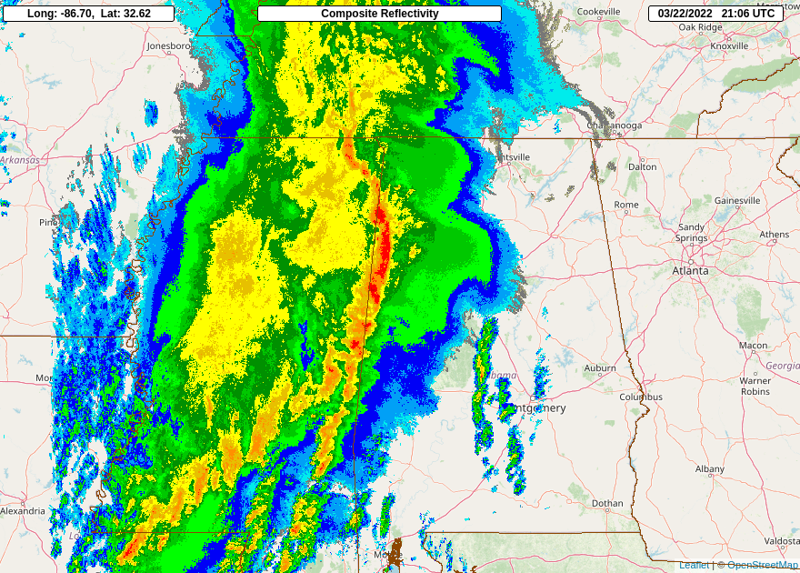
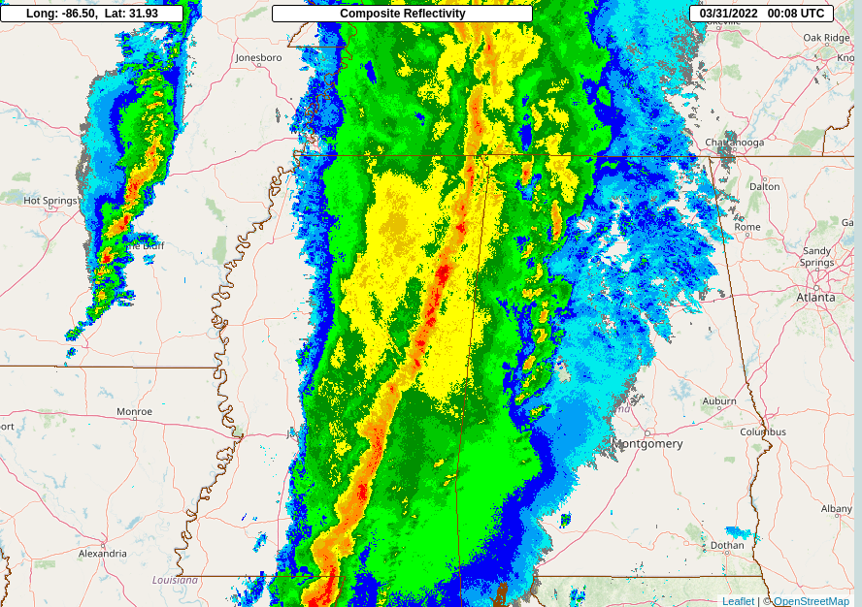
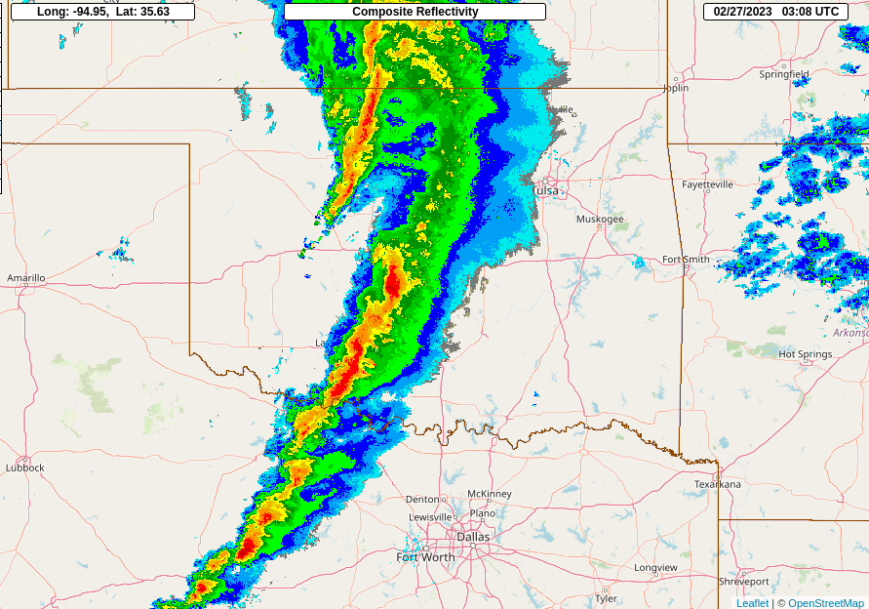

Slide 8
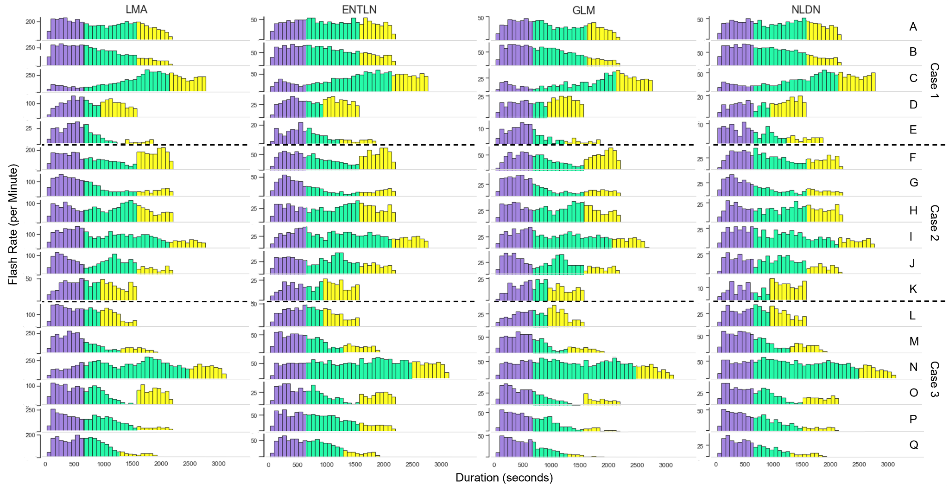
Flash Rates
Before Tornado
During Tornado
Following Tornado
–Most of the flash rate trends between networks are overall similar in appearance, different in magnitudes
–Often see a local maximum in flash rate prior to tornado, then a decrease in flash rate during the tornado
*Tornado C is an
exception to this

Slide 9
Flash Rates
Before Tornado
During Tornado
Following Tornado
–Most of the flash rate trends between networks are overall similar in appearance, different in magnitudes
–Often see a local maximum in flash rate prior to tornado, then a decrease in flash rate during the tornado
*Tornado C is an
exception to this

Slide 10
Flash Rates
Before Tornado
During Tornado
Following Tornado
–Most of the flash rate trends between networks are overall similar in appearance, different in magnitudes
–Often see a local maximum in flash rate prior to tornado, then a decrease in flash rate during the tornado
*Tornado C is an
exception to this
10/17 negatively correlated
9/17 negatively correlated
13/17 negatively correlated
10/17 negatively correlated

Slide 11
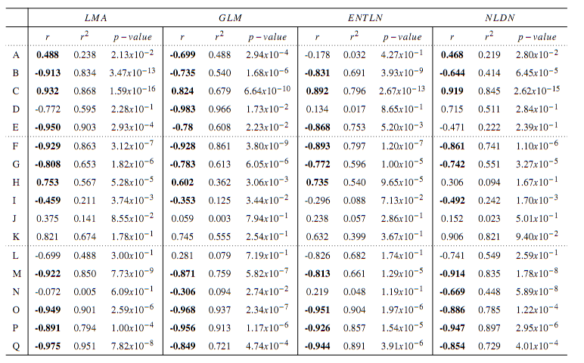

Slide 12
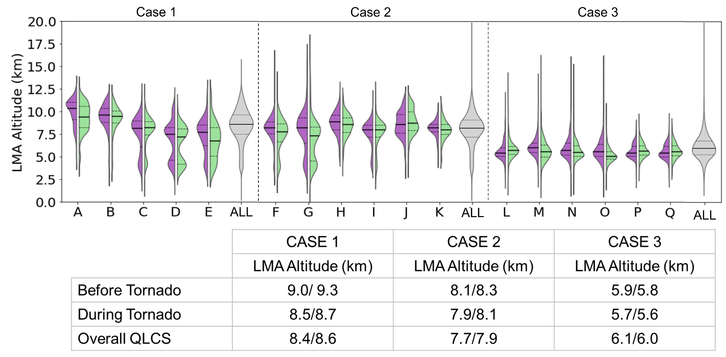
Initiation Altitude Changes Surrounding Tornadoes
A more prominent lower altitude initiation region occurs during many tornadoes versus the overall QLCS.
Higher flash initiations occur just prior to tornadoes versus the overall QLCS.
10 Minutes before Tornado During Tornado Overall QLCS

Slide 13
Initiation Altitude Changes Surrounding Tornadoes
A more prominent lower altitude initiation region occurs during many tornadoes versus the overall QLCS.
Case three has only the lower altitude region during tornadoes
Higher flash initiations occur just prior to tornadoes versus the overall QLCS.
10 Minutes before Tornado During Tornado Overall QLCS

Slide 14
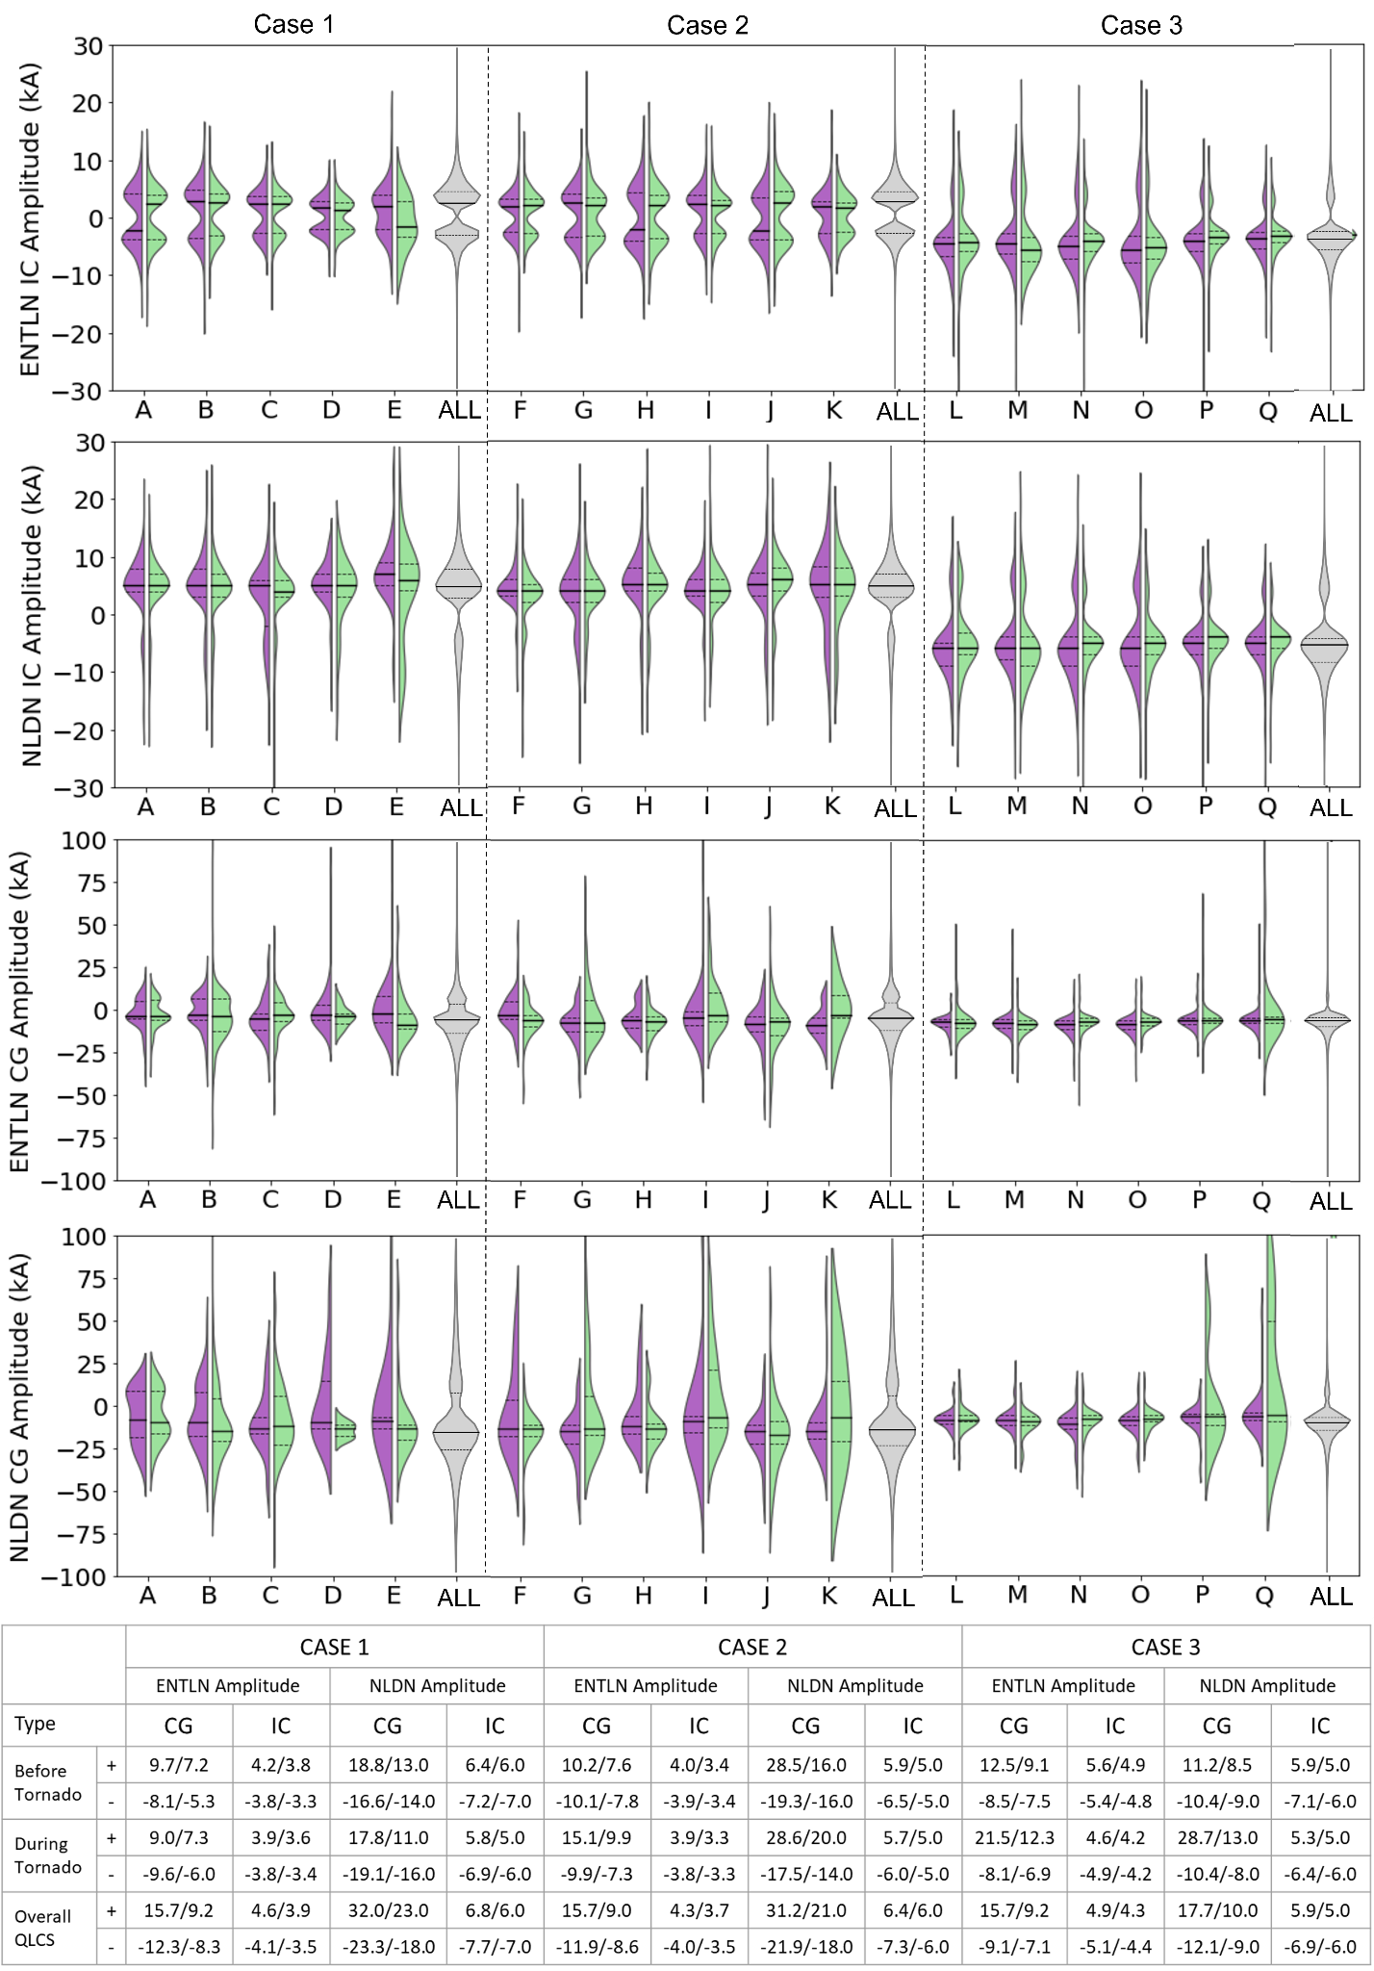
Flash Type: CG
Case 1 and Case 2:
CG flashes surrounding tornadoes are lower energy (both - and +) on average than the overall QLCS.
NLDN CG flashes are higher energy than ENTLN CGs.
Case 3:
Smaller amplitudes overall than Case 1 and 2
Positive CG flashes have higher energy on average during tornadoes than prior to tornado or the overall QLCS
NLDN and ENTLN CG amplitudes are more similar than other cases
.
 | Case1 |  |  |  | Case 2 |  |  |  | Case 3
 | ENTLN |  | NLDN |  | ENTLN |  | NLDN |  | ENTLN |  | NLDN
 | + | – | + | – | + | – | + | – | + | – | + | –
Before Tornado | 9.7 | -8.1 | 18.8 | -16.6 | 10.2 | -10.1 | 28.5 | -19.3 | 12.5 | -8.5 | 11.2 | -10.4
During Tornado | 9.0 | -9.6 | 17.8 | -19.1 | 15.1 | -9.9 | 28.6 | -17.5 | 21.5 | -8.1 | 28.7 | -10.4
Overall QLCS | 15.7 | -12.3 | 32.0 | -23.3 | 15.7 | -11.9 | 31.2 | -21.9 | 15.7 | -9.1 | 17.7 | -12.1

Slide 15
Flash Type: CG
Case 1 and Case 2:
CG flashes surrounding tornadoes are lower energy (both - and +) on average than the overall QLCS.
NLDN CG flashes are higher energy than ENTLN CGs.
Case 3:
Smaller amplitudes overall than Case 1 and 2
Positive CG flashes have higher energy on average during tornadoes than prior to tornado or the overall QLCS
NLDN and ENTLN CG amplitudes are more similar than other cases
.
 | Case1 |  |  |  | Case 2 |  |  |  | Case 3
 | ENTLN |  | NLDN |  | ENTLN |  | NLDN |  | ENTLN |  | NLDN
 | + | – | + | – | + | – | + | – | + | – | + | –
Before Tornado | 9.7 | -8.1 | 18.8 | -16.6 | 10.2 | -10.1 | 28.5 | -19.3 | 12.5 | -8.5 | 11.2 | -10.4
During Tornado | 9.0 | -9.6 | 17.8 | -19.1 | 15.1 | -9.9 | 28.6 | -17.5 | 21.5 | -8.1 | 28.7 | -10.4
Overall QLCS | 15.7 | -12.3 | 32.0 | -23.3 | 15.7 | -11.9 | 31.2 | -21.9 | 15.7 | -9.1 | 17.7 | -12.1

Slide 16
Flash Type: CG
Case 1 and Case 2:
CG flashes surrounding tornadoes are lower energy (both - and +) on average than the overall QLCS.
NLDN CG flashes are higher energy than ENTLN CGs.
Case 3:
Smaller amplitudes overall than Case 1 and 2
Positive CG flashes have higher energy on average during tornadoes than prior to tornado or the overall QLCS
NLDN and ENTLN CG amplitudes are more similar than other cases
.
 | Case1 |  |  |  | Case 2 |  |  |  | Case 3
 | ENTLN |  | NLDN |  | ENTLN |  | NLDN |  | ENTLN |  | NLDN
 | + | – | + | – | + | – | + | – | + | – | + | –
Before Tornado | 9.7 | -8.1 | 18.8 | -16.6 | 10.2 | -10.1 | 28.5 | -19.3 | 12.5 | -8.5 | 11.2 | -10.4
During Tornado | 9.0 | -9.6 | 17.8 | -19.1 | 15.1 | -9.9 | 28.6 | -17.5 | 21.5 | -8.1 | 28.7 | -10.4
Overall QLCS | 15.7 | -12.3 | 32.0 | -23.3 | 15.7 | -11.9 | 31.2 | -21.9 | 15.7 | -9.1 | 17.7 | -12.1

Slide 17
Flash Type: IC
Case 1 and Case 2:
For ICs, most are positive for NLDN, equal negative and positive for ENTLN
Not much difference in IC amplitudes surrounding tornadoes versus the overall QLCS
Case 3:
Very few positive flashes in general
NLDN and ENTLN more in alignment for this case
Not much difference in IC amplitudes surrounding tornadoes versus the overall QLCS
 | Case1 |  |  |  | Case 2 |  |  |  | Case 3
 | ENTLN |  | NLDN |  | ENTLN |  | NLDN |  | ENTLN |  | NLDN
 | + | – | + | – | + | – | + | – | + | – | + | –
Before Tornado | 4.2 | -3.8 | 6.4 | -7.2 | 4.0 | -3.9 | 5.9 | -6.5 | 5.6 | -5.4 | 5.9 | -7.1
During Tornado | 3.9 | -3.8 | 5.8 | -6.9 | 3.9 | -3.8 | 5.7 | -6.0 | 4.6 | -4.9 | 5.3 | -6.4
Overall QLCS | 4.6 | -4.1 | 6.8 | -7.7 | 4.3 | -4.0 | 6.4 | -7.3 | 4.9 | -5.1 | 5.9 | -6.9

Slide 18
Flash Type: IC
Case 1 and Case 2:
For ICs, most are positive for NLDN, equal negative and positive for ENTLN
Not much difference in IC amplitudes surrounding tornadoes versus the overall QLCS
Case 3:
Very few positive flashes in general
NLDN and ENTLN more in alignment for this case
Not much difference in IC amplitudes surrounding tornadoes versus the overall QLCS
 | Case1 |  |  |  | Case 2 |  |  |  | Case 3
 | ENTLN |  | NLDN |  | ENTLN |  | NLDN |  | ENTLN |  | NLDN
 | + | – | + | – | + | – | + | – | + | – | + | –
Before Tornado | 4.2 | -3.8 | 6.4 | -7.2 | 4.0 | -3.9 | 5.9 | -6.5 | 5.6 | -5.4 | 5.9 | -7.1
During Tornado | 3.9 | -3.8 | 5.8 | -6.9 | 3.9 | -3.8 | 5.7 | -6.0 | 4.6 | -4.9 | 5.3 | -6.4
Overall QLCS | 4.6 | -4.1 | 6.8 | -7.7 | 4.3 | -4.0 | 6.4 | -7.3 | 4.9 | -5.1 | 5.9 | -6.9

Slide 19
Cloud Flash Fraction
For Case 1 and 2, CFF is larger during tornadoes than the overall QLCS for both ENTLN and NLDN, implying more IC flashes occur surrounding tornadoes
For Case 3, ENTLN has a larger fraction of CGs surrounding tornadoes than the overall QLCS
  NLDN does not show this pattern
 | Case 1 |  |  | Case 2 |  |  | Case 3
 | IC | CG | CFF | IC | CG | CFF | IC | CG | CFF
ENTLN | 3124 | 1031 | 0.752 | 3185 | 570 | 0.848 | 4079 | 1788 | 0.695
NLDN | 3065 | 403 | 0.884 | 2214 | 267 | 0.892 | 3764 | 622 | 0.858
Overall ENTLN | 50076 | 21245 | 0.702 | 45778 | 13857 | 0.768 | 27052 | 8441 | 0.762
Overall NLDN | 43812 | 10875 | 0.787 | 35085 | 7566 | 0.823 | 24762 | 4236 | 0.854

Slide 20
Cloud Flash Fraction
For Case 1 and 2, CFF is larger during tornadoes than the overall QLCS for both ENTLN and NLDN, implying more IC flashes occur surrounding tornadoes
For Case 3, ENTLN has a larger fraction of CGs surrounding tornadoes than the overall QLCS
  NLDN does not show this pattern
 | Case 1 |  |  | Case 2 |  |  | Case 3
 | IC | CG | CFF | IC | CG | CFF | IC | CG | CFF
ENTLN | 3124 | 1031 | 0.752 | 3185 | 570 | 0.848 | 4079 | 1788 | 0.695
NLDN | 3065 | 403 | 0.884 | 2214 | 267 | 0.892 | 3764 | 622 | 0.858
Overall ENTLN | 50076 | 21245 | 0.702 | 45778 | 13857 | 0.768 | 27052 | 8441 | 0.762
Overall NLDN | 43812 | 10875 | 0.787 | 35085 | 7566 | 0.823 | 24762 | 4236 | 0.854

Slide 21
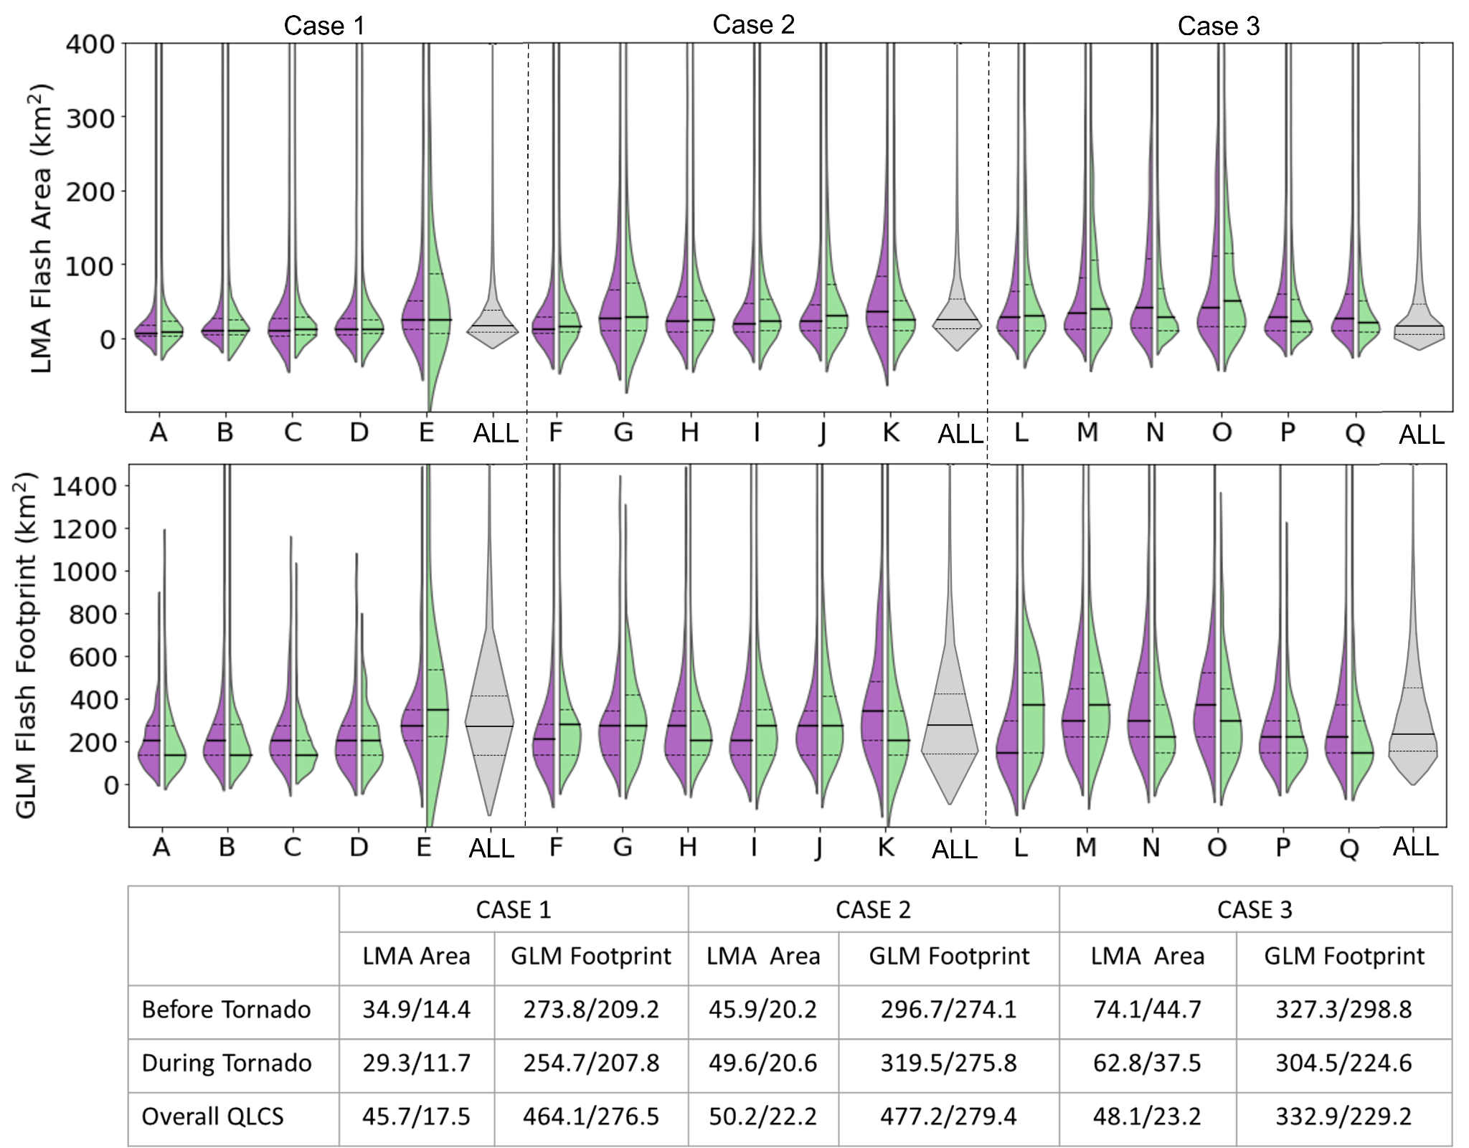
Flash Size
Case 1 and Case 2:
Average GLM and LMA area are smaller surrounding tornadoes than the overall QLCS, especially GLM
Case 3:
LMA flashes are larger during tornadoes versus overall QLCS
  GLM did not follow the same pattern

Slide 22
Flash Size
Case 1 and Case 2:
Average GLM and LMA area are smaller surrounding tornadoes than the overall QLCS, especially GLM
Case 3:
LMA flashes are larger during tornadoes versus overall QLCS
  GLM did not follow the same pattern

Slide 23
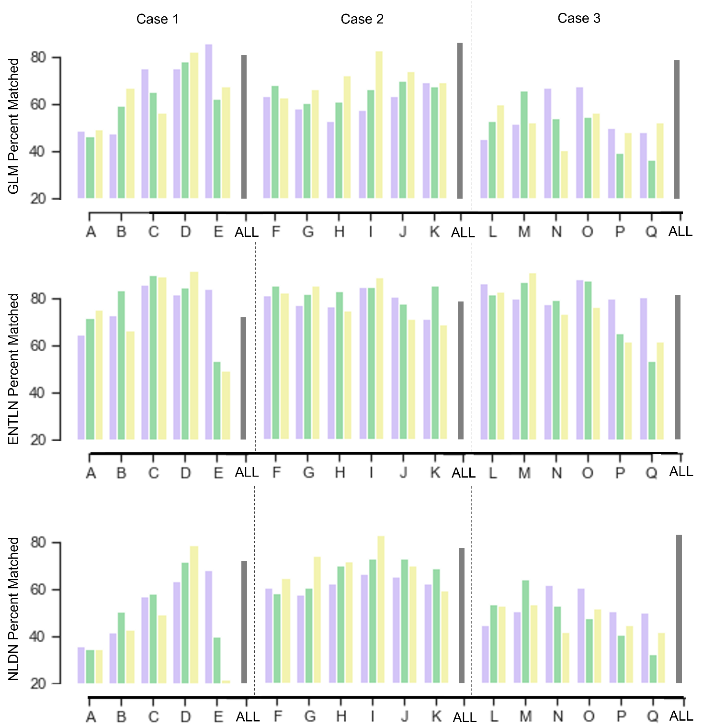
Percent Matched
Before Tornado
During Tornado
Following Tornado
Overall QLCS
For GLM and NLDN, the percentage of flashes that matched to LMA surrounding tornadoes were lower than the overall QLCS for all cases.
  Lowest percent matched for Case 3
For ENTLN, percentages matched were similar to overall QLCS
Case 1 and 2 had less flashes matching just prior to tornadoes and decreased during tornadoes, while Case 3 had the opposite

Slide 24
Summary
Comparing network trends surrounding tornadoes, it is evident that there are differences in both detection and classification of lightning depending on the network
Periods just prior to tornadoes tended to be associated with localized increases in lightning, ICs, and higher altitude flashes, while decreases in flash rates, smaller flashes, and a lower altitude region of lightning occurred during tornadoes
  Anomalous storm was different
Flashes were more likely to be detected by all 4 networks in areas of lower flash rates, larger flashes, and less ICs, and matched less during tornadoes than the overall QLCS
Future work:
– Analyze more cases to see if trends hold, and link more of the microphysics to each network’s performance.
– Create a merged product
LMA only
GLM only
ENTLN only
NLDN only
Multiple Network Detection
During Tornadoes
INCREASES
DECREASES
LMA
Altitude
Size, Amount, Matching
Size, Energy, Amount, Matching
GLM
ENTLN
IC flashes
Energy, Amount
IC flashes
Energy, Amount, Matching
NLDN

Slide 25
Summary
Comparing network trends surrounding tornadoes, it is evident that there are differences in both detection and classification of lightning depending on the network
Periods just prior to tornadoes tended to be associated with localized increases in lightning, ICs, and higher altitude flashes, while decreases in flash rates, smaller flashes, and a lower altitude region of lightning occurred during tornadoes
  Anomalous storm was somewhat different
Flashes were more likely to be detected by all 4 networks in areas of lower flash rates, larger flashes, and less ICs, and matched less during tornadoes than the overall QLCS
Future work:
– Analyze more cases to see if trends hold, and link more of the microphysics to each network’s performance.
– Create a merged product
LMA only
GLM only
ENTLN only
NLDN only
Multiple Network Detection
During Tornadoes
INCREASES
DECREASES
LMA
Normal
Altitude
Size, Amount, Matching
Anomalous
Size
Altitude, Amount, Matching
Normal
Size, Energy, Amount, Matching
GLM
Anomalous
Energy, Amount, Matching
Normal
IC flashes
Energy, Amount
ENTLN
Anomalous
CG flashes, Energy
Amount
Normal
IC flashes
Energy, Amount, Matching
NLDN
Anomalous
Amount, Matching

Slide 26
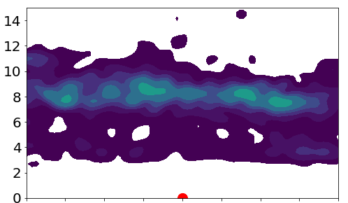
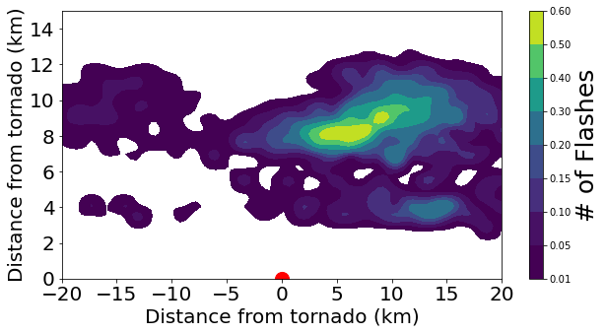
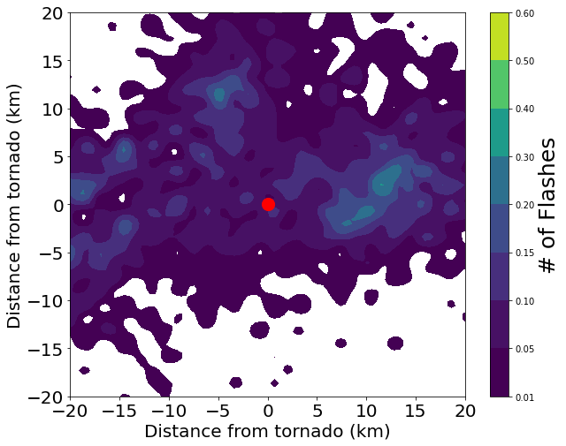
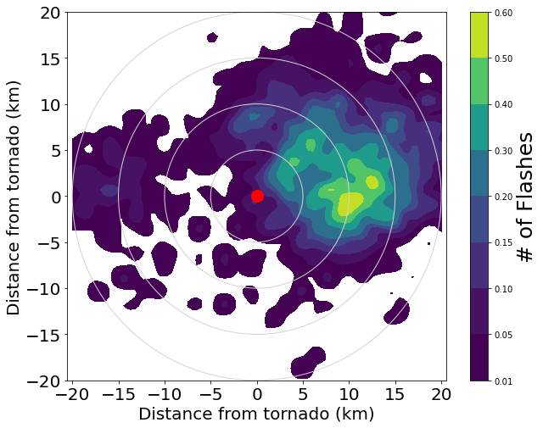
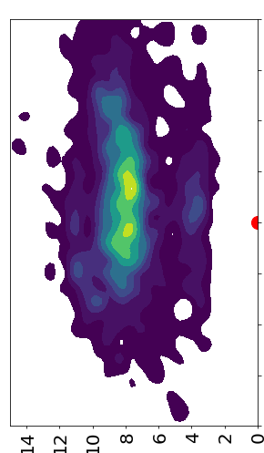
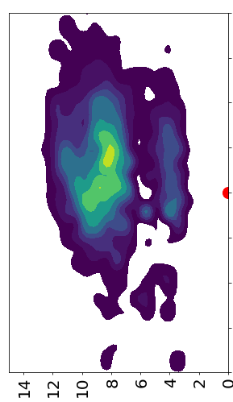
Lightning Locations
Both IOP1 and IOP2 display more lightning to the north of the tornado and two regions of initiation
IOP 2
Altitude (km)
IOP 1
Altitude (km)
Altitude (km)
Altitude (km)

Slide 27
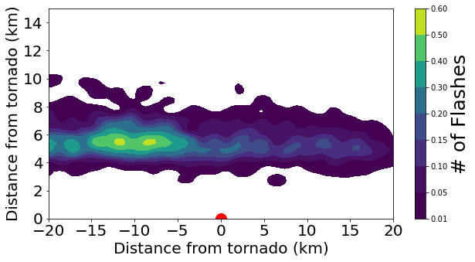
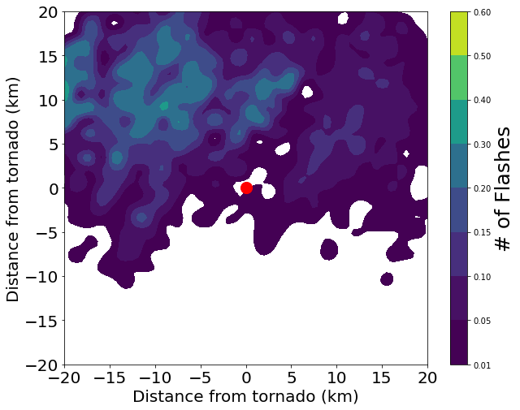
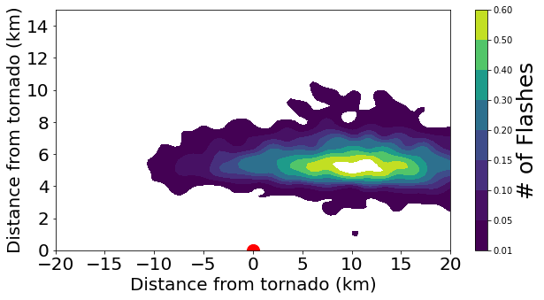
Lightning Locations
Similar to IOP 1 and 2, most of lightning north of tornado in IOP3
  Further west
IOP3 had only one main region of flash initiation
Altitude (km)
IOP 3
Altitude (km)

Slide 28
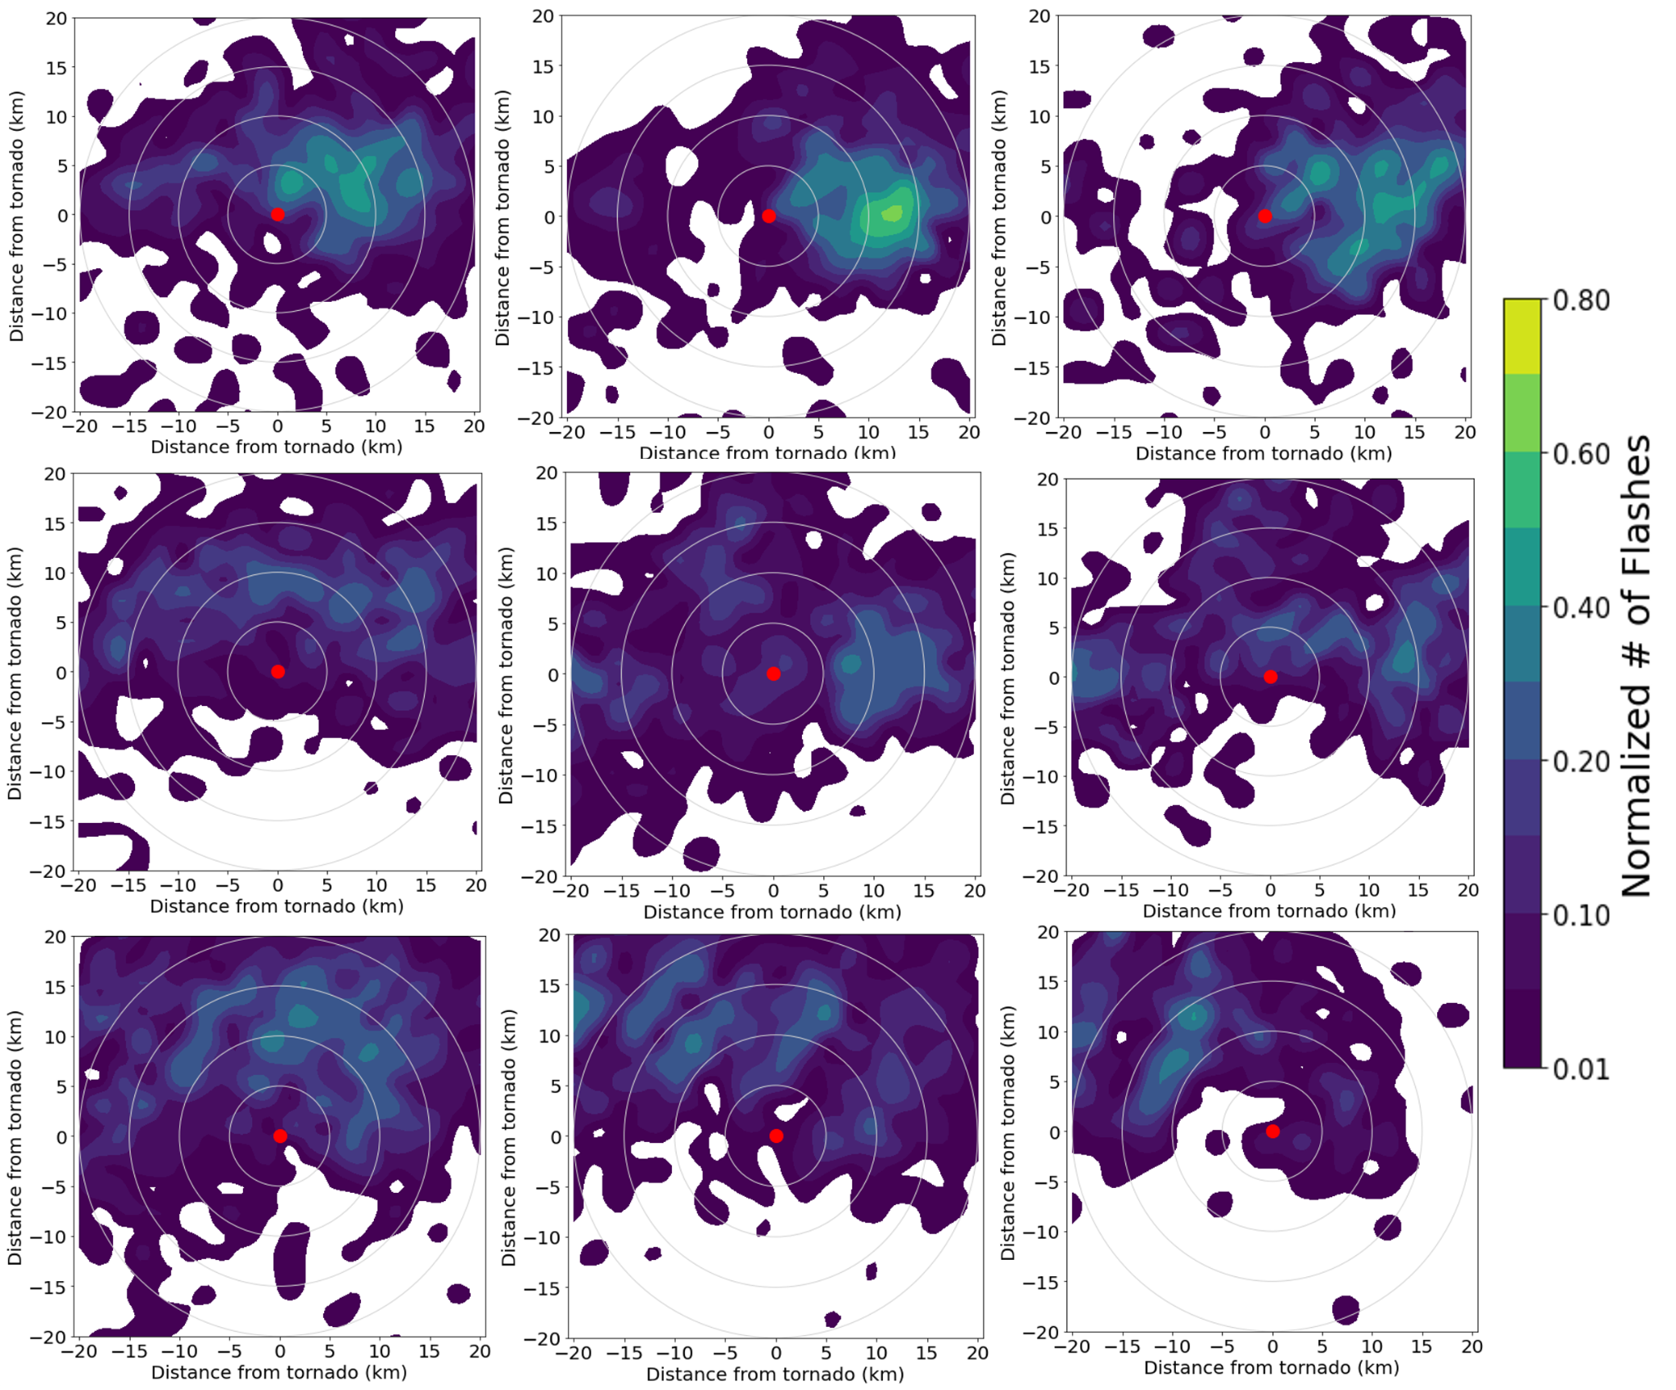
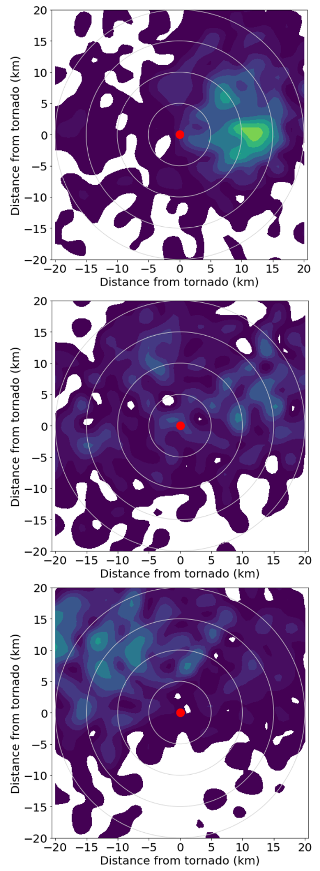
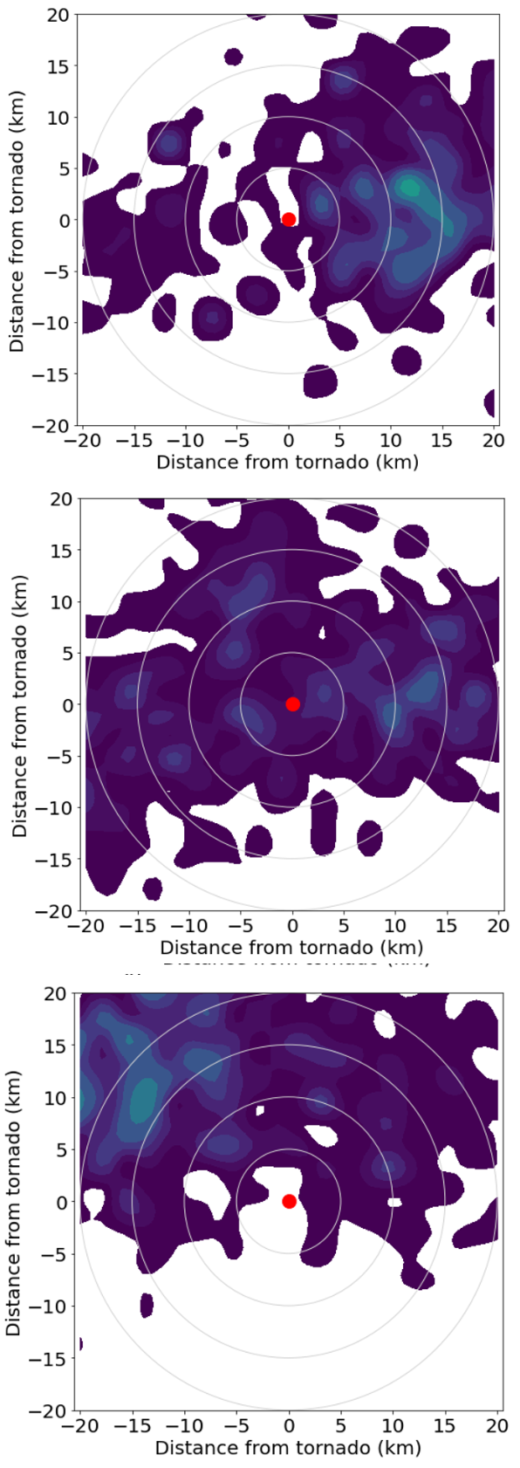
Spatial Plots
ENTLN
NLDN
GLM
Case 1
Show similar spatial patterns of lightning as LMA, with maximum to the east of tornado and less lightning to the south
Case 2
Case 3

Slide 29
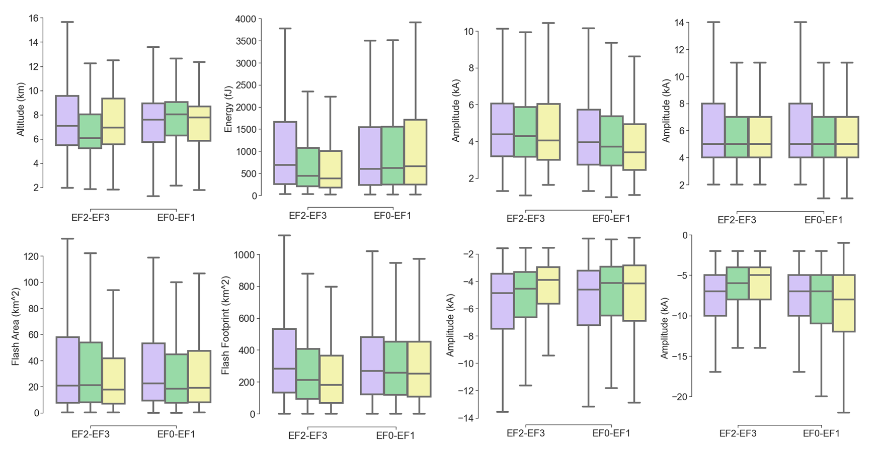
Lightning Characteristics during Tornadoes
10 Minutes before Tornado During Tornado 10 Minutes Following
Flashes that are:
higher altitude,
larger area,
higher energy
occur prior to tornado
On average, Flashes are higher, less energetic, and smaller surrounding tornado than entire QLCSs

Slide 30
Overall
+
+
+
12 km
+
+
+
+
10 km
-
-
-
+
+
+
+
+
-
-
-
-
-
-
+
+
8 km
-
-
-
-
-
-
-
-
-
-
-
-
-
-
+
+
+
+
-
+
+
+
-
-
-
-
6 km
+
+
+
+
+
-
4 km
+
+
+
+
+
+
+
+
2 km

Slide 31
Tornadoes
+
+
+
12 km
+
+
+
+
10 km
-
-
-
+
+
+
+
+
-
-
-
-
-
-
+
+
8 km
-
-
-
-
-
-
-
-
-
-
-
-
-
-
+
+
+
+
-
+
+
+
-
-
-
-
6 km
+
+
+
+
+
-
4 km
+
+
+
+
+
+
+
+
2 km

Slide 32
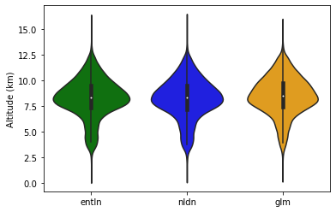
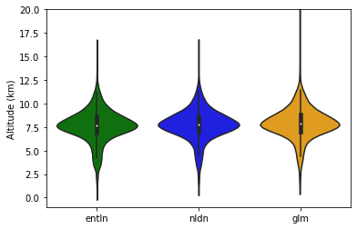
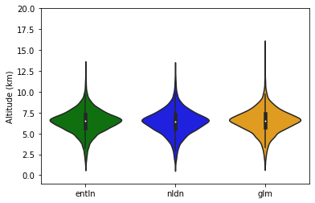
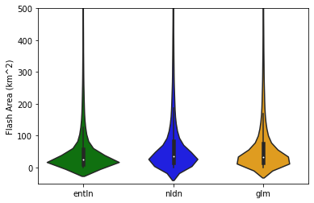
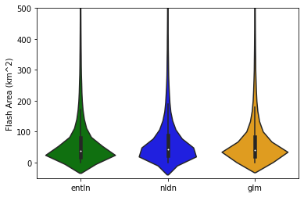
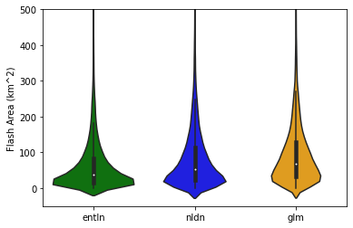
Characteristics of LMA flashes that Each Network Matched to
IOP1
IOP2
OK Case
Flash Size (km)
Flash Size (km)
Flash Size (km)
Altitude: Secondary peak in matched flashes

Slide 33
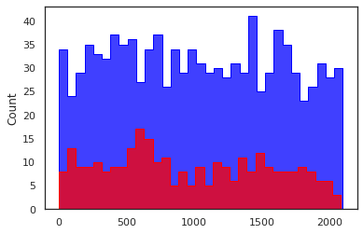
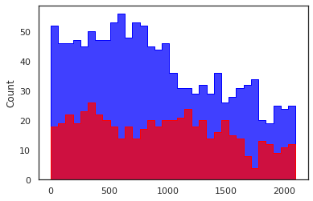
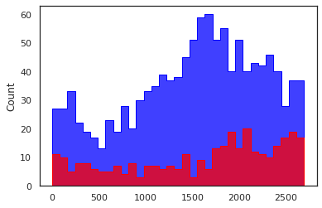
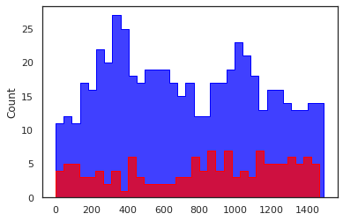
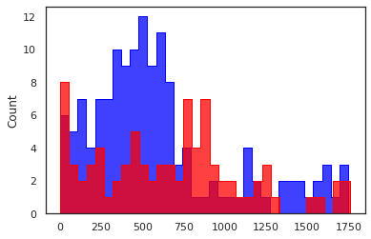
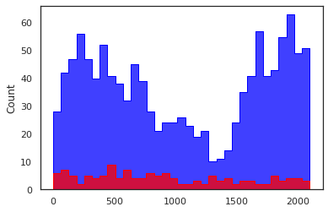
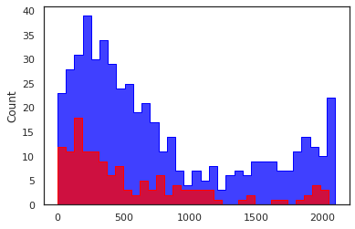
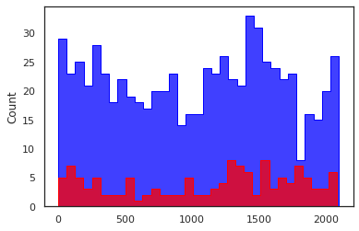
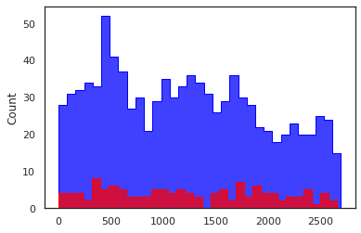








ENTLN Flash Type red=CG, blue=IC
IOP1
0.778
0.694
0.787
0.803
0.631
IOP2
0.898
0.785
0.844
0.881
0.822
0.808
OK Case
0.633
0.595
0.705
0.637
0.808
0.796

Slide 34
Data
Case 1
Case 2
Case 3
Want to compare how lightning networks behave during tornadoes
4 Lightning Networks:
Lightning Mapping Array (LMA)
Earth Networks Total Lightning Network (ENTLN)
National Lightning Detection Network (NLDN)
Geostationary Lightning Mapper (GLM)
3 QLCSs:
Case 1: IOP1 March 22, 2022
Case 2: IOP2 March 30, 2022
Case 3: OK February 26, 2023
 | Case 1 | Case 2 | Case 3
SBCAPE (J/kg) | 500 | 700 | 250
0-3 km SRH (m^2/s^2) | 380 | 400 | 600
0-6 km Bulk Shear (m/s) | 18 | 15 | 20
EL (km) | 12.5 | 11.6 | 11.1

Slide 35

2
2

Slide 36


