Slide 1

PERiLS PBL Profiling:
CLAMPS and CopterSonde UAS
Dr. Elizabeth Smith Research Meteorologist–NOAA National Severe Storms Laboratory
Affiliated Assistant Professor–OU School of Meteorology
Tyler Bell, Joshua Gebauer, Tony Segales – OU CIWRO

Slide 2
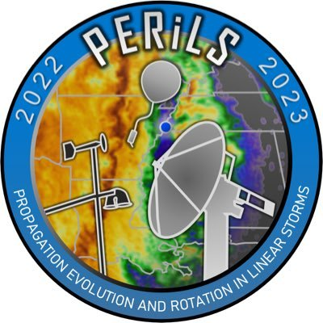
Our Context: PERiLS
Similar goals – understand storms and environments, etc – and building on VORTEX-SE lessons while going partly mobile to target quasi-linear convection systems (QLCSs)
Southeast US complexity invites innovation to meet mission needs:
Observation platforms
Observation strategies
Observation analysis products

Slide 3
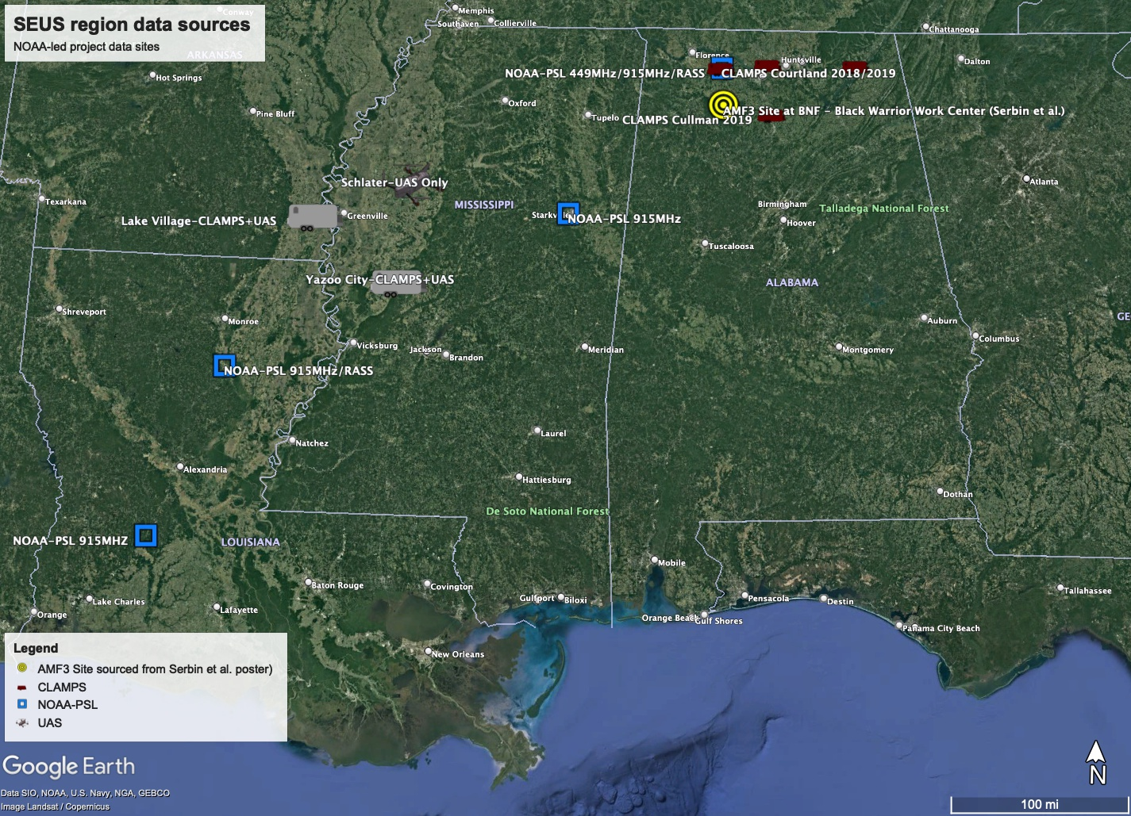
VORTEX-USA/PERiLS
2015-2020 VORTEX-SouthEast
Cool season deployments of fixed facilities to North Alabama
Use these years of data to determine scales of motion and necessary observation spacing

Slide 4
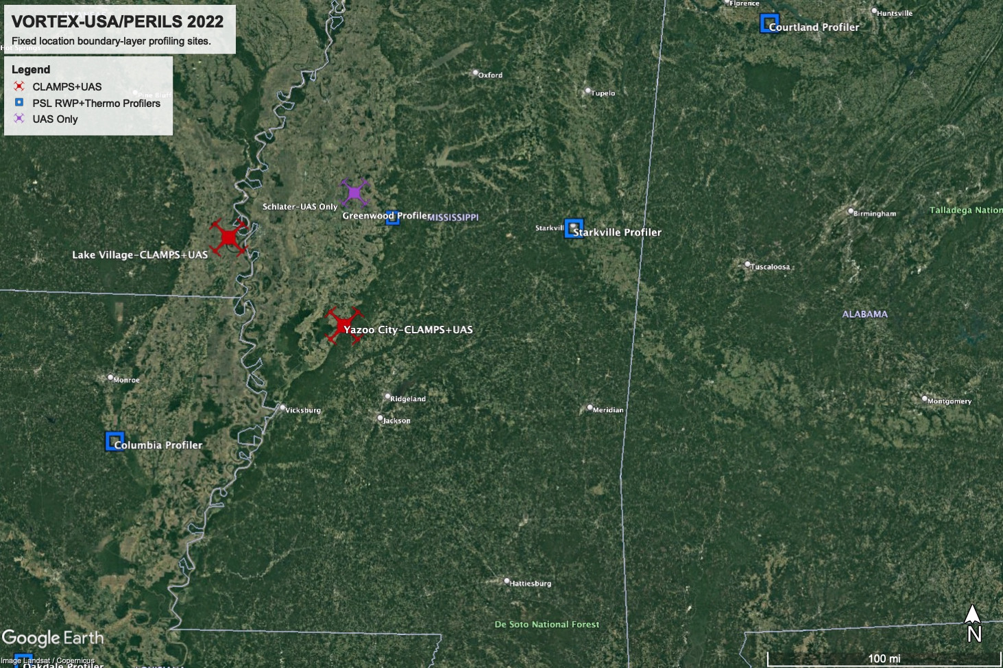
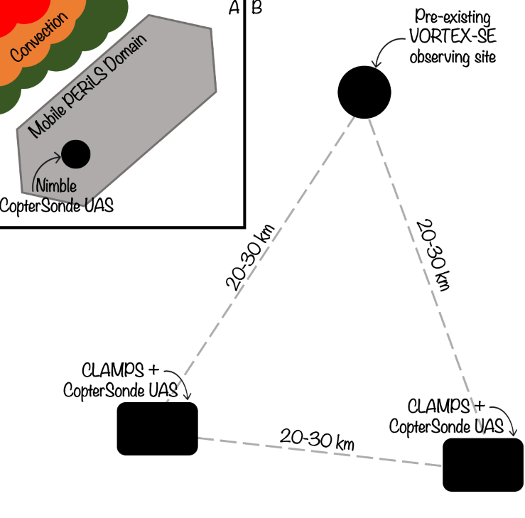
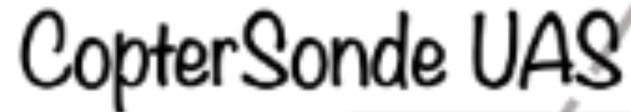
Innovation as motivation for PERiLS CONOPS
Need: network low-atmosphere observations in challenging environment of southeastern US
VORTEX-SE findings: above-surface variability critical, 2016-2019 remote sensor profiling obs suggested ~50 km min. spacing, 90 km spacing
PERiLS opportunity: deploy prototype network with network-in-network framework
Finer spacing within broader coarse deployment
Mix obs types; remote sensor types and UAS
Enables experiments with adaptable network concepts, testing data assimilation density needs, evaluating impacts of mixed obs networks, etc…
COA: 3 sites, 0–1.5km AGL
0–5000 feet AGL

Slide 5
PERiLS as a next-generation observation network testbest

Slide 6
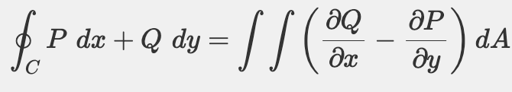
Innovation as motivation for PERiLS CONOPS
Need: network low-atmosphere observations in challenging environment of southeastern US
VORTEX-SE findings: above-surface variability critical
PERiLS opportunity: deploy prototype network with network-in-network framework
Networked deployment strategy enables interesting analyses
Exploring development of products for future next-generation networks, including 3D networks
Green’s Theorem

Slide 7
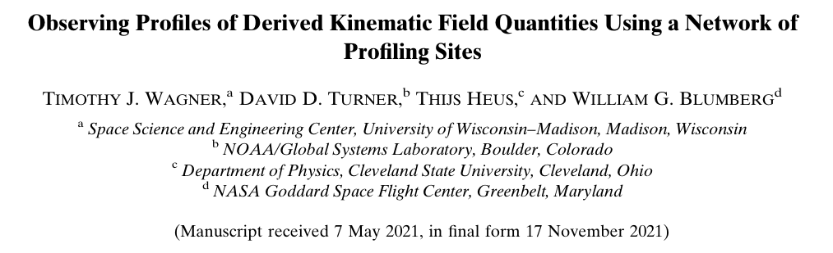
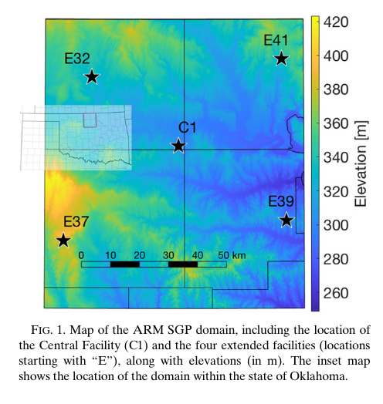
Green’s Theorem: Wagner et. al. (2022)
Used HRRR profiles and data from remote profilers locations at the ARM SGP central and satellite facilities to evaluate the method
Decent agreement between quantities derived from HRRR and ARM data
Found small perturbations to the location of a vertex could impact calculations, especially if the magnitudes were small to begin with

Slide 8
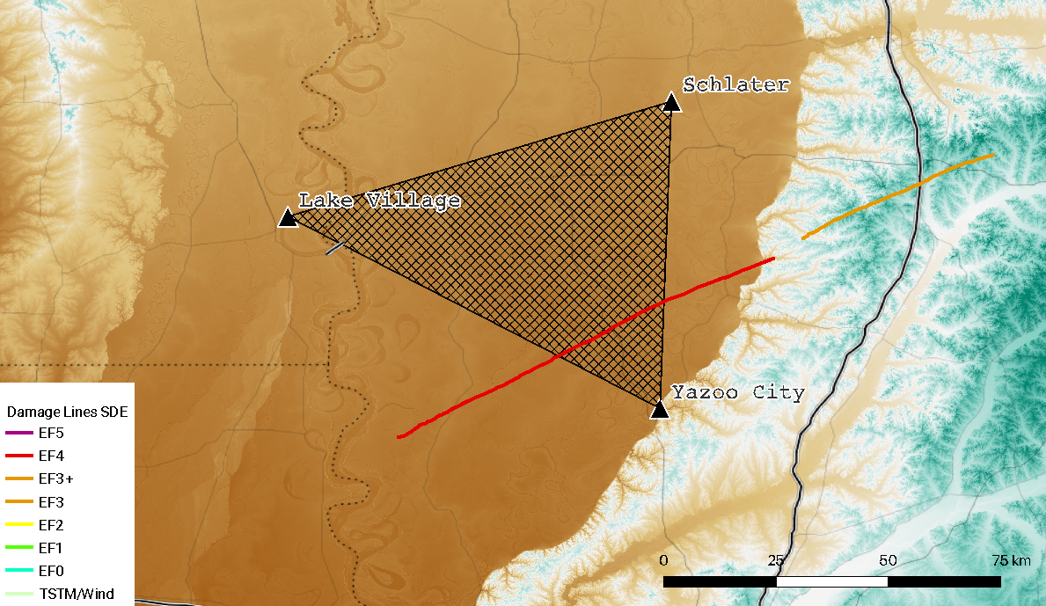

Green’s Theorem: Application
Rolling Fork Tornado
PERiLS mobile armada deployed NNW
(Lake Village area)

Slide 9
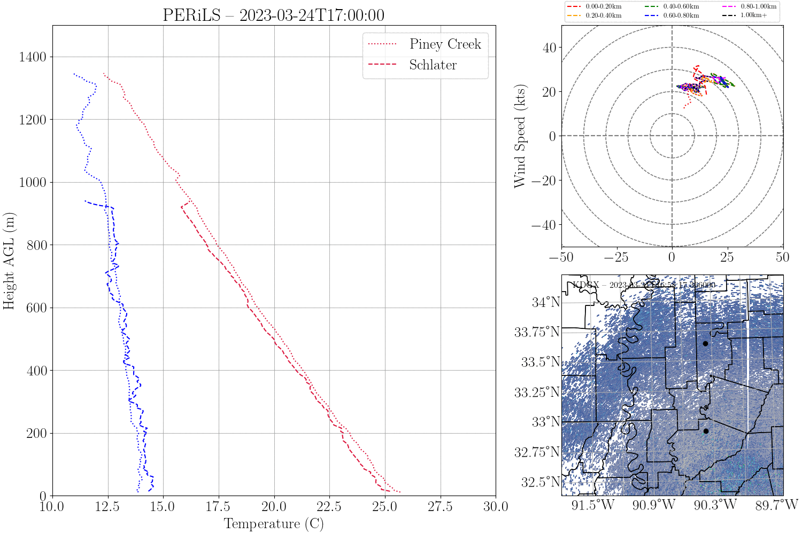
Green’s Theorem: Application
Each line is one Coptersonde site.
If a line is missing that site did not fly for that timestamp. Points correspondingly appear/disappear on radar plot
Different sites make it to different maximum heights due to wind tolerance and visual line of site limits (cloud base)
LV= WEST PC= SOUTH
SCH= NORTH

Slide 10
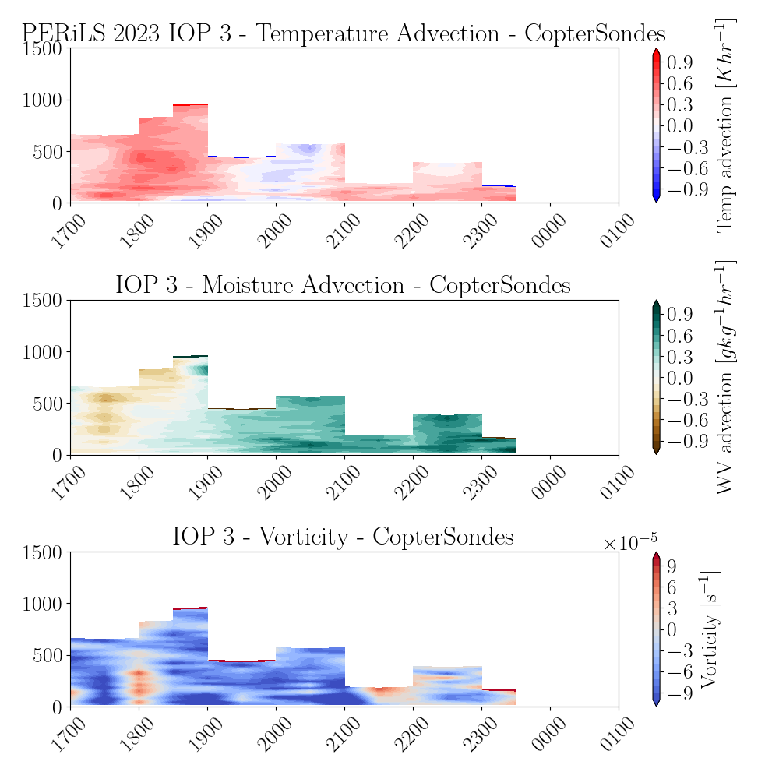
Green’s Theorem: Application
Variable profile depth/information content degrades the success of this approach for basic CopterSonde data
Southeast US complexity invites innovation to meet mission needs:
Observation platforms
Observation strategies
Observation analysis products

Slide 11
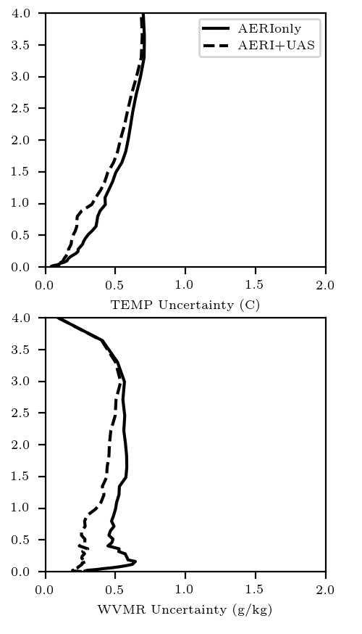
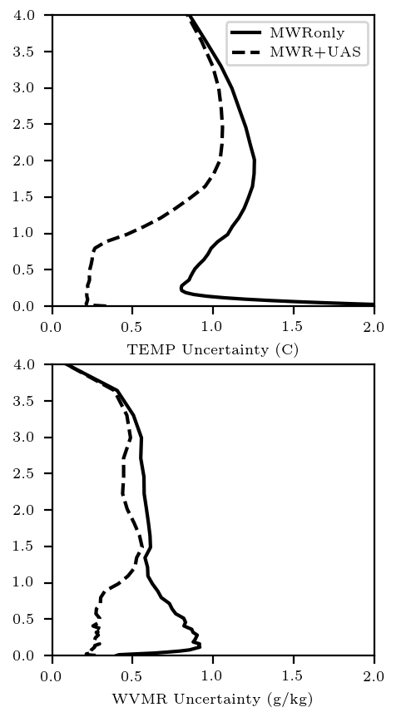
TROPoe – Tropospheric Remotely Observed Profiling via optimal estimation
IRS (AERI)
MWR
Developed primarily for performing thermodynamic retrievals from IRS and MWRs
Method can be generalized to take multiple types of input
Provides a way to create similar datasets from dissimilar data, with uncertainty baked in
Bell, 2021

Slide 12
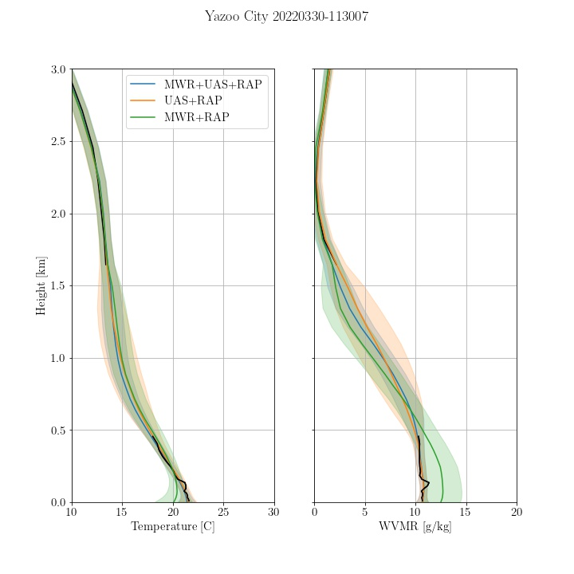
TROPoe – Tropospheric Remotely Observed Profiling via optimal estimation
NOAA Rapid Refresh (RAP) Model above 1.5 km
TROPoe can take any combination of instruments as long as a proper forward model is available
+ RAP above 1.5 km
But what about the winds?
+ RAP above 1.5 km
+ RAP above 1.5 km

Slide 13
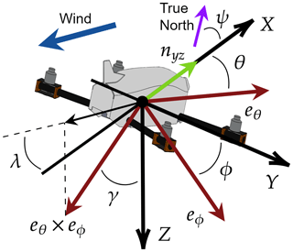
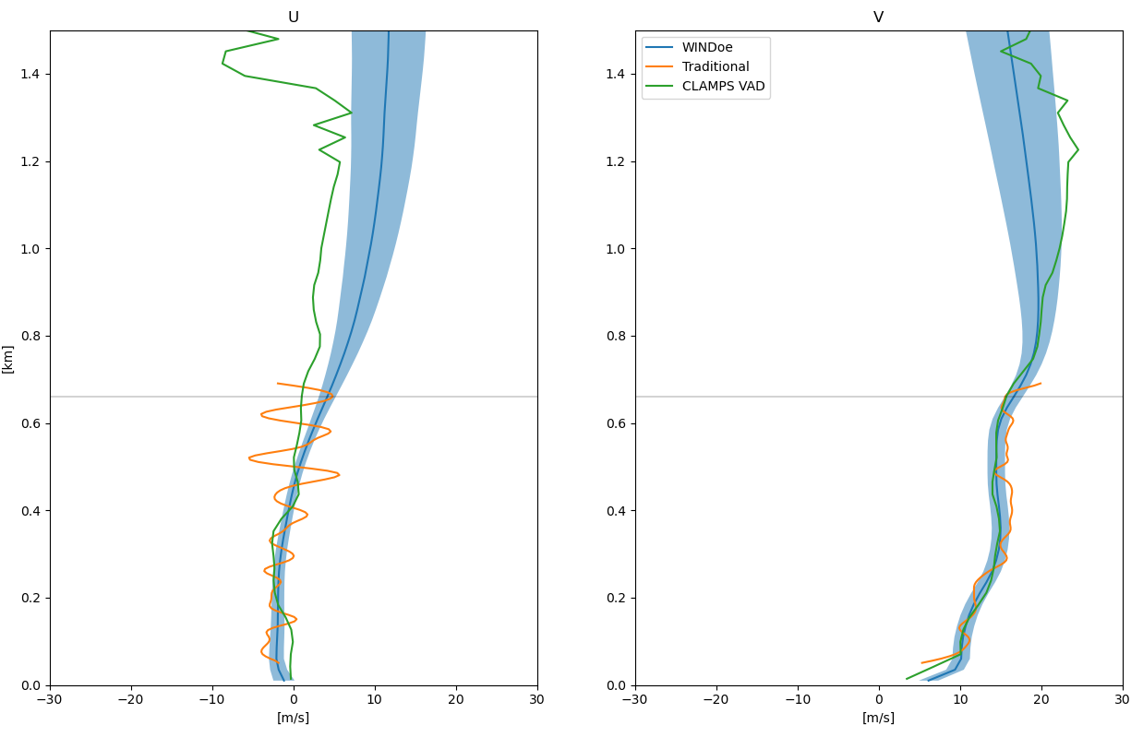
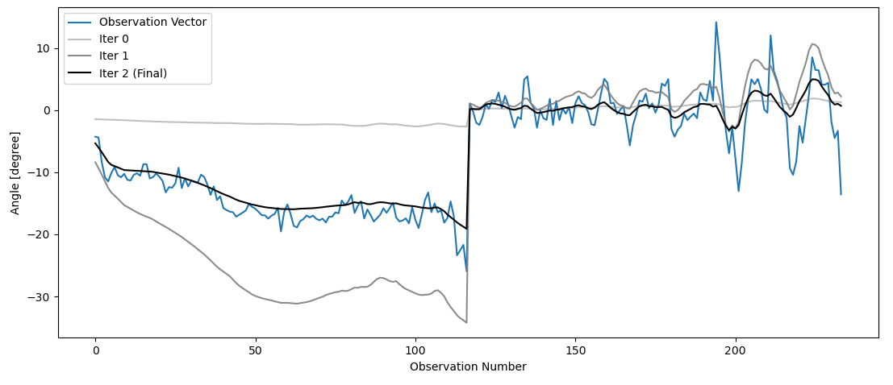
WINDoe
A new OE method developed by Dr. Josh Gebauer can retrieve wind profiles from dissimilar wind profiling platforms and data streams (pub under review)
Figure from Segales et al. (2020)
Roll
Pitch

Slide 14
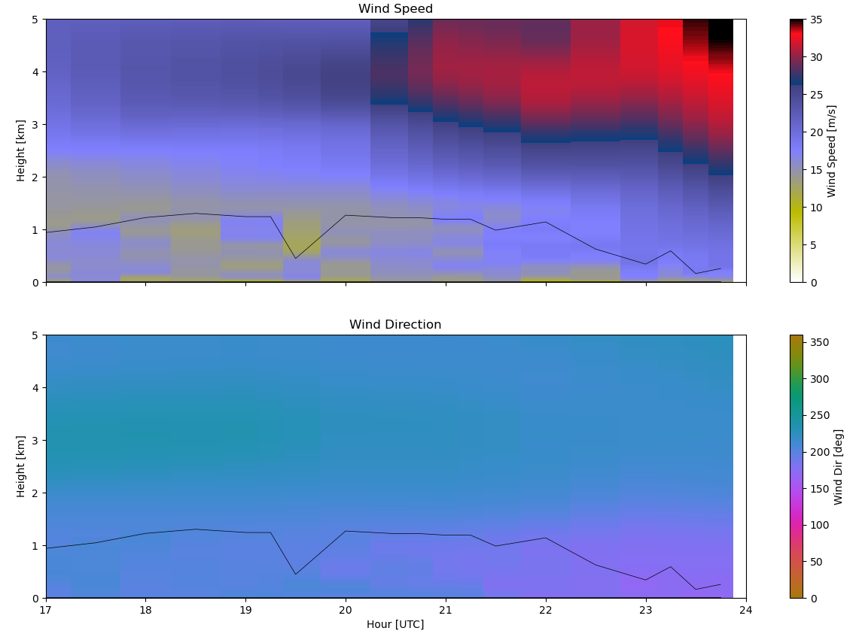
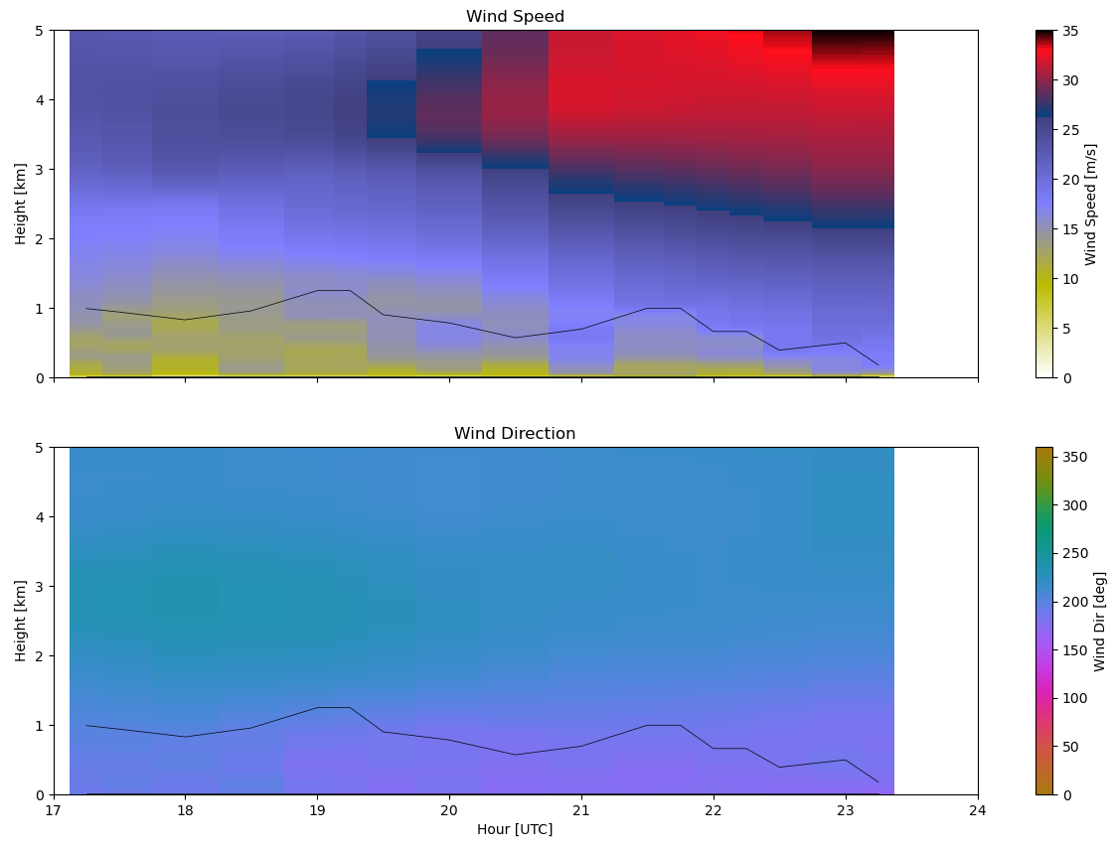
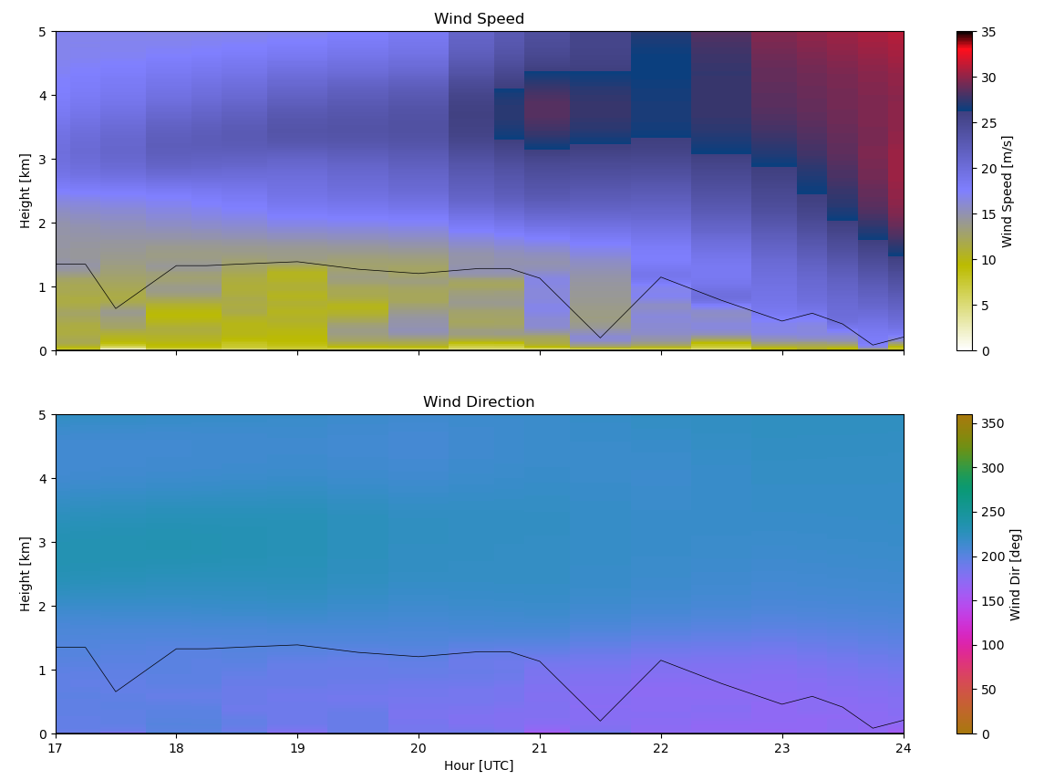
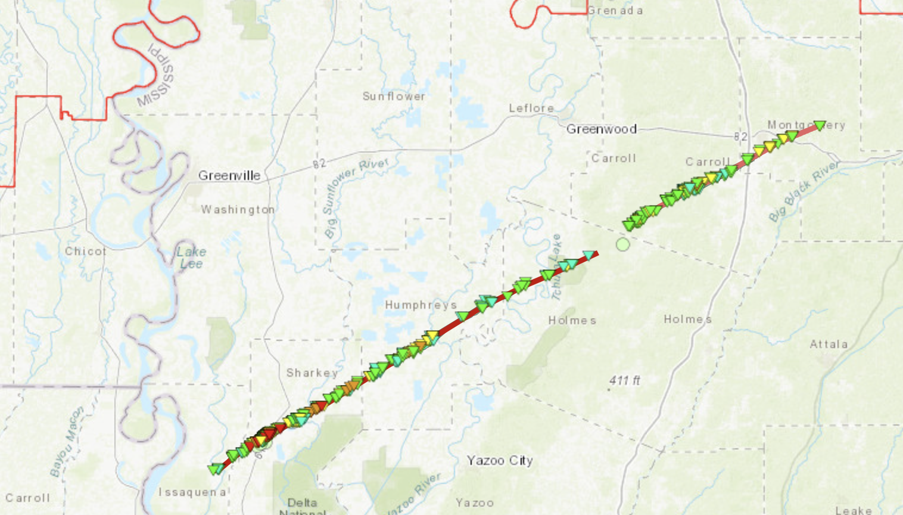
WINDoe examples
Lake Village
Schlater
Piney Creek

Slide 15
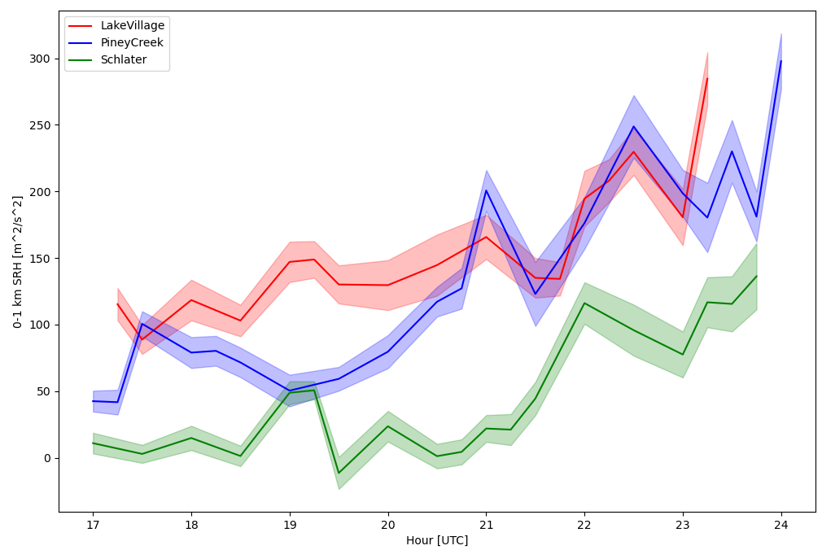
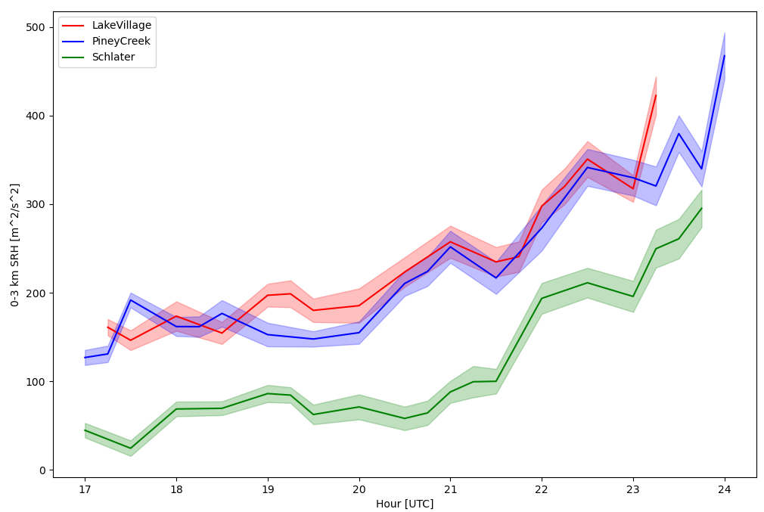
WINDoe examples
0-1 km SRH
Through Monte Carlo sampling of the posterior covariance matrix, we can obtain uncertainties for derived indices using the retrieved profile
0-3 km SRH

Slide 16
Green’s Theorem: TROPoe + WINDoe
NOAA Rapid Refresh (RAP) Model above 1.5 km
TROPoe can take any combination of instruments as long as a proper forward model is available
Combined with WINDoe, can rerun advection analysis on retrieved profiles

Slide 17
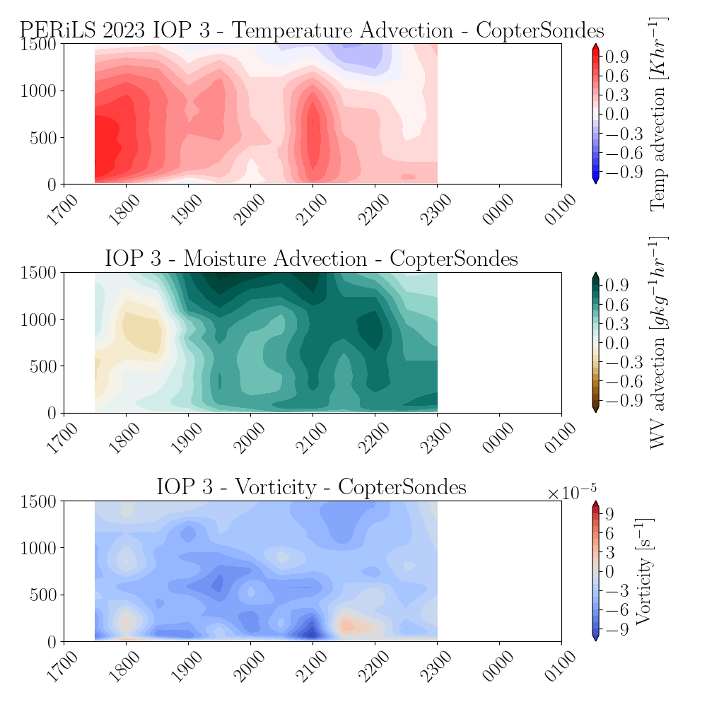
Green’s Theorem: TROPoe + WINDoe

Slide 18
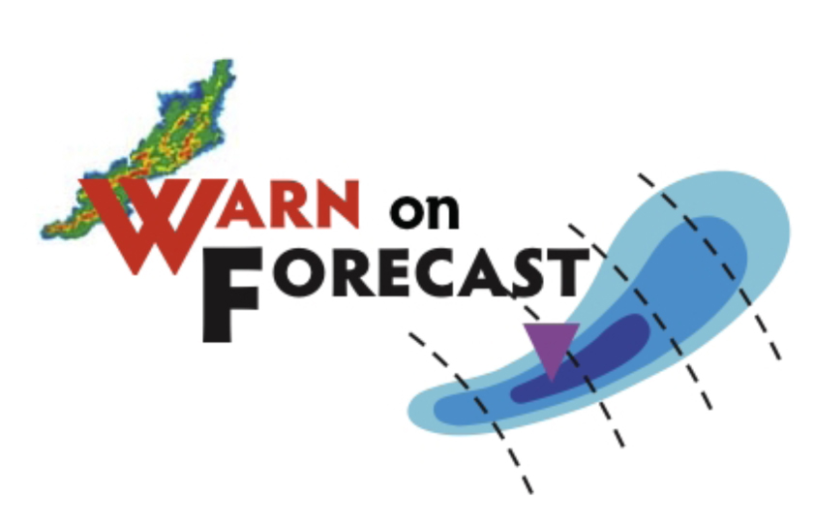
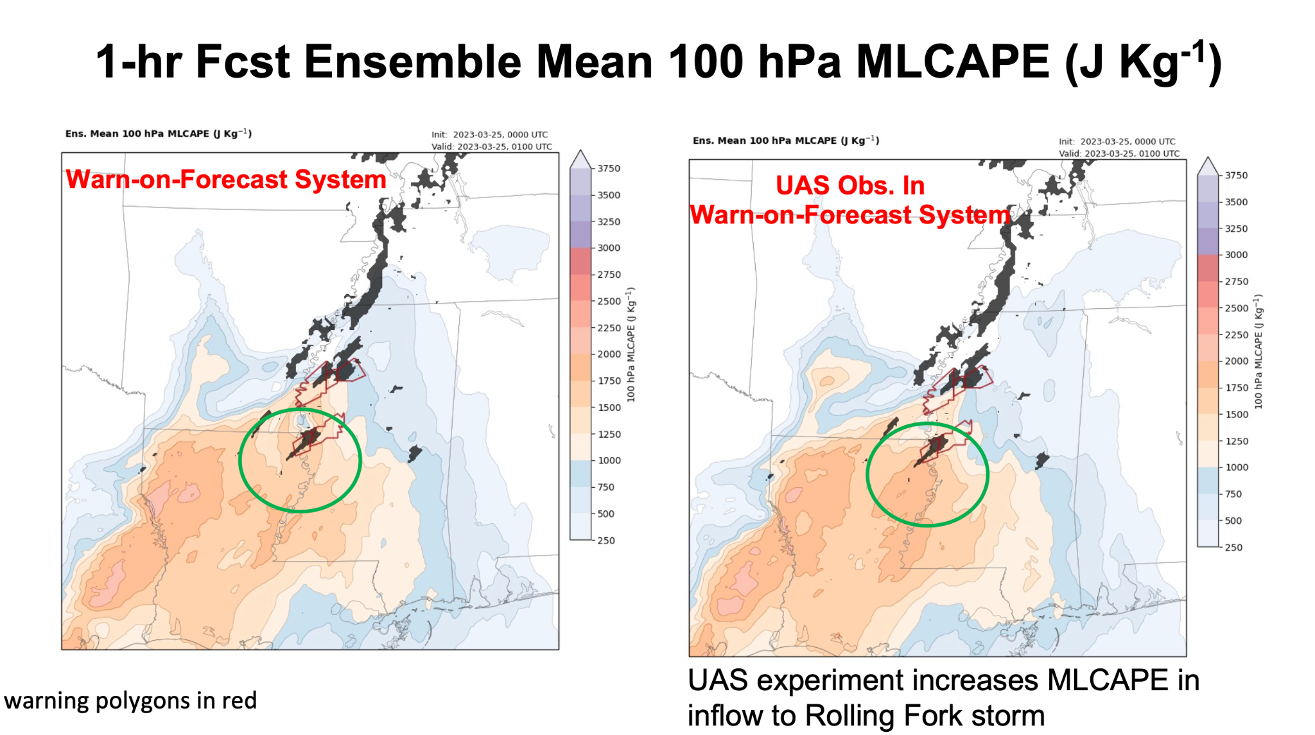
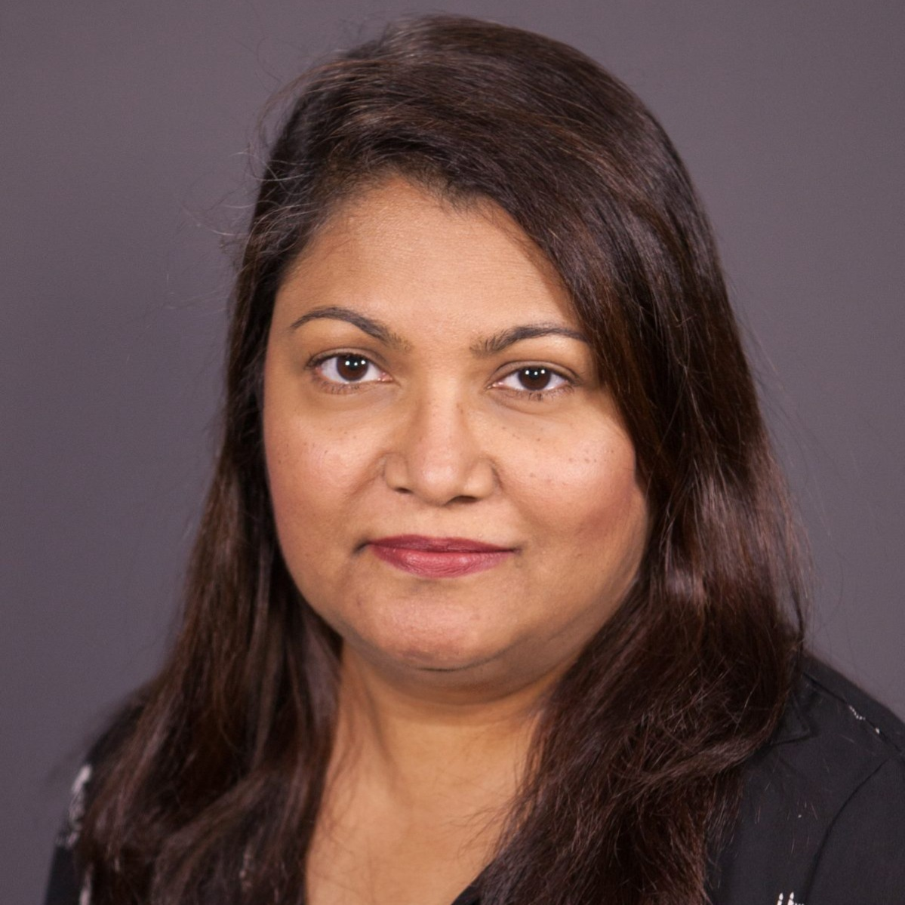
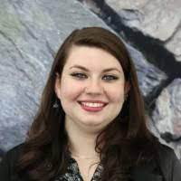
Data Assimilation Experiments
CIWRO Scientist
Dr. Nusrat Yussouf
MS Student
Jordan Tweedie

Slide 19
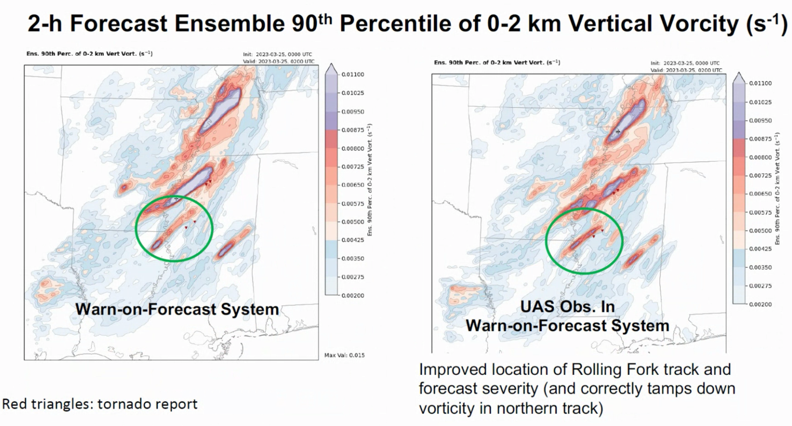
Data Assimilation Experiments
CIWRO Scientist
Dr. Nusrat Yussouf
MS Student
Jordan Tweedie

Slide 20
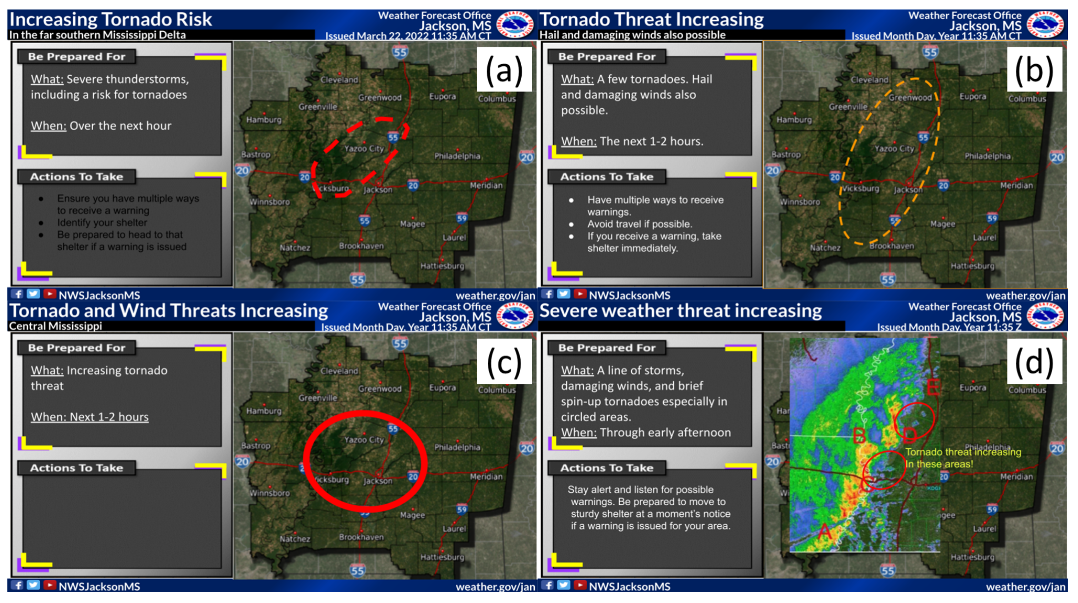
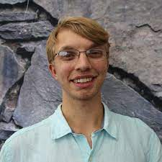
R2O – Stakeholder/End User Needs
PERiLS 2022 CopterSonde data evaluated in NWS forecast exercises
Between the second (1505 UTC) and third (1535 UTC) time steps, and then between the fourth (1605 UTC) and last (1635 UTC) time steps, only updates from the radar and CopterSonde were provided. P6 described the benefit of having observations between updates in the RAP, such that “the CopterSonde provided data that helped me determine that the environment at Point D had changed over the past 30 minutes and had become more supportive of a tornado threat.” Most of the experimental groups’ responses to the survey at this time, focused on the use of CopterSonde data.
Connor Bruce, 2023: Exploring CopterSonde Use for National Weather Service Operations
OU Master Thesis

Slide 21
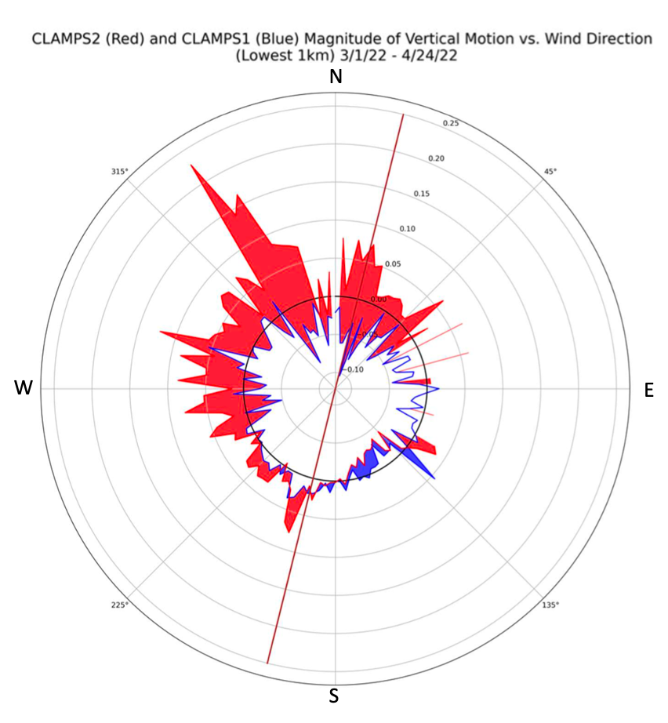
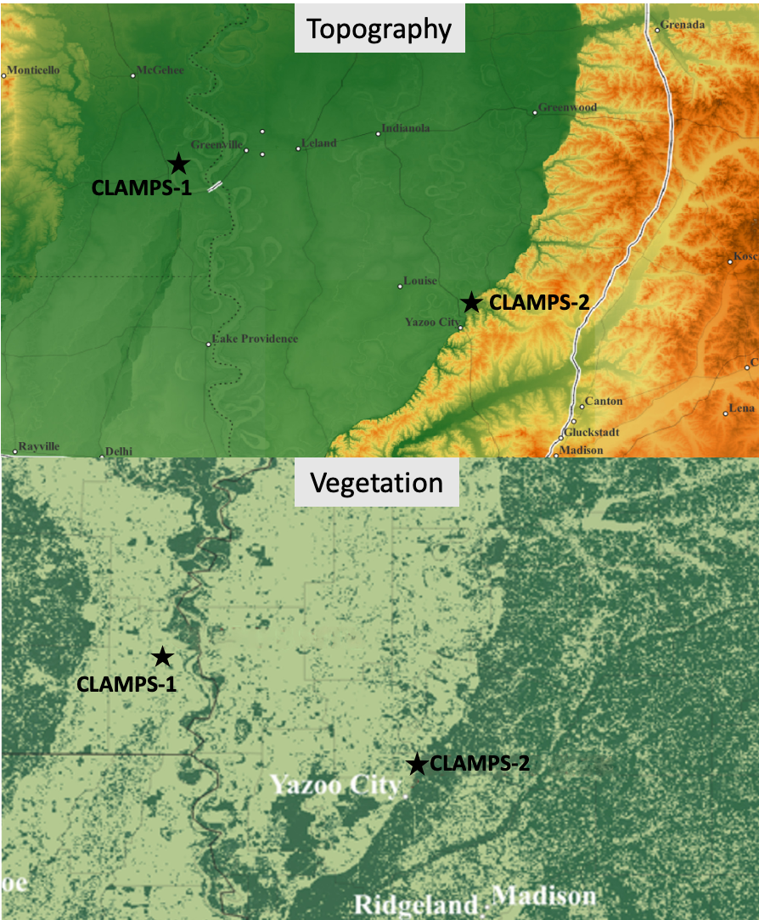
Process Understanding – Terrain Influence

Slide 22
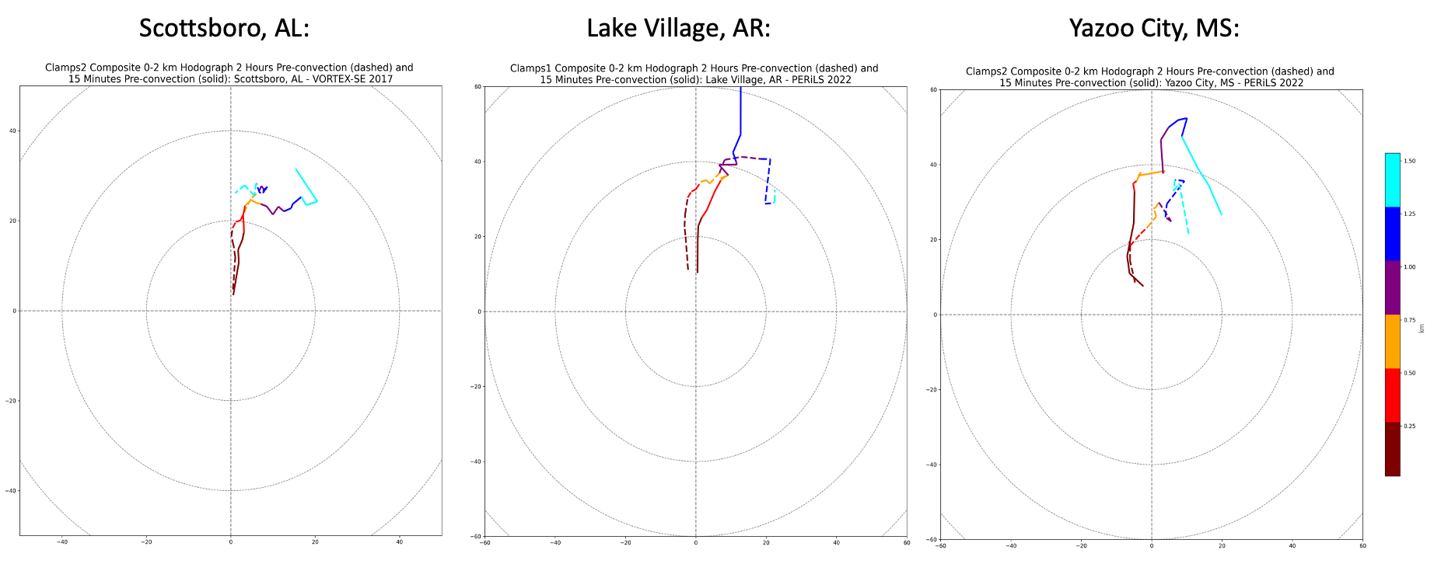
Process Understanding – Terrain Influence
Yazoo City composite exhibits much more curvature in lowest ~0.5 km due to terrain-induced backing of near-surface flow. This promotes more streamwise oriented vorticity
There is notable acceleration of 0-1 km shear vector between 2 hours pre-convection, and 15 minutes pre-convection in Yazoo City composite while others reflect little change

Slide 23
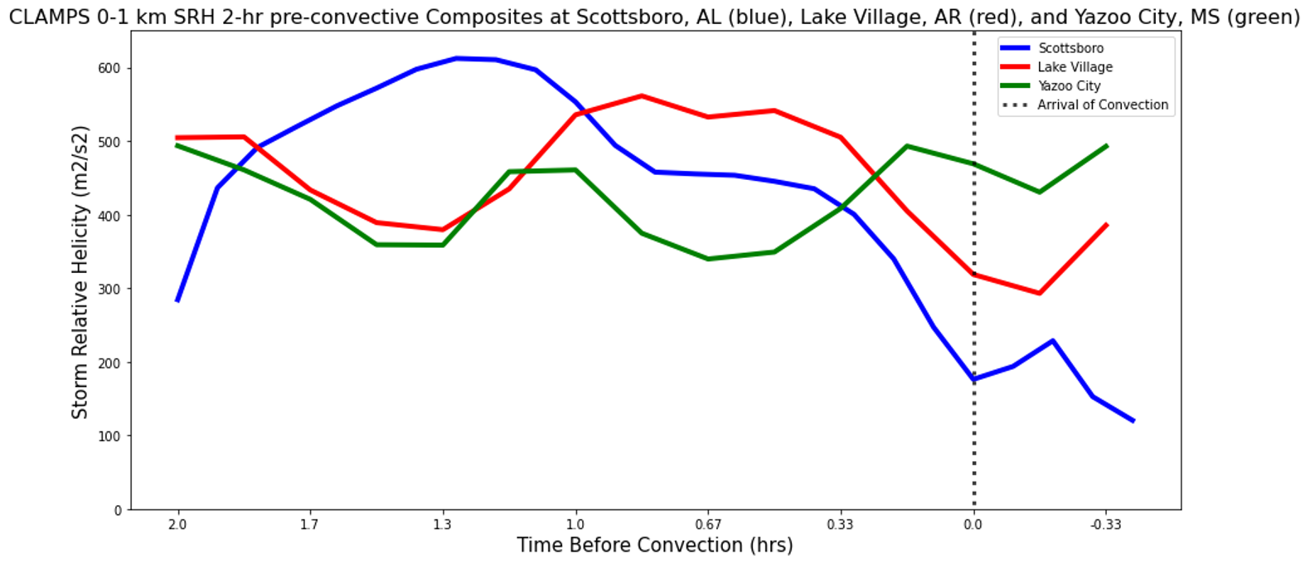
Process Understanding – Terrain Influence
0-1 km SRH increases during the ~45 minutes leading up to the arrival of convection at the Yazoo City site while it decreases during that same period at the other sites. This is possibly due to the interaction between the terrain gradient and the backing winds that occurs in response to the storm inflow.

Slide 24
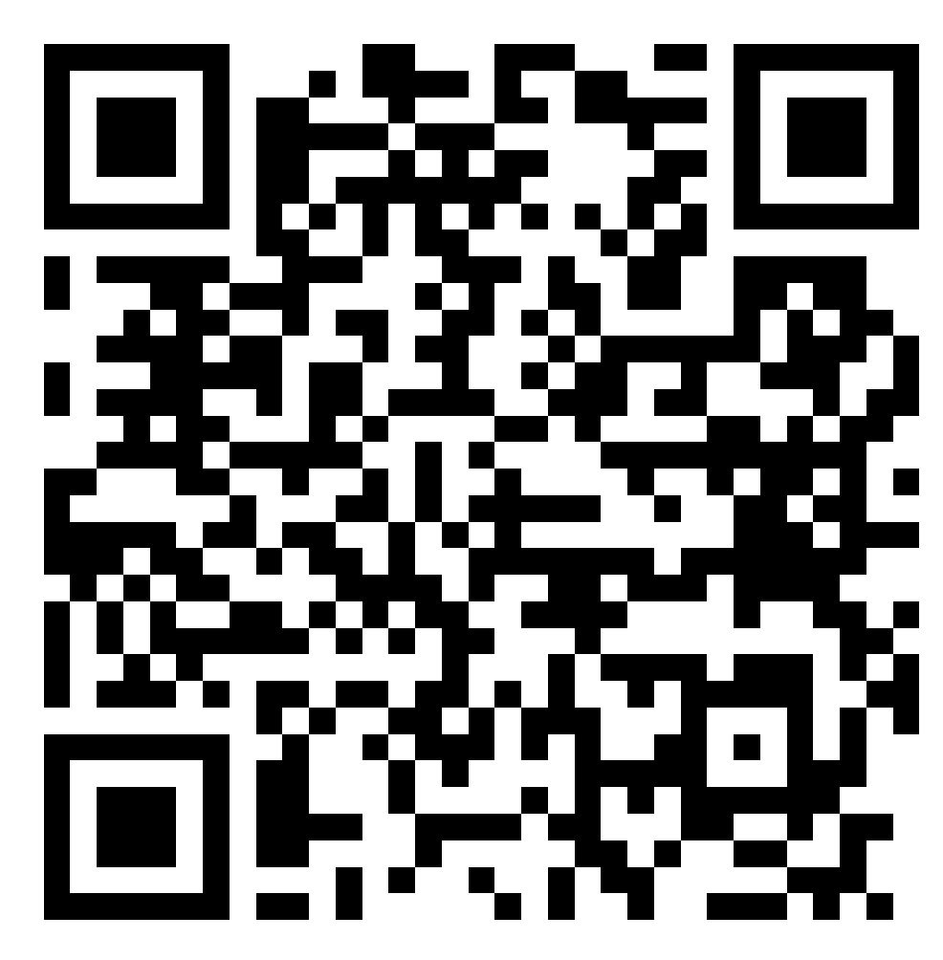
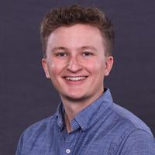
Process Understanding – Terrain Influence
Recorded Seminar:
bliss.science/seminar/20230508-matthew-ammon/

Slide 25
PERiLS PBL Profiling:
CLAMPS and CopterSonde UAS
Dr. Elizabeth Smith Research Meteorologist–NOAA National Severe Storms Laboratory
Affiliated Assistant Professor–OU School of Meteorology
Email: elizabeth.smith@noaa.gov / Social media: @eeeeelizzzzz
Tyler Bell, Joshua Gebauer, Tony Segales – OU CIWRO

Slide 26
Looking ahead
Ongoing work and what’s next

Slide 27
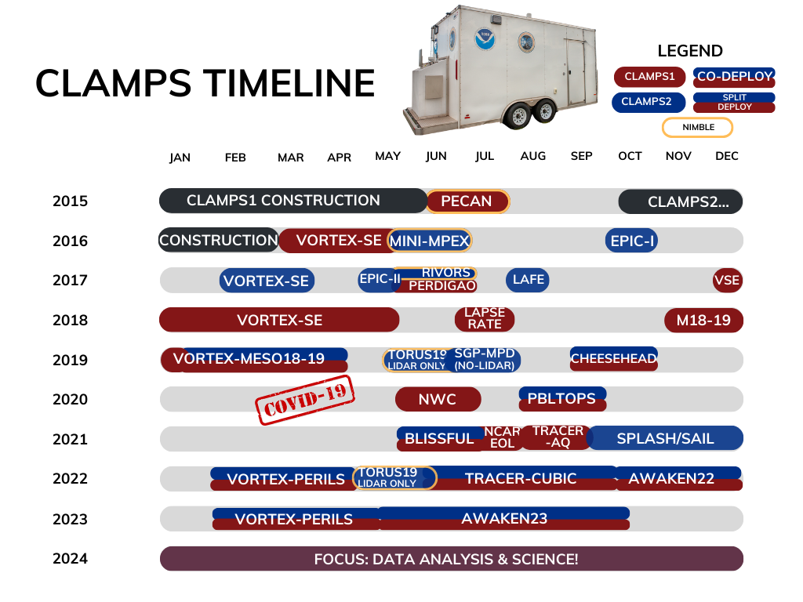

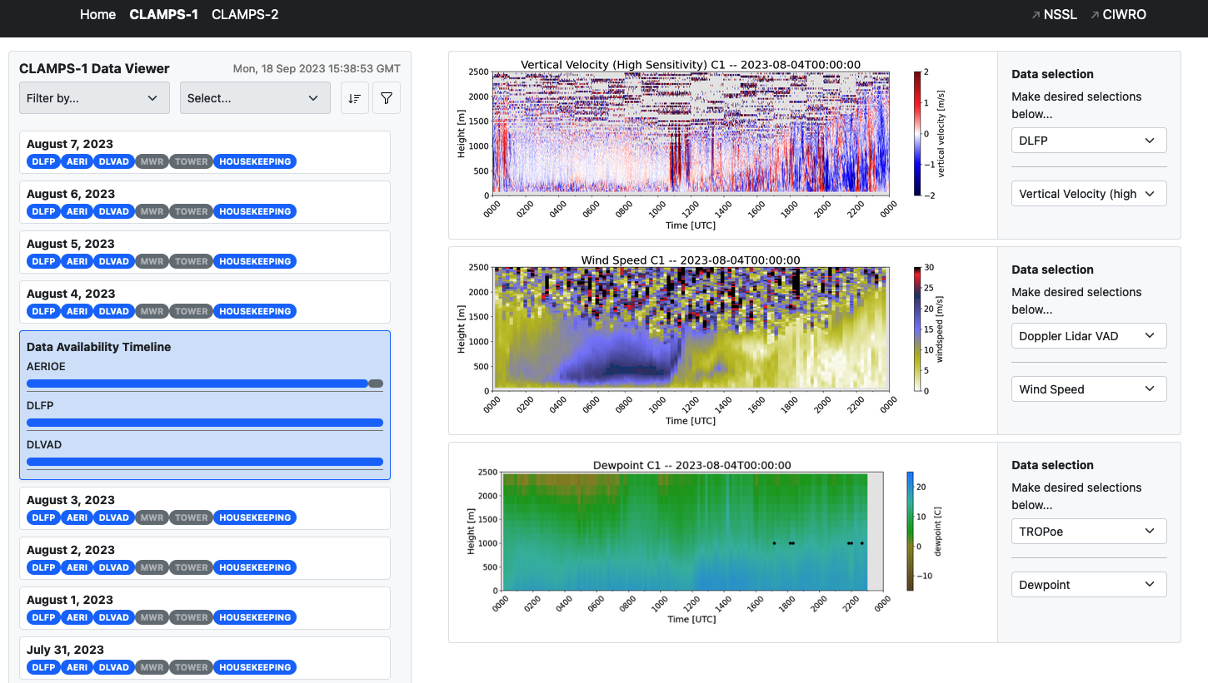
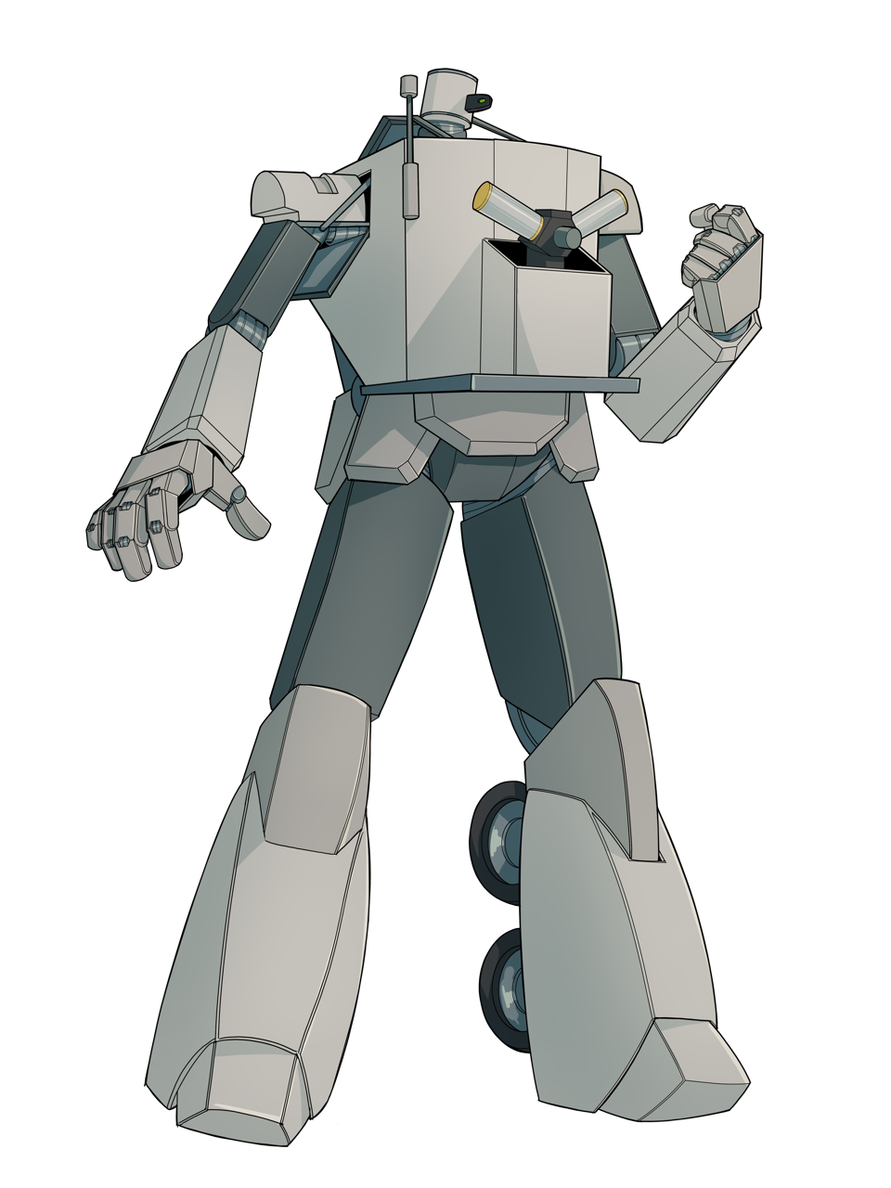


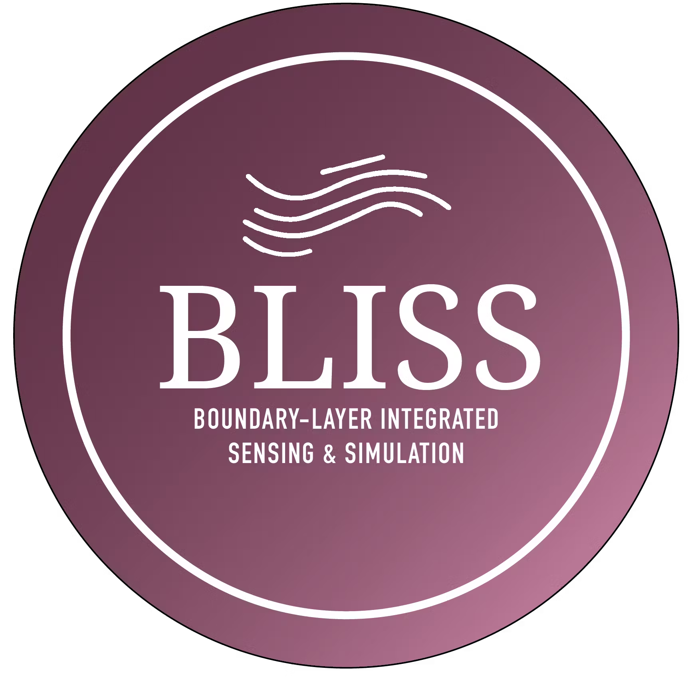
Created by OU UG Victor Alvarez
Get started using our data with tools at bliss.science/resources/code
Data Viewer
THREDDS Data Access

Slide 28
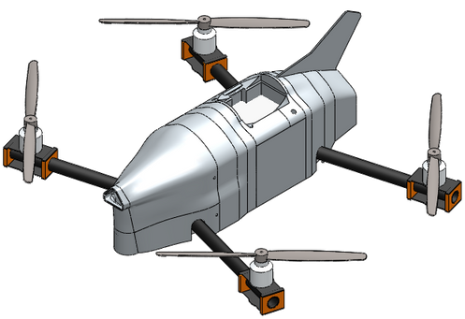

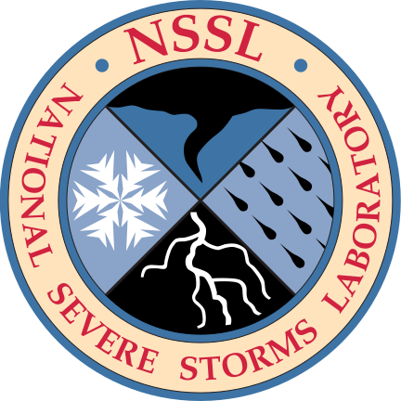
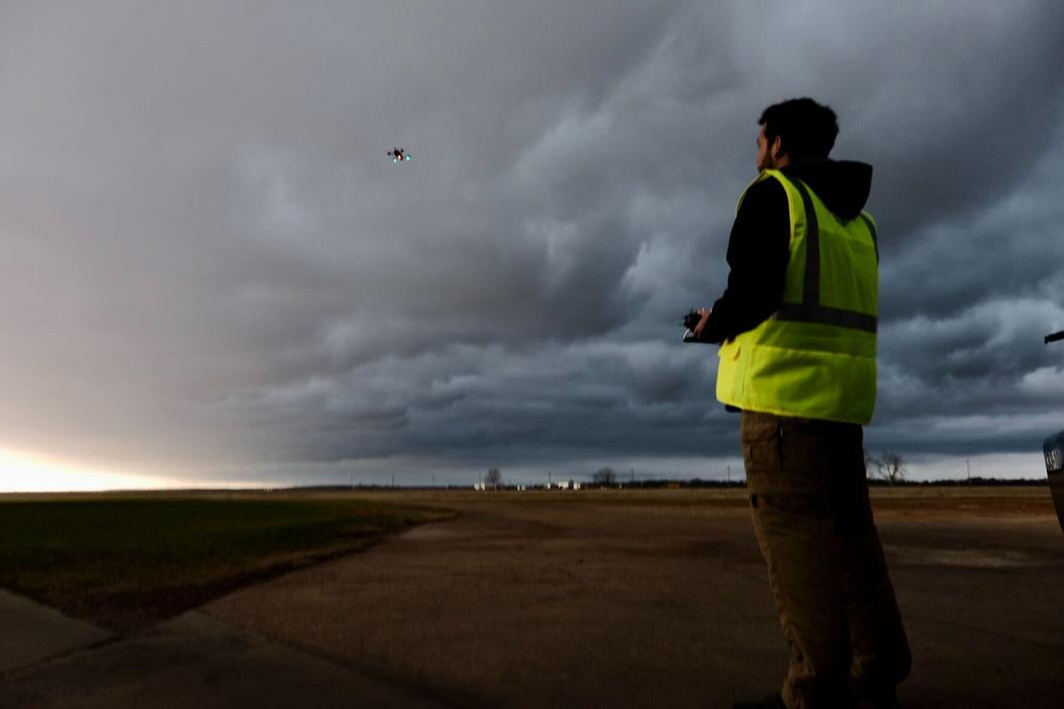

CopterSonde flights are enabling rapid, in-situ, low-level profiling of thermodynamic and kinematic conditions in the atmosphere.
Many research directions are being explored.
  R&D of UAS platform and supporting software and hardware
  to increase flight capability and autonomy
  similarities, differences, and possible synergies between UAS-based and ground-based profiling techniques
  impacts and network needs for low-level, rapid profiles in data assimilation contexts
  basic science (e.g., knowledge development based on the new types of obs these platforms enable such as parcel residence times, convection initiation processes, etc.)
PRODIGEE-UAS
The Coptersonde UAS collects meteorological profiling observations on multiple projects at NSSL and CIWRO/University of Oklahoma. Since 2020, it has conducted approximately 1,500 research flights. Science & engineering staff at NSSL and CIWRO are leading a project supported by NOAA's UxSRTO called PRODIGEE to advance Coptersonde capabilities.
CURRENT
TARGET
WIND TOLERANCE:
22 M/S (50 MPH)
–>
WIND TOLERANCE:
35 M/S (78 MPH)
MAX FLIGHT CEILING:
1.5 KM AGL
–>
MAX FLIGHT CEILING:
3 KM AGL
VISUAL LINE OF SIGHT OPERATIONS
–>
BEYOND VISUAL LINE OF SIGHT OPERATIONS
bliss.science/resources/sensing/coptersonde
Notes:
PRODIGEE links to newly funded work for R&D of the CopterSonde platform.
Lower link goes to a description of the current CopterSonde platform.

Slide 29

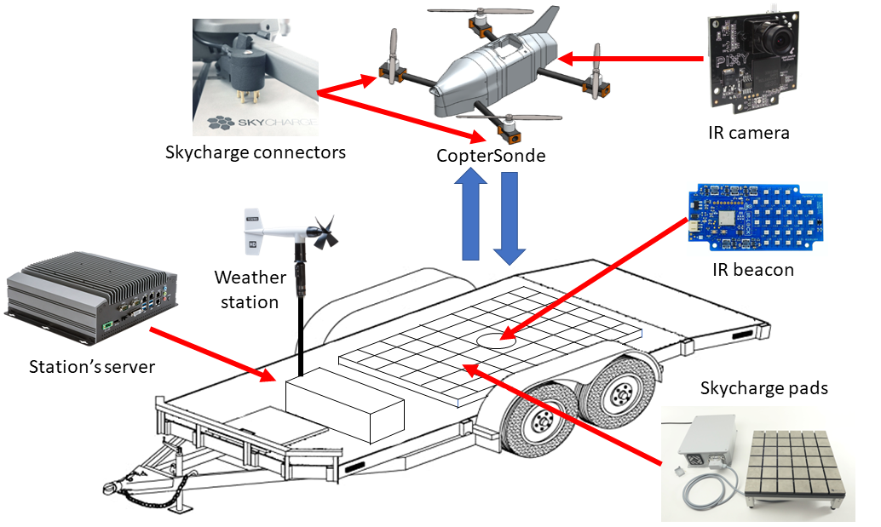
CIWRO – Precision Landing and Auto-Charging for Weather-Sensing UAS
Key research goals:
Create a proof-of-concept platform for the future development of many supporting requirements (e.g. detect and avoid capabilities, surface station integration, fully remote launch and recovery, etc.) necessary to realize fully autonomous operations (i.e. the 3D Mesonet)
Continue to develop the cloud-infrastructure necessary to operate and monitor remote operations

Slide 30
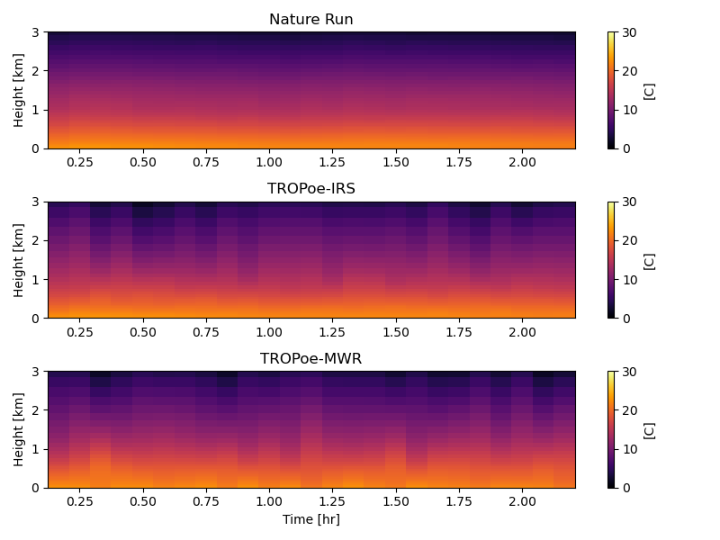
WPO: Venturing into the Vertical–OSSES
This study proposes to conduct research that will facilitate the development of a vital boundary layer profiling mesonet, often referred to as a 3D mesonet, that could fill the boundary layer data gap in current observation networks. Remote and in situ platforms such as infrared spectrometers, microwave radiometers, Doppler lidars, and weather-sensing uncrewed aircraft systems (UAS) can provide boundary layer observation profiles, but the optimal design of such a network venturing into the vertical remains unknown.
Key research goals:
Observing system simulation experiments (OSSEs) with high-quality observation simulators to replicate directly observed variables from remote profilers, UAS.
Field deployments with up to 12 weather UAS to replicate operational boundary layer profiling mesonet in high-impact weather environments.
Use OSSEs and field deployments to test analysis and retrieval techniques that could be performed in near-real time.
Leverage high-resolution flow-simulations and data from past and current CopterSonde deployments to improve upon the CopterSonde design for operational profiling.

Slide 31
WPO: Venturing into the Vertical–OSSES
This study proposes to conduct research that will facilitate the development of a vital boundary layer profiling mesonet, often referred to as a 3D mesonet, that could fill the boundary layer data gap in current observation networks. Remote and in situ platforms such as infrared spectrometers, microwave radiometers, Doppler lidars, and weather-sensing uncrewed aircraft systems (UAS) can provide boundary layer observation profiles, but the optimal design of such a network venturing into the vertical remains unknown.
OSSE
Key research goals:
Observing system simulation experiments (OSSEs) with high-quality observation simulators to replicate directly observed variables from remote profilers, UAS.
Field deployments with up to 12 weather UAS to replicate operational boundary layer profiling mesonet in high-impact weather environments.
Use OSSEs and field deployments to test analysis and retrieval techniques that could be performed in near-real time.
Leverage high-resolution flow-simulations and data from past and current CopterSonde deployments to improve upon the CopterSonde design for operational profiling.
TEST DA IMPACTS
INFORM NETWORK DESIGN
MULTI PURPOSE OSSE FRAMEWORK
FULL
SCALE NETWORK
IDEAS
FIELD
OBS
UPSCALED NETWORK HYPOTHESES

Slide 32
PERiLS PBL Profiling:
CLAMPS and CopterSonde UAS
Dr. Elizabeth Smith Research Meteorologist–NOAA National Severe Storms Laboratory
Affiliated Assistant Professor–OU School of Meteorology
Email: elizabeth.smith@noaa.gov / Social media: @eeeeelizzzzz
Tyler Bell, Joshua Gebauer, Tony Segales – OU CIWRO

Slide 33
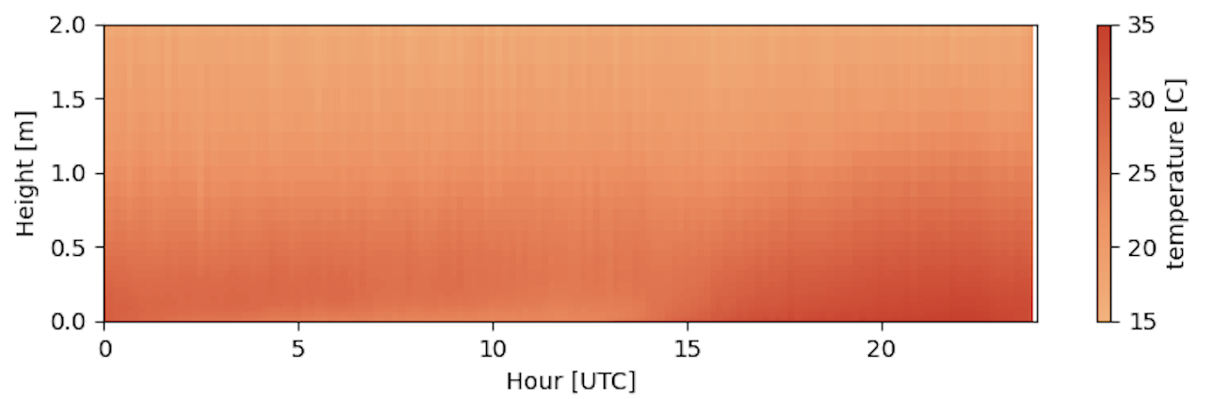
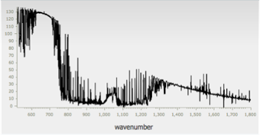
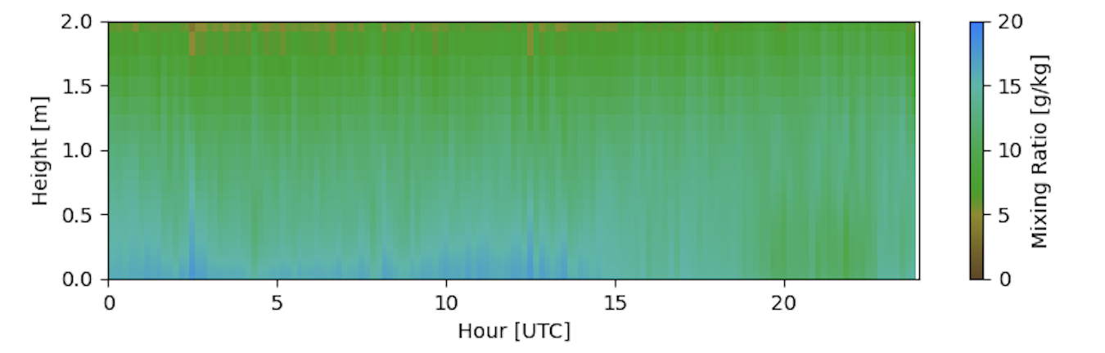
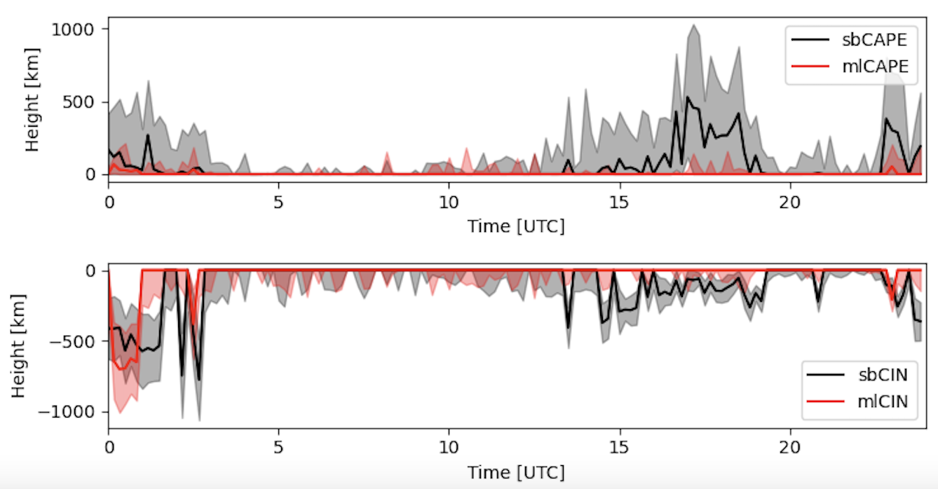
TROPoe: Tropospheric Remotely Observed Profiling via Optimal Estimation
TROPoe
Thermodynamic optimal estimation retrieval developed and maintained in collaboration with Global Systems Laboratory.
Very flexible retrieval system that works with:
Infrared spectrometers
Microwave radiometers
Micropulse differential absorption lidar
Radio acoustic sounding systems
CopterSondes
Radiosondes
Numerical weather prediction

Slide 34



WINDoe: Wind via Optimal Estimation
Newly developed wind profile optimal estimation retrieval designed to be a complement to TROPoe. Developed by CIWRO/NSSL staff.
The technique allows for information content from wind profiling instrument to be used to the fullest extent and enables combined data products from:
Doppler lidar
Radar wind profiler
CopterSondes
Soundings
Models
WINDoe retrievals on 19 April 2023
Example Combined WINDoe Retrieval at ARM-SGP Site
Code available for OAR at: https://github.com/OAR-atmospheric-observations/WINDoe

Slide 35



CopterSonde UAS
  Technical Specs
  All-up weight: 2 kg
  Hover time: 18 min
  Max. mean wind: 22 m/s
  Max. wind gust: 26 m/s
  Max. altitude (AGL): 1500m
  Max. const. current: 61.5 A
Scoop Inlet
Sensor location
Fan for aspiration

Slide 36


CopterSonde Comparisons

Slide 37

CopterSonde Thermodynamics
Wind vane function significantly helps mitigating sources of measurement errors

Slide 38



CopterSonde Vertical wind estimation

Slide 39
PERiLS 2022–2023 Operations
Variable | All Sites | Yazoo City | Schlater | Lake Village
Max altitude (m) | 1380 | 1380 | 1300 | 1247
Avg altitude (m) | 491 | 572 | 514 | 393
Total flight count | 347 | 119 | 111 | 103
Total operations time | 44:15:19

Slide 40


The Incidents…

Slide 41





Green’s Theorem Approach
Per Wagner et. al. (2022), since the calculation depend on the scalar magnitude, the mean scalar value of the vertices needs to be removed prior to calculating advection to be properly scaled

Slide 42



Innovation as motivation for PERILS CONOPS
Colocated with CLAMPS remote sensing boundary layer profiler (or near other profiler site)
CopterSondes begin profiling 8 hours prior to expected storm arrival
Coordinated flights occur every 30 minutes, unless the cadence is changed by the mission commander
Cadence may increase (at all sites) to 15-minute if a site is near-storm or another interesting weather feature is thought to be observable
+
occurrence
Observe the continuum from quiescent BL up to storm arrival!
Rare, weak
condition
Rare, EXTREME!

Slide 43




VORTEX-USA/PERiLS
PhD student
Tyler Pardun
2015-2020 VORTEX-SouthEast
Cool season deployments of fixed facilities to North Alabama
Use these years of data to determine scales of motion and necessary observation spacing
Time-to-space (Taylor’s Frozen)
D = ITS x U
D=distance, ITS= integral time scale,
U= mean wind speed
Note water vapor mixing ratio smallest time scale

Slide 44
VORTEX-USA/PERiLS
PhD student
Tyler Pardun
Convective cases:
ITS ~ 40 min
U ~15-20 m/s
D = 36 – 48 km
2015-2020 VORTEX-SouthEast
Cool season deployments of fixed facilities to North Alabama
Use these years of data to determine scales of motion and necessary observation spacing
Time-to-space (Taylor’s Frozen)
D = ITS x U
D=distance, ITS= integral time scale,
U= mean wind speed
Note water vapor mixing ratio smallest time scale

Slide 45

Innovation as motivation for PERiLS CONOPS
Need: network low-atmosphere observations in challenging environment of southeastern US
VORTEX-SE findings: above-surface variability critical

Slide 46

Innovation as motivation for PERiLS CONOPS
Need: network low-atmosphere observations in challenging environment of southeastern US
VORTEX-SE findings: above-surface variability critical, 2016-2019 remote sensor profiling obs suggested ~50 km min. spacing
PERiLS opportunity: deploy prototype network with network-in-network framework
Network-in-network concept further enhanced by PERiLS mobile armada (esp. adaptable obs)
Deploys only when high-impact weather is imminent
Iterations with NOAA UASD
defined ultimate location of inner network
led to elimination of nimble + fixed approach
walk before you can run!
Ended up with 90 km
COA: 3 sites, 0–1.5km AGL
0–5000 feet AGL

