Slide 1


NOAA/PSL PERiLS Boundary Layer Studies
Bianca Adler, Laura Bianco, Tim Myers, Dave Turner, Jim Wilczak

Slide 2
Outline:
Thermodynamic profile retrievals
  - What we’ve done to improve them for PERiLS
PWV characteristics during PERiLS 2022 and 2023
  - How IOPs are different from non-IOP days
Evaluation of HRRR forecasts at Courtland, AL
  - Interaction between surface and clouds

Slide 3
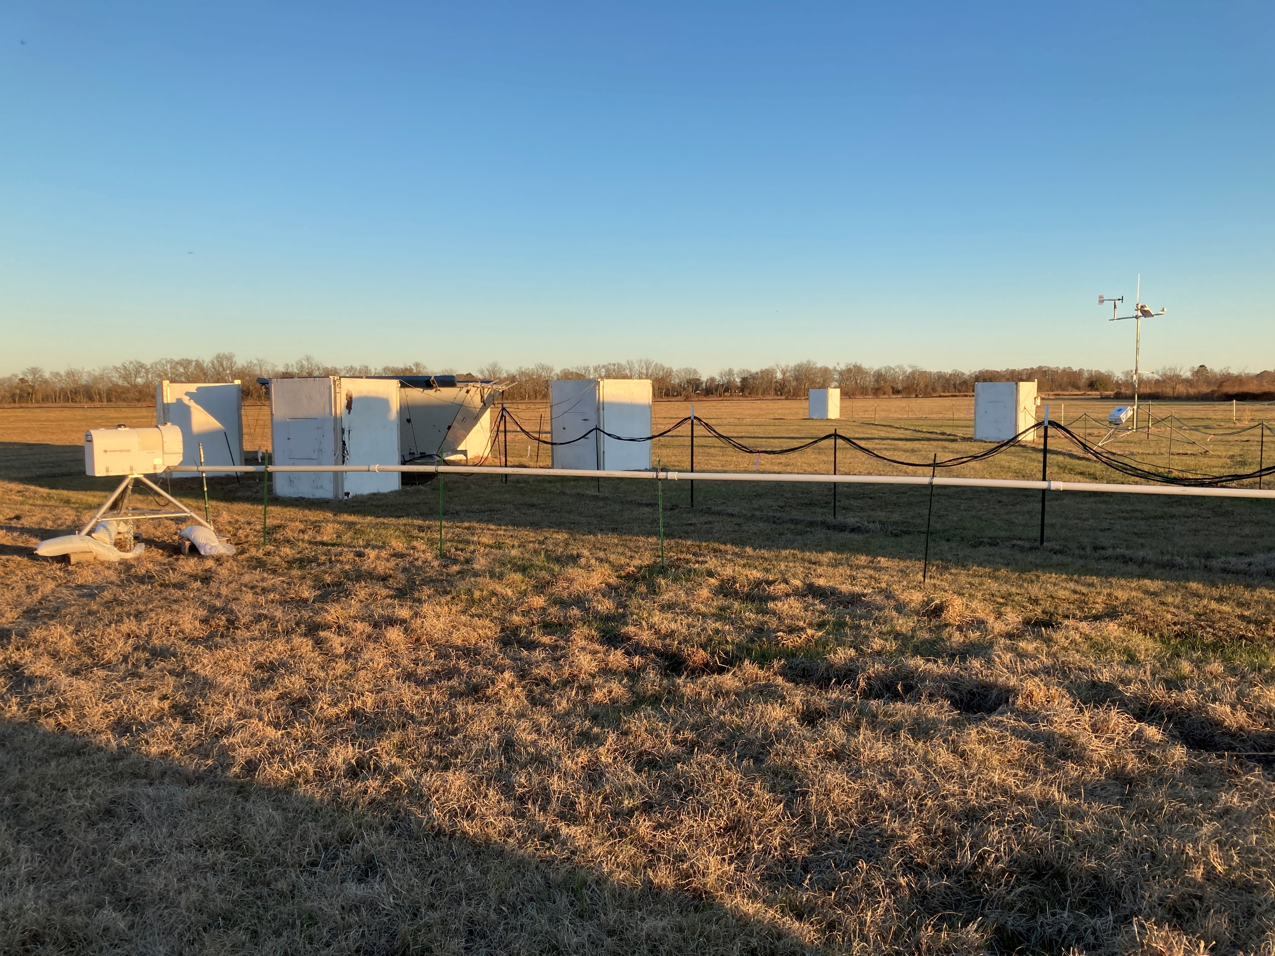
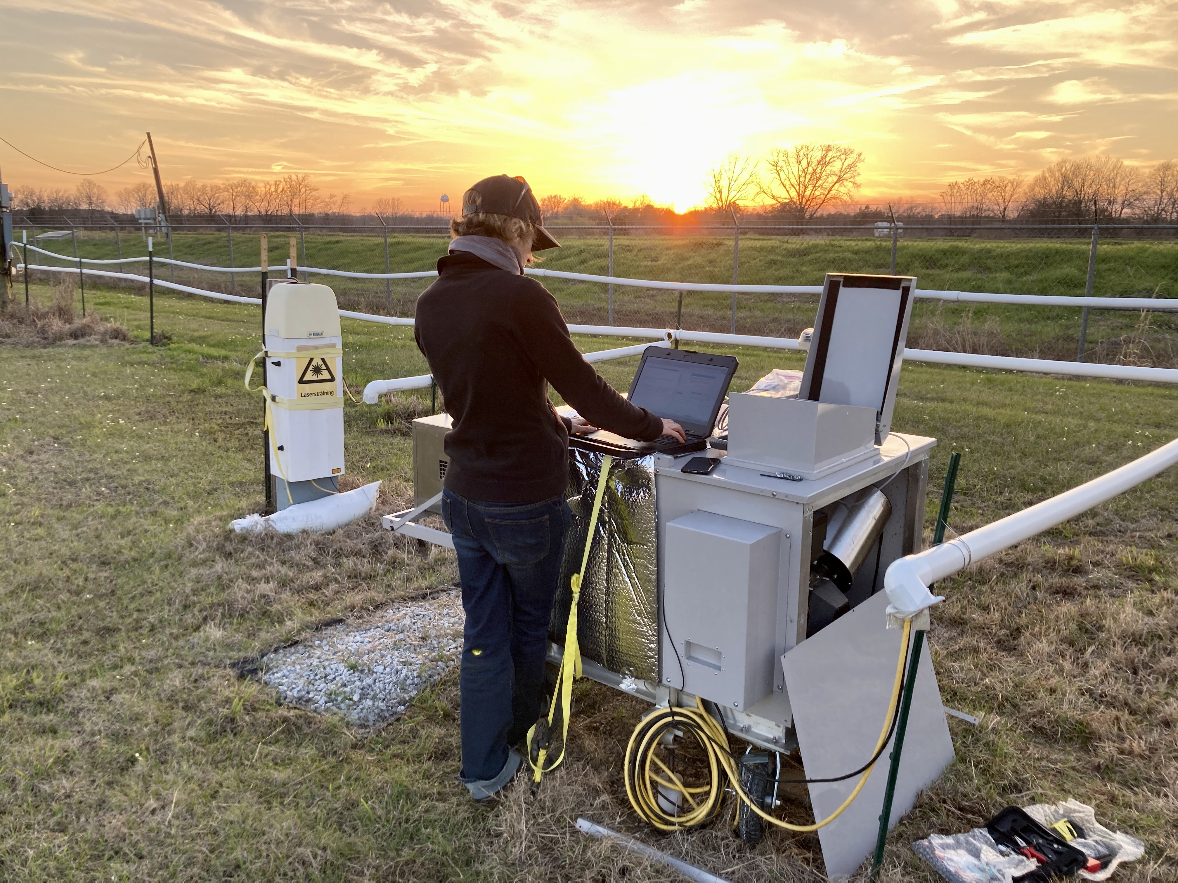
Columbia, LA NOAA/PSL PERiLS site
Infrared Spectrometer (IRS)

Slide 4
Optimal estimation physical retrieval TROPoe
Based on AERIoe (Turner and Löhnert, 2014, Turner and Blumberg, 2019, Turner and Löhnert, 2021)
Three ingredients:
  Observations: (IRS and/or MWR irradiances ) + ( Optional T&q from RASS, aircraft, UAS, radiosondes, surface met, models)
  Prior X_{a} (nearby radiosonde climatology)
  Radiative transfer model F (LBLRTM or MONORTM).
  -> optimal state vector X: T(z), q(z), LWP
The state vector at the n+1 iteration is computed as:
where K is the Jacobian of F, S_{a} is the covariance matrix of the prior, Y is the observation vector, and S_{ϵ} denotes the observation error covariance matrix.
Monthly priors are computed for each site recentered using daily average of near-surface water vapor mixing ratio.

Slide 5
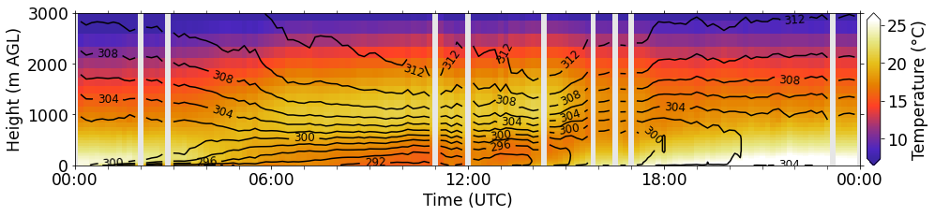
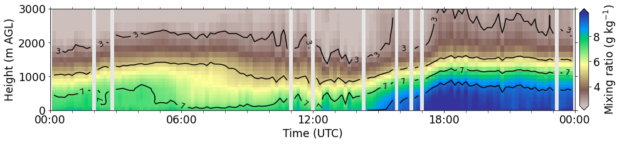
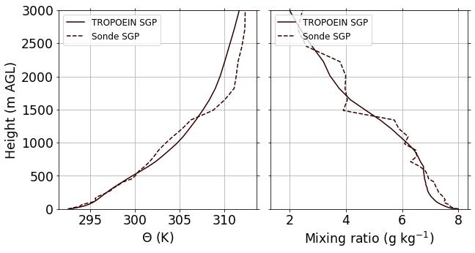
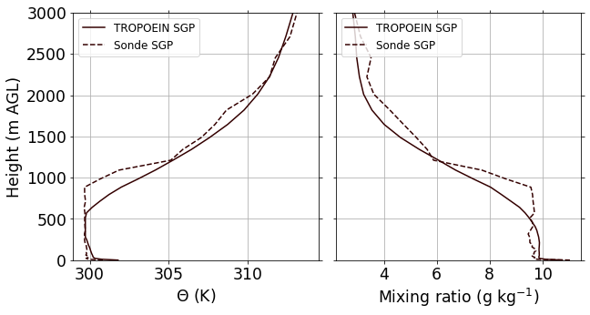
Example of IRS retrieved thermodynamic profiles
RS launch times
Convective boundary layer
Strong surface inversion
IRS time resolution: 5 min

Slide 6
Issues with past TROPoe configurations
Overfitting of profiles for IRS-based retrievals
  TROPoe may not converge because it is overly constrained.
  Constraint comes because uncertainty of forward model is currently not included due to computational limitations. Instead radiance uncertainty is inflated to compensate for this (Turner and Blumberg 2019).
  But even inflation of uncertainties may not be sufficient to prevent overfitting and lack of convergence
  → Implement default minimum noise level for radiance uncertainty
Saturation of IRS water vapor bands in very moist environments
  TROPoe may not converge because traditional spectral bands used for water vapor can be saturated and contain little information content
  → Add additional spectral band for water vapor
Temporal consistency of profiles
  Every time stamp is processed separately without using any information from previous state of the atmosphere
  ‘Noisy’ time series hindering analysis of physical processes and diurnal cycles
  → Include information from previous retrieved thermodynamic profile with inflated uncertainty as input to the retrieval
Notes:
.

Slide 7
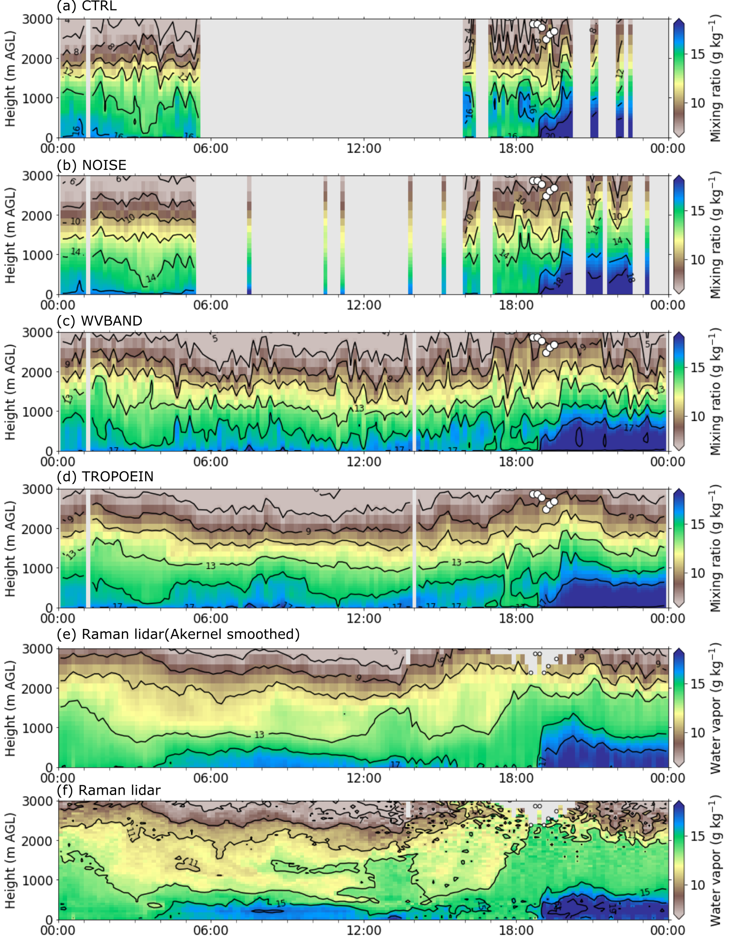
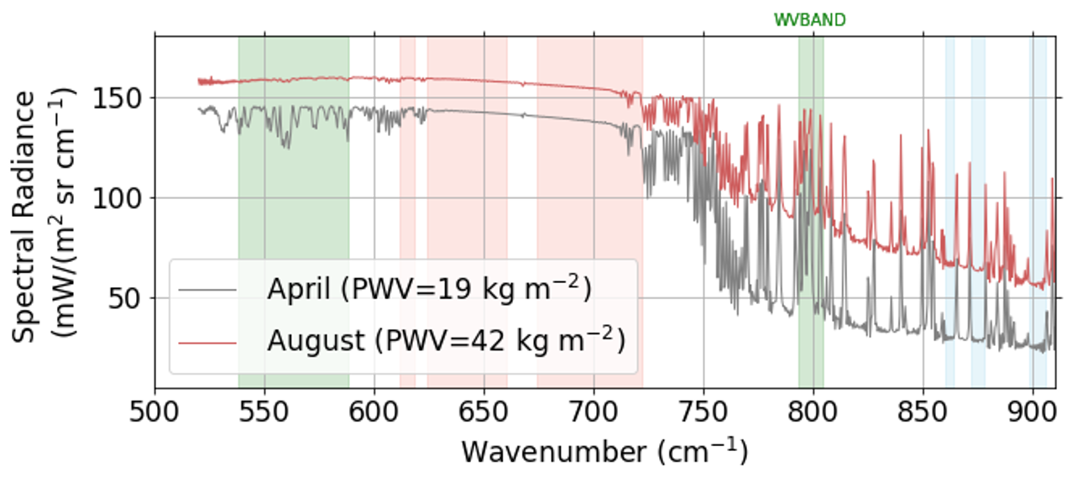
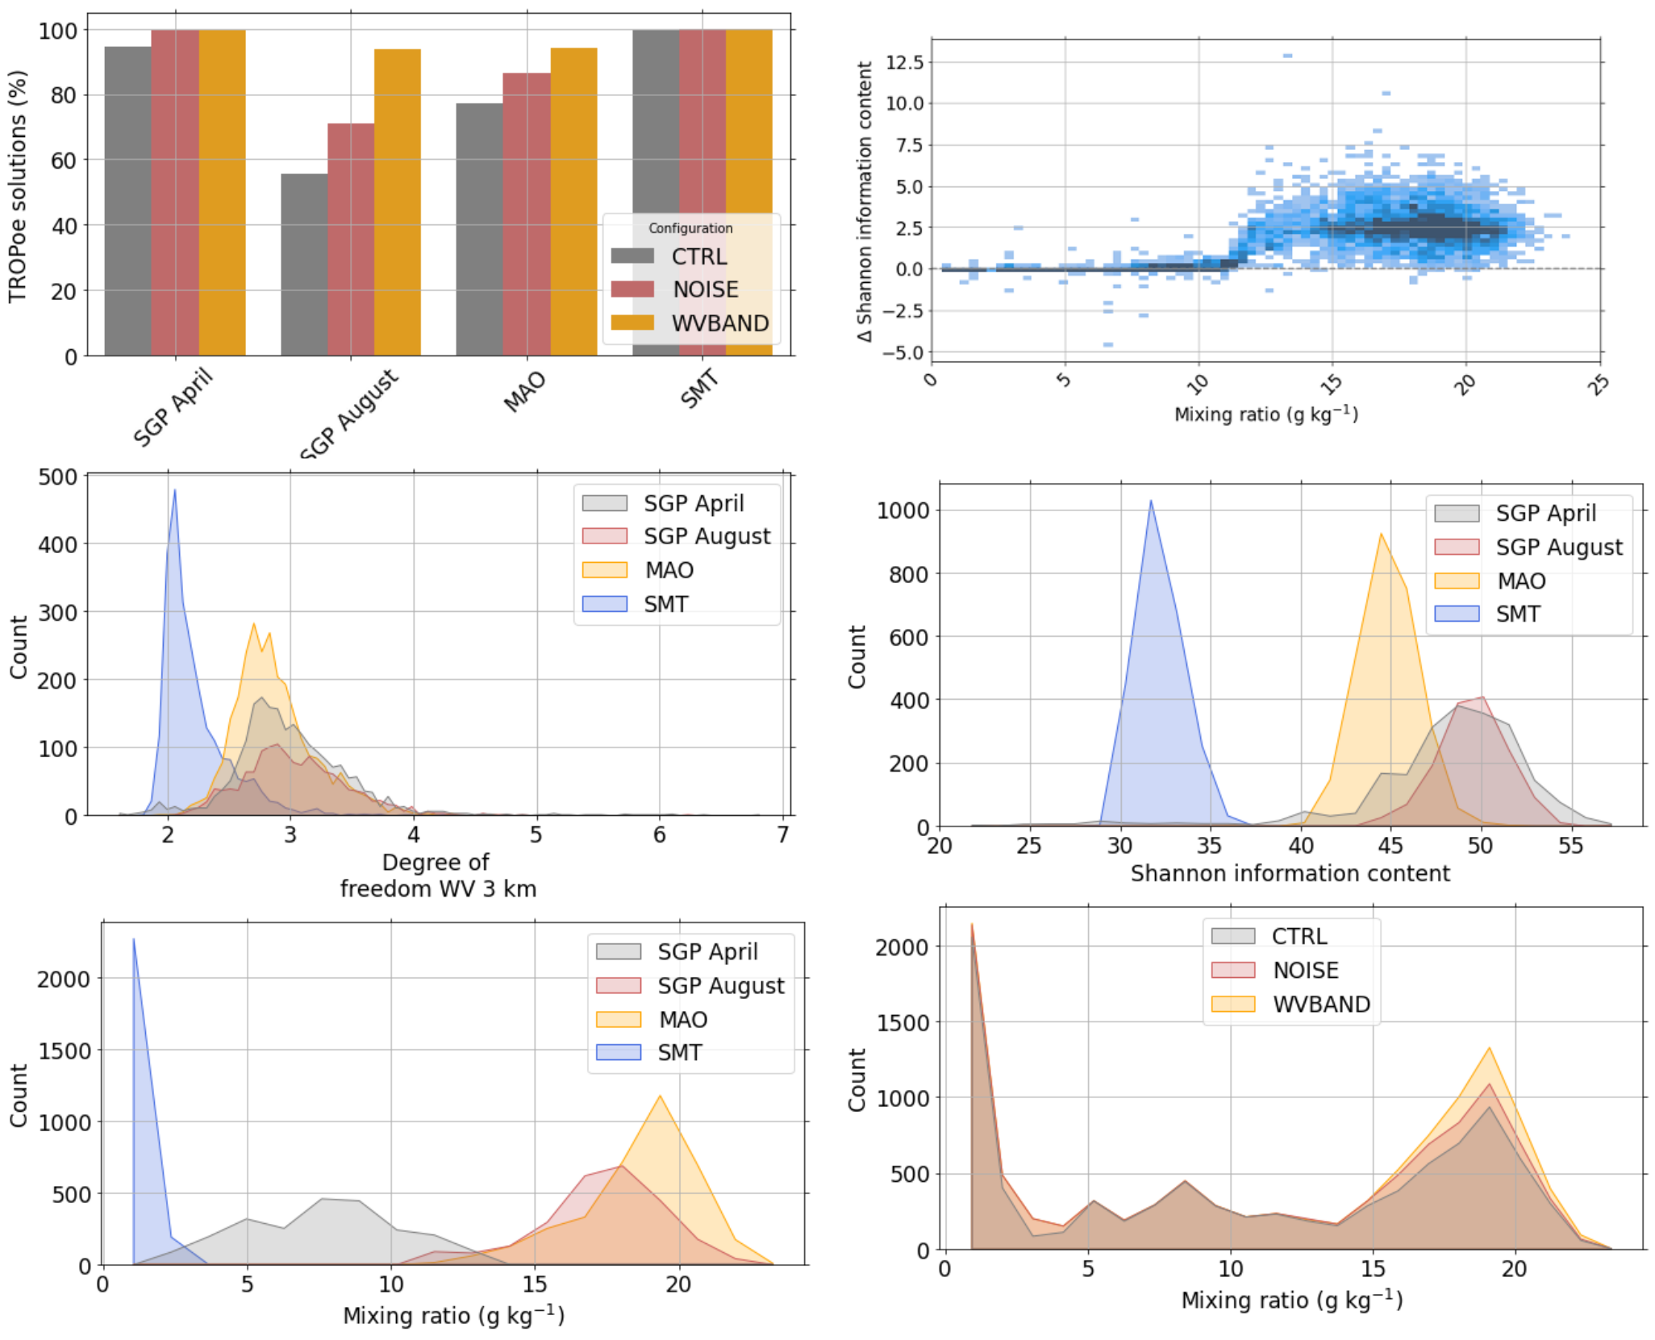
1 & 2. Noise and Saturation of water vapor bands

Slide 8
Temporal consistency of profiles
Every time stamp is processed separately without using any information from previous state of the atmosphere
‘Noisy’ time series make analysis of physical processes and diurnal cycles challenging
→ Include information from previous retrieved thermodynamic profile with inflated uncertainty as input to the retrieval

Slide 9
Temporal consistency of profiles
Every time stamp is processed separately without using any information from previous state of the atmosphere
‘Noisy’ time series make analysis of physical processes and diurnal cycles challenging
→ Include information from previous retrieved thermodynamic profile with inflated uncertainty as input to the retrieval

Slide 10
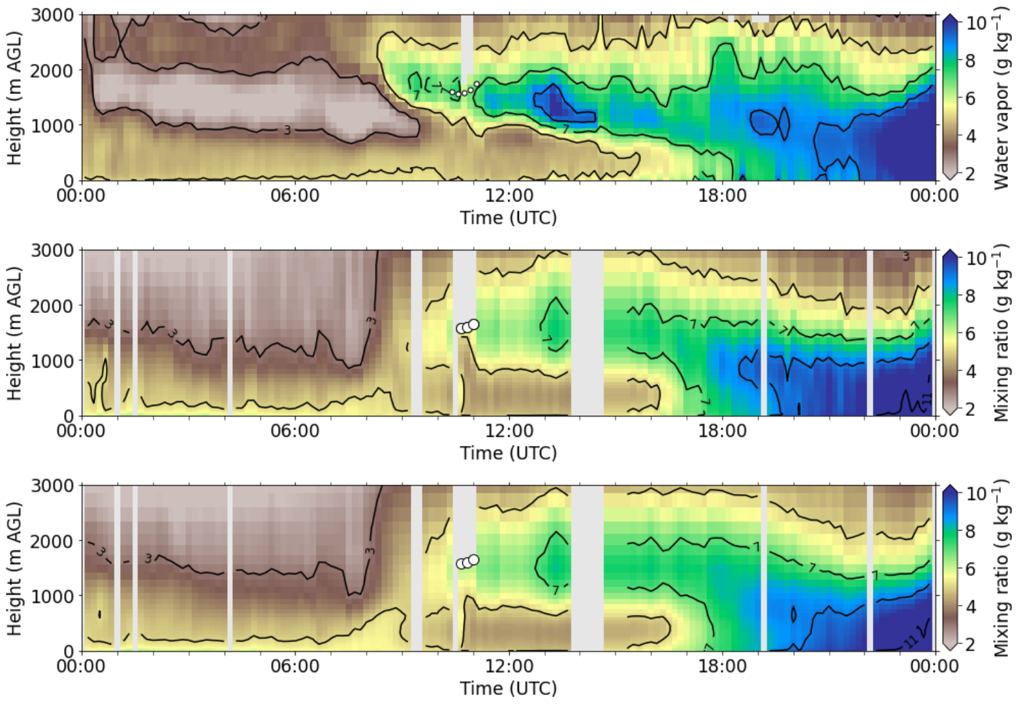
Example of advection of elevated moist air layer
Raman lidar
While noise is reduced in TROPOEIN, mesoscale changes are still well represented
TROPOEIN
We are currently reprocessing all PERiLS data for our IRS and MWR using these improved techniques

Slide 11
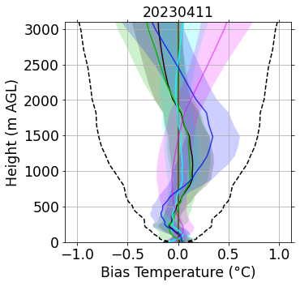
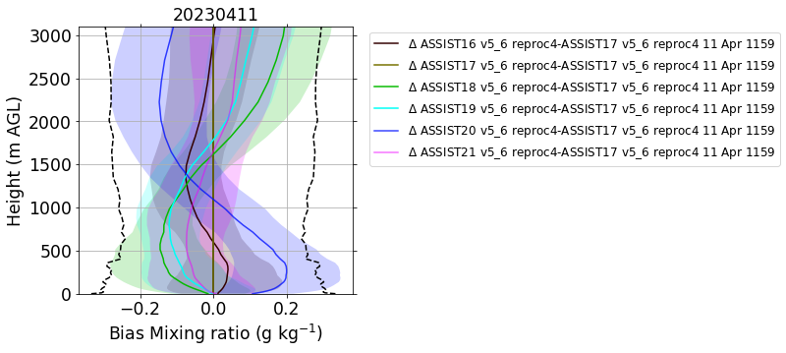
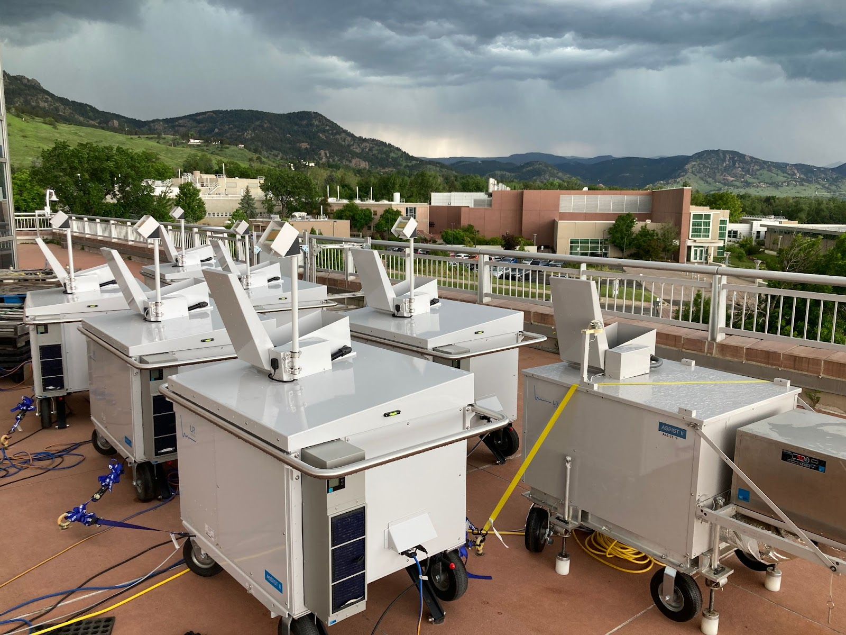
Inter-instrument differences reprocess 4 - 20230411

Slide 12
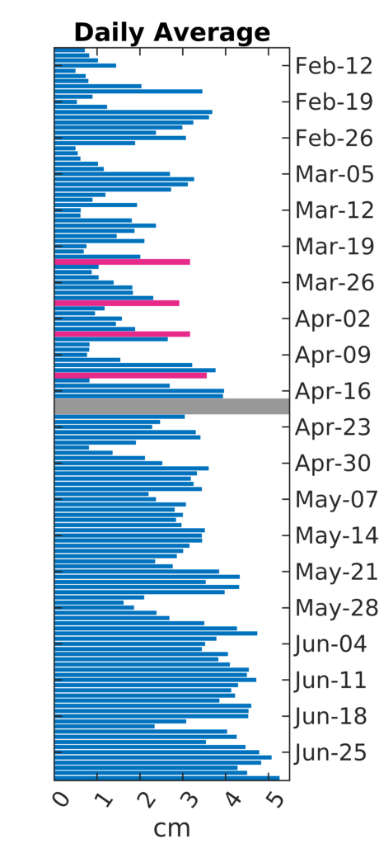
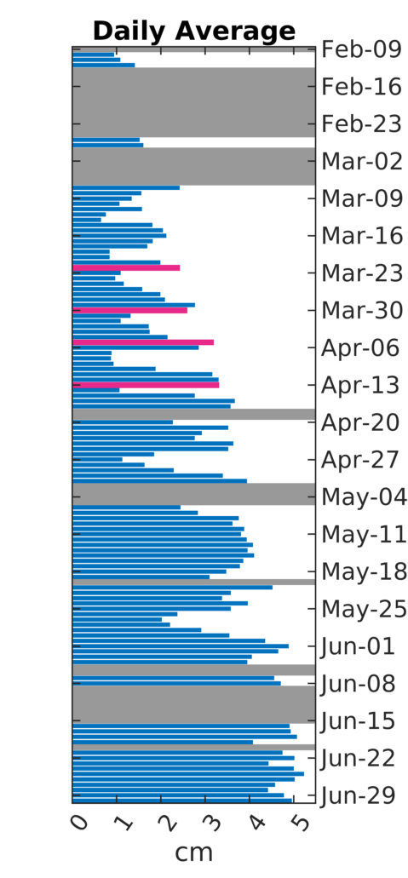
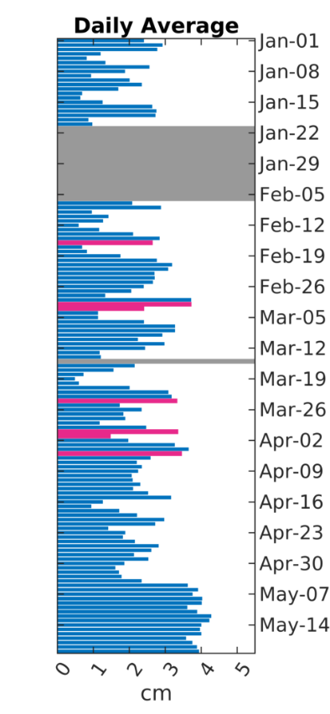
PWV Daily Averages from Columbia, LA During PERiLS 2022 and 2023
HRRRv4 Analysis 2022
ASSIST 2022
ASSIST 2023
QLCSs, as identified by the IOPs, feature seasonally high PWV, followed by drier conditions

Slide 13
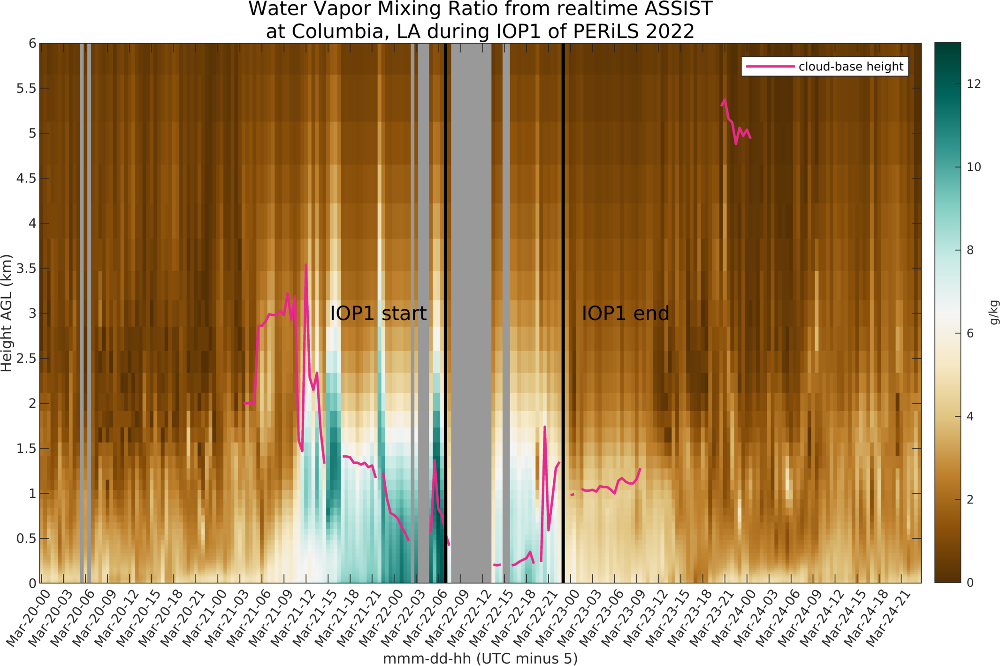
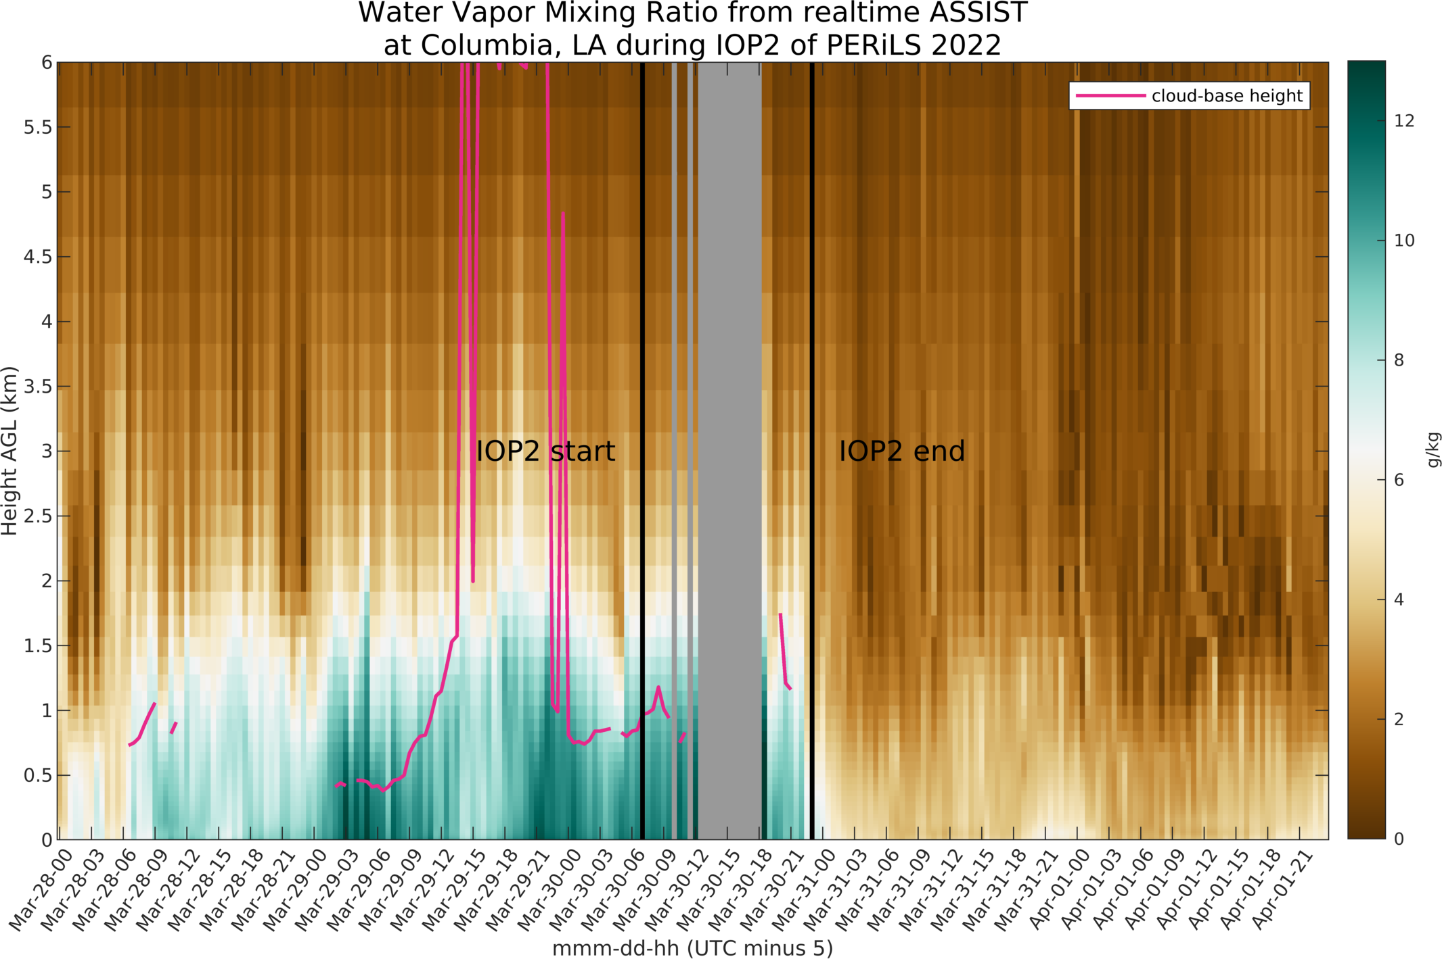
A water vapor view of a QLCS during IOP1 and IOP2 of PERiLS 2022
IOP1
IOP2
IRS only

Slide 14
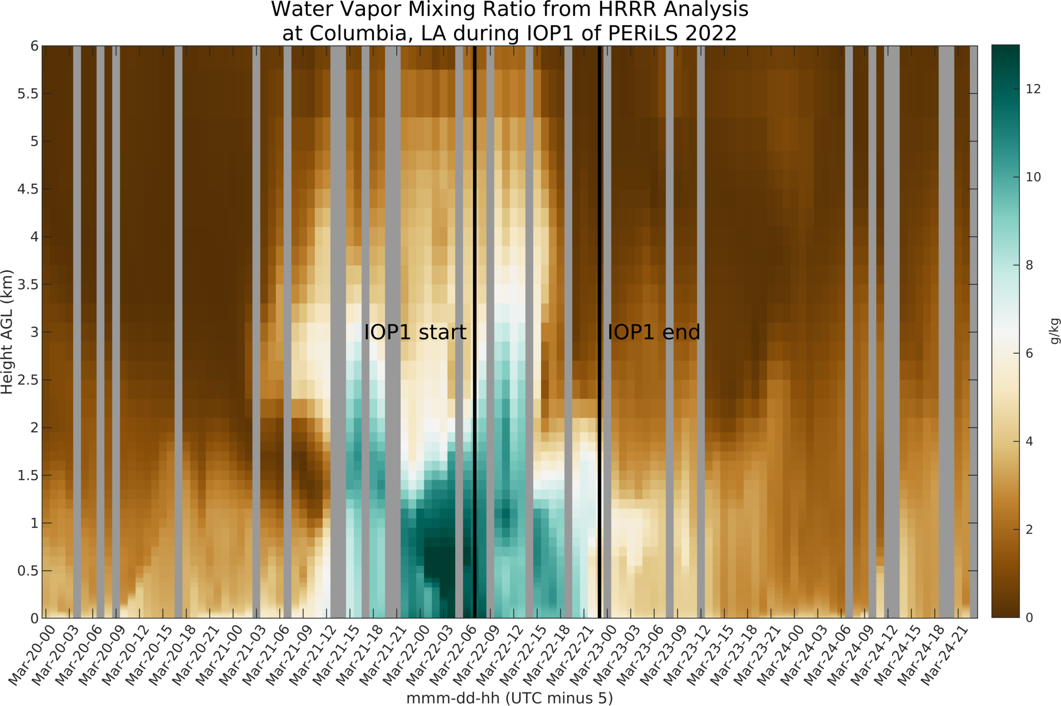
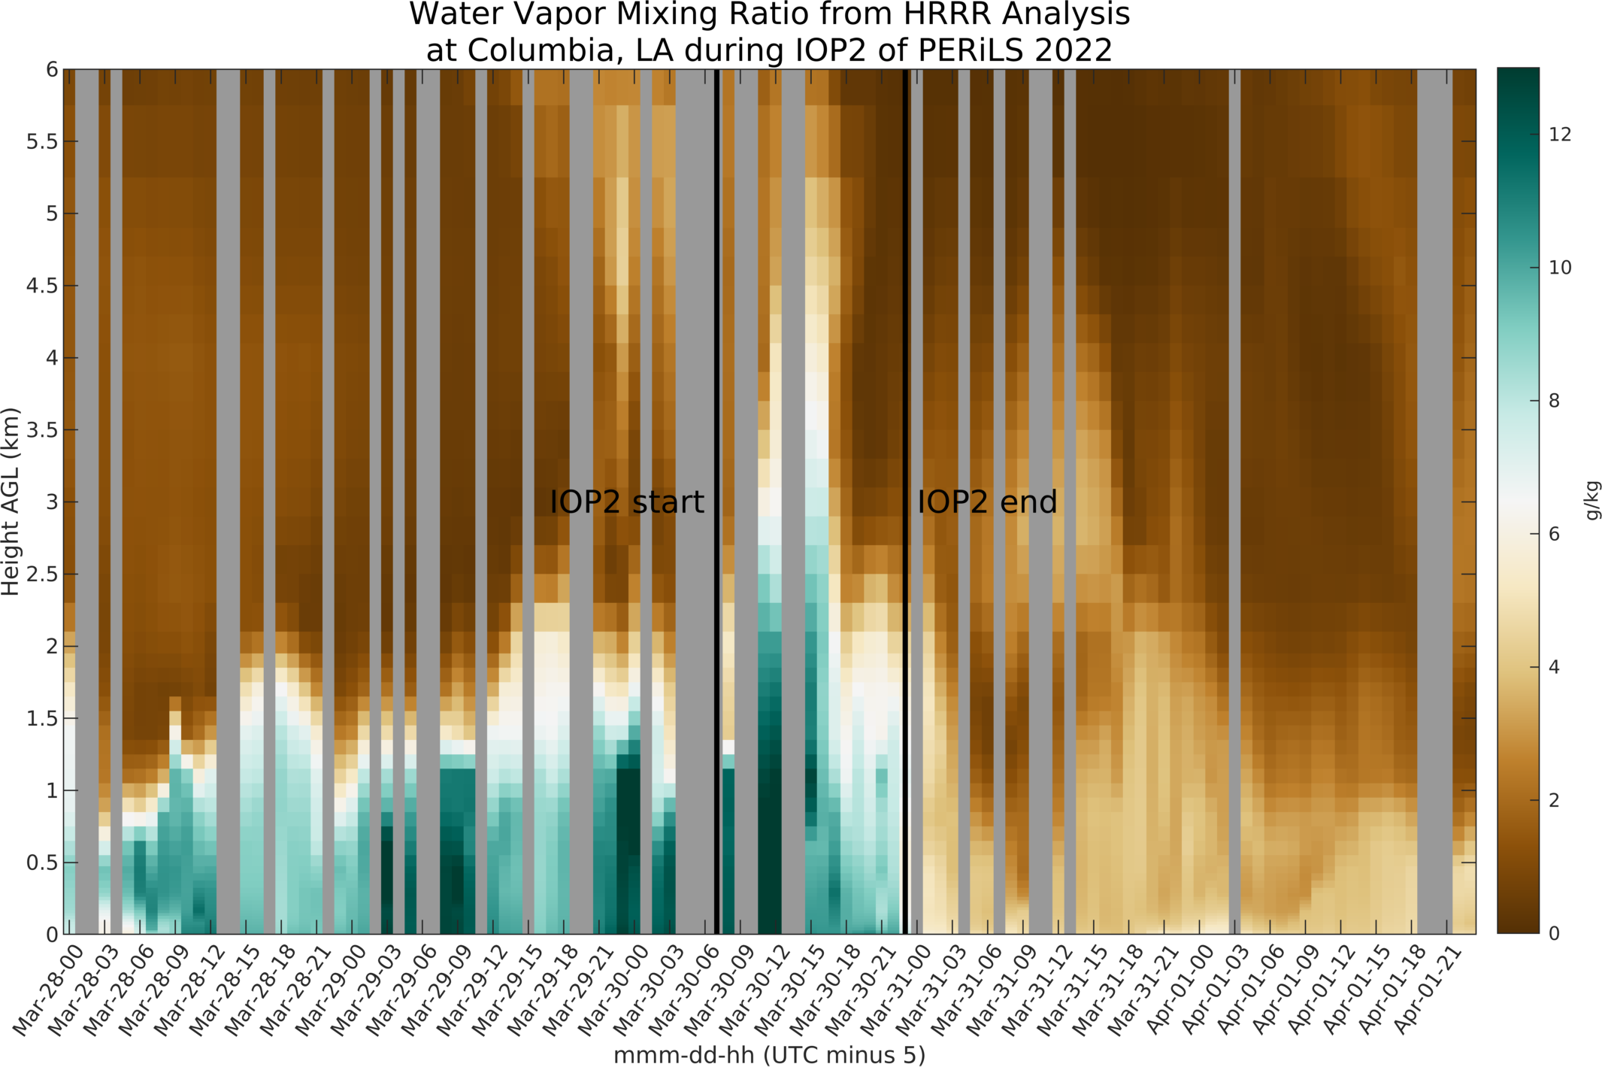
IOP1
IOP2
HRRRv4 Analysis

Slide 15
Evaluation of HRRR forecasts at Courtland, AL

Slide 16
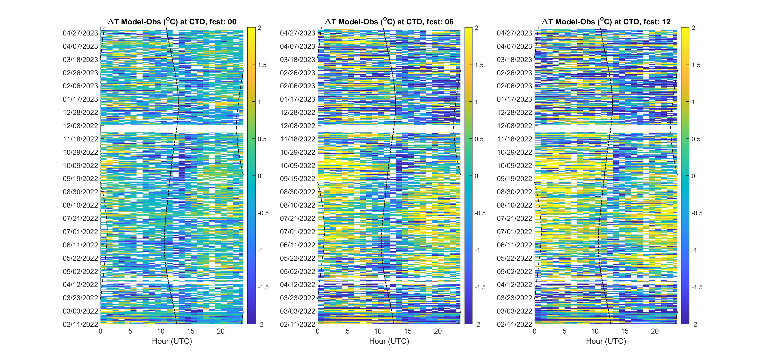
HRRR 2-m Temperature Biases, Feb 2022 – May 2023, Courtland, AL
ΔT, Initialization time
ΔT, Forecast horizon 12

Slide 17
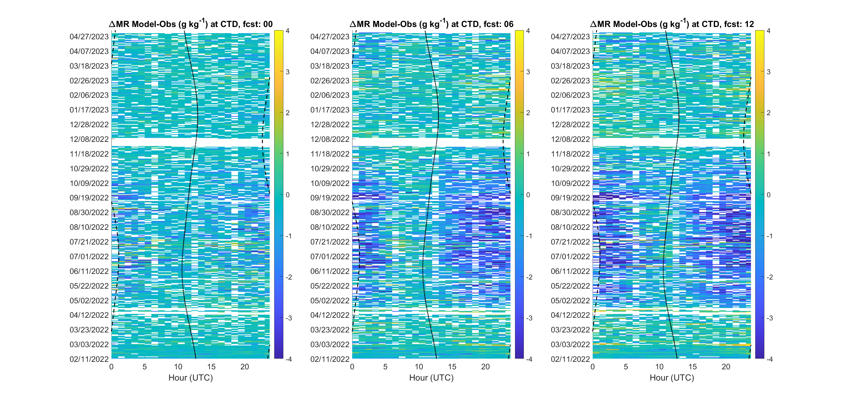
HRRR 2-m Mixing Ratio Biases, Feb 2022 – May 2023, Courtland, AL
ΔMR, Initialization time
ΔMR, Forecast horizon 12

Slide 18
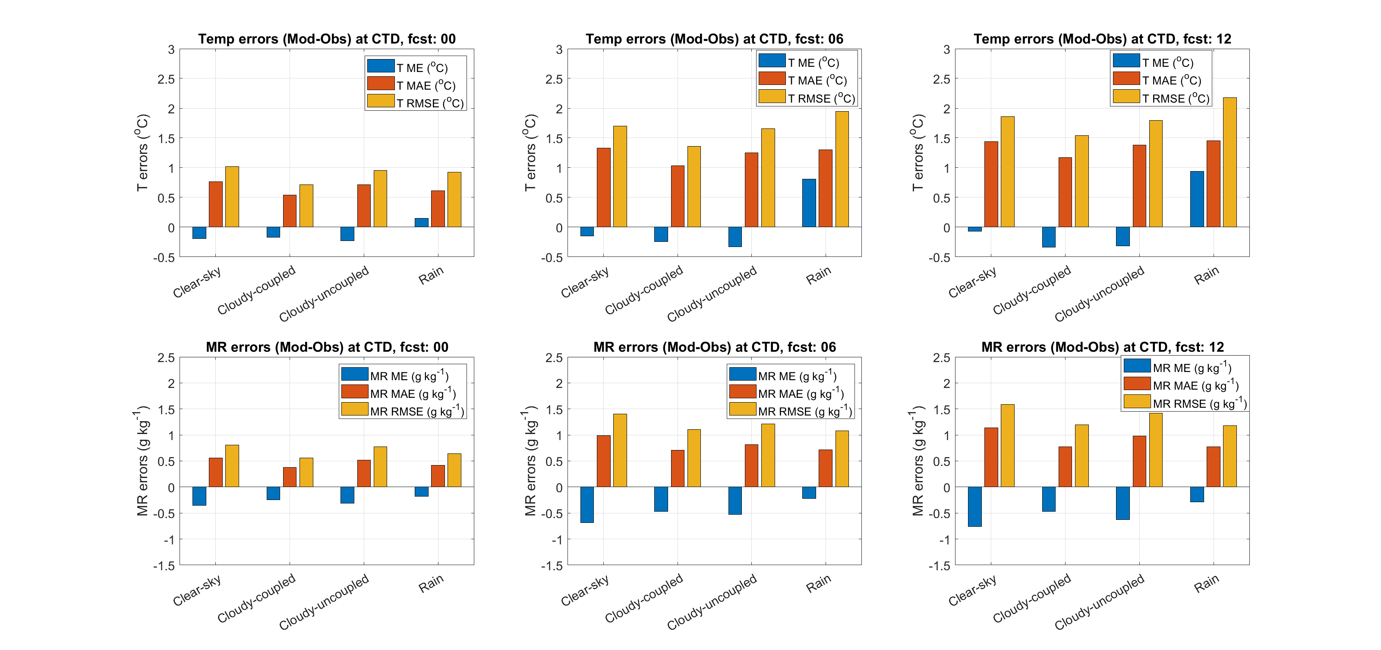
1) Do the HRRR 2m T & MR errors translate to cloud base height errors?
HRHR Cloud Base Height Bias (HRRR-Ceilometer)
Initialization time: -219 m
12 h forecast: -53 m
2) Does the presence of clouds impact model 2m T and MR errors?

Slide 19
Thanks!
Questions?

Slide 20
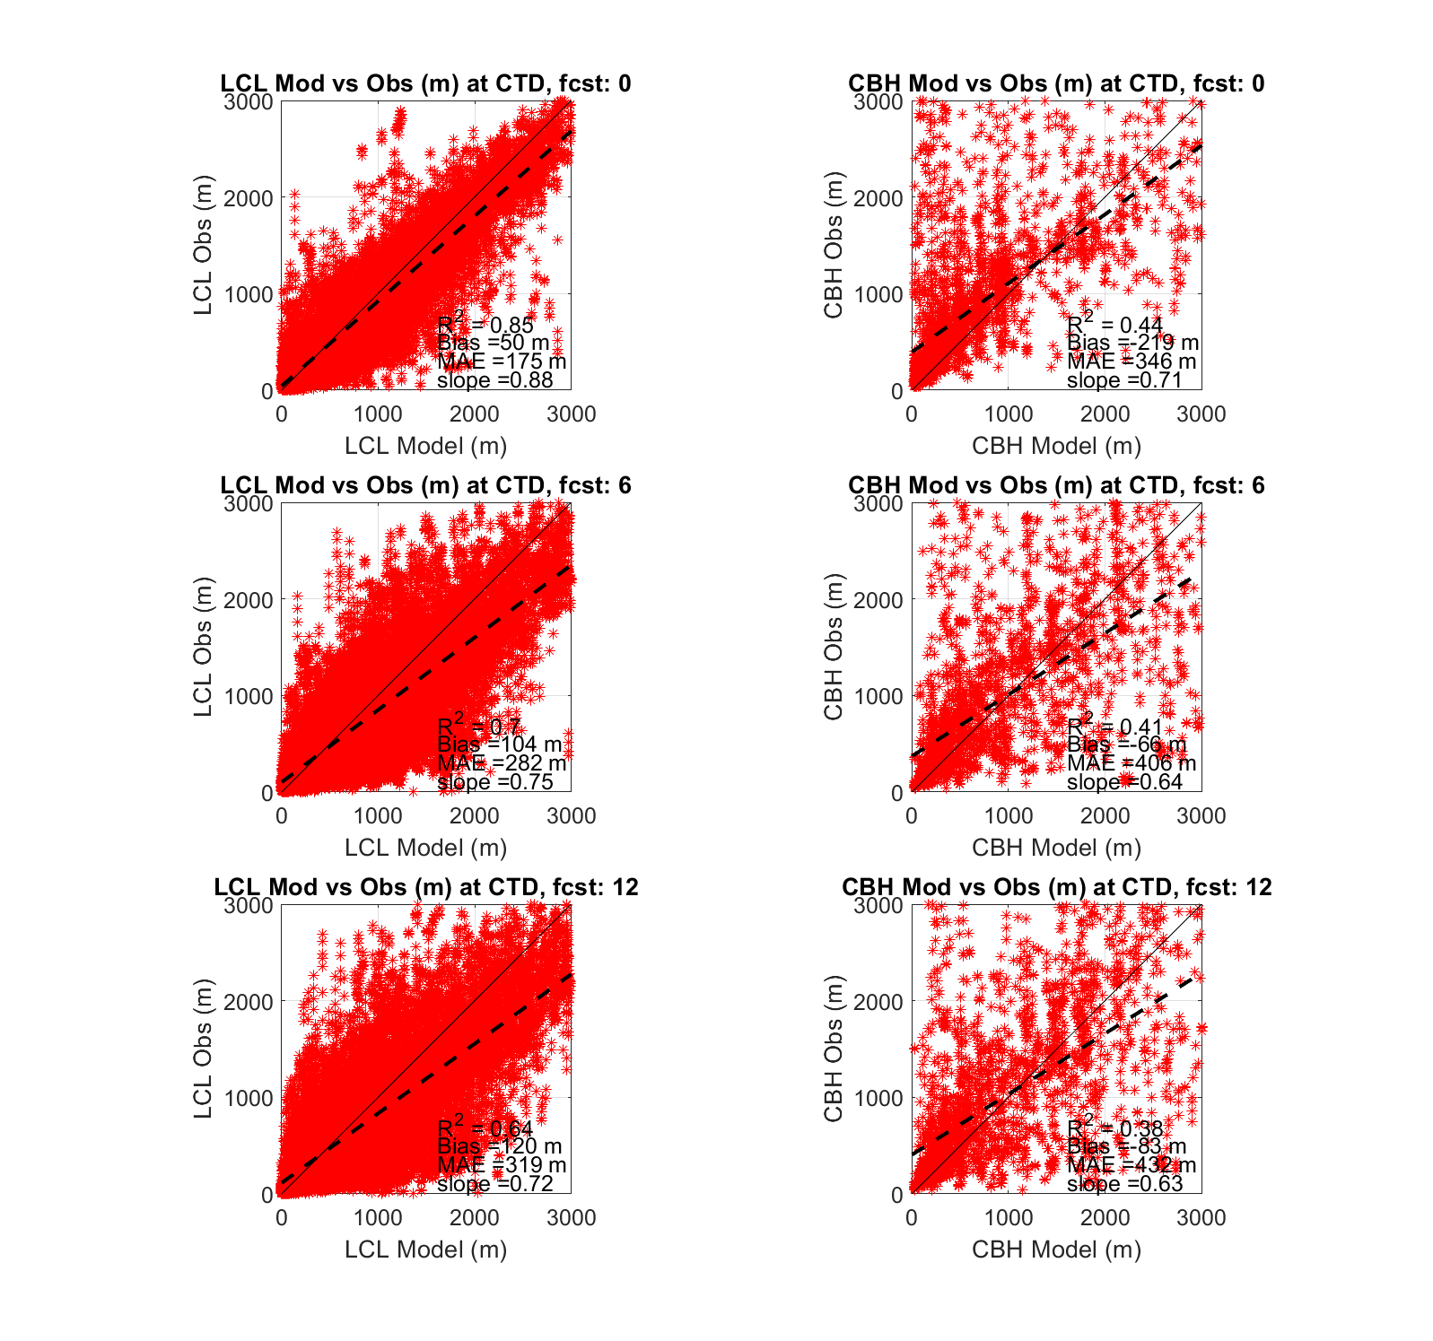
February 2022 – May 2023, OBS vs HRRR, LCL and CBH at Courtland, AL
LCL
CBH
Initialization time
Forecast horizon 06

Slide 21
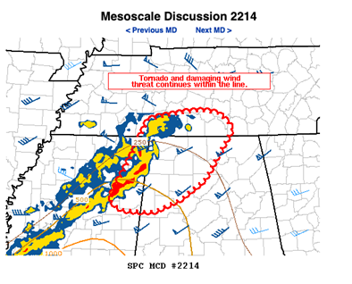
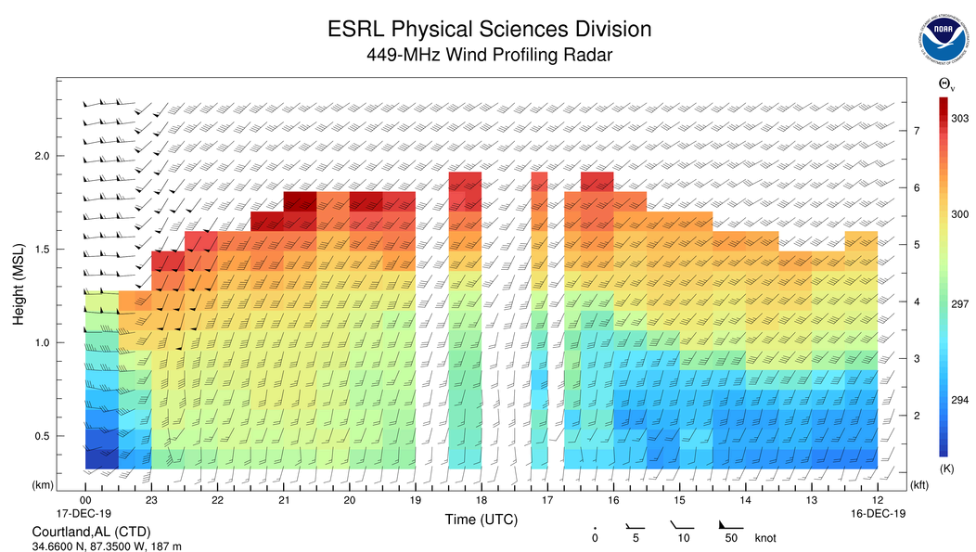
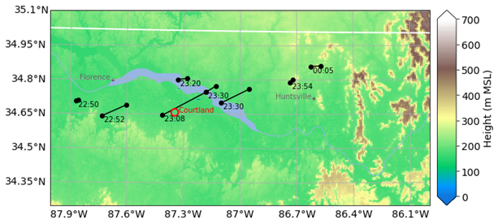

PERiLS QLCS Tornado Case Study 16 Dec 2019
RWP winds and RASS potential temperature

Slide 22
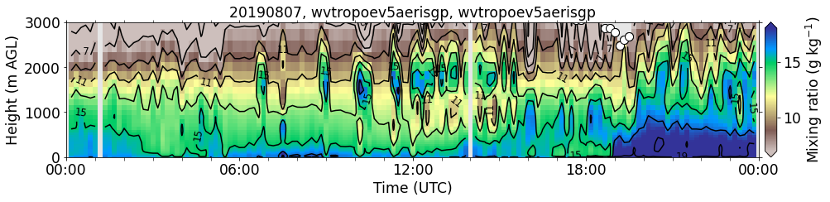
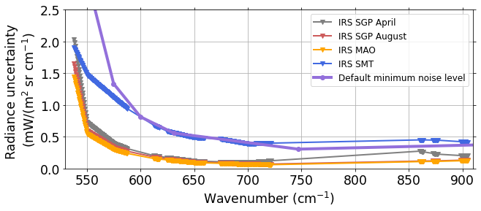

Overfitting of profiles
Uncertainty of forward model is currently not included due to computational limitations. Instead radiance uncertainty is inflated to compensate for this (Turner and Blumberg 2019).
But radiance uncertainty is instrument dependent and even inflated uncertainty my not be sufficient to prevent overfitting and result in unrealistic profiles
→ Implement default minimum noise level for radiance uncertainty
Indicators for suspicious profiles
𝛾 (from state vector equation) is used to change relative weight between prior and observations. 𝛾 > 1: More information from the prior than from the observations
Large RMSR indicate a large discrepancy between the solution and the observations (here RMSR > 5)
Notes:
If we apply a minimum noise level we get a few more profiles and some unrealistic patterns disappear, e.g. 18 UTC.
The minimum
However there are still large gaps in the retrieved data.

