Slide 1
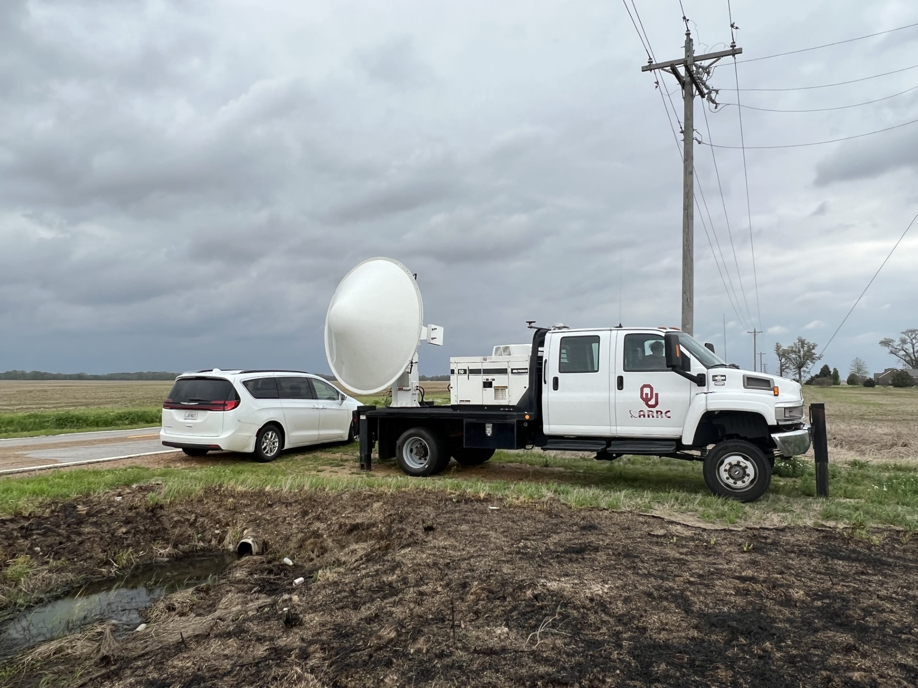
RaXPol Data Collection on PERiLS
Morgan Schneider, David Bodine, Boonleng Cheong, and David Schvartzman

Slide 2
RaXPol
Rapid-scanning X-band Polarimetric (RaXPol) mobile radar at OU ARRC
Participated in PERiLS during March and April 2023 (IOPs 2–5)
Rapid-scan (180°/s), shallow 30-s volumes
Preliminary quality control:
  Automated clutter filtering
  Manual azimuth correction
  Z/ZDR calibration
Data are in CFradial and will be uploaded to EOL in the future
RaXPol operating parameters
Transmit frequency | 9.74 GHz
Operating wavelength | 3.08 cm
Peak power | 20 kW
Antenna | 2.4-m parabolic dish
-3 dB beamwidth | 1.0°
Polarization | Dual-linear, simultaneous H/V
Maximum rotation speed | 180°/s
Pulse width | 0.1 – 40 μs
Maximum range (PERiLS) | 37.5 km
Nyquist velocity (PERiLS) | 30.8 m/s

Slide 3
IOP2
Crew: David Bodine (lead), Brandon Cohen, Boonleng Cheong, Min-Duan Tzeng
Observing period: 3 March 2023, 0745–0908 UTC
VCP: 13 tilts, 1.0–19.0° every 1.5°, scanning speed 180°/s
Data issues: Data gap between 0750–0805 UTC due to transmitter malfunction
Noteworthy: Close-range observations of a nontornadic mesovortex, simultaneous mobile mesonet surface observations

Slide 4
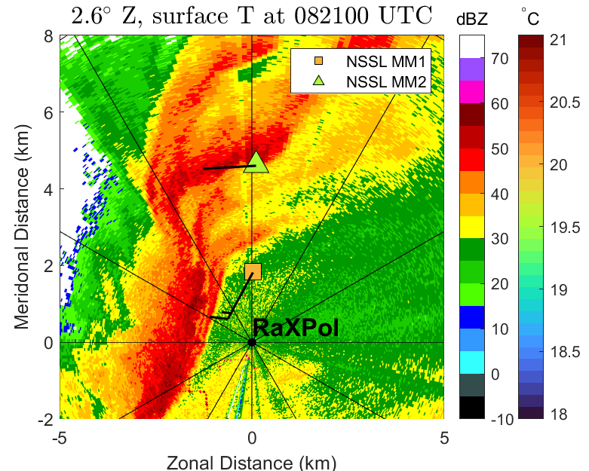
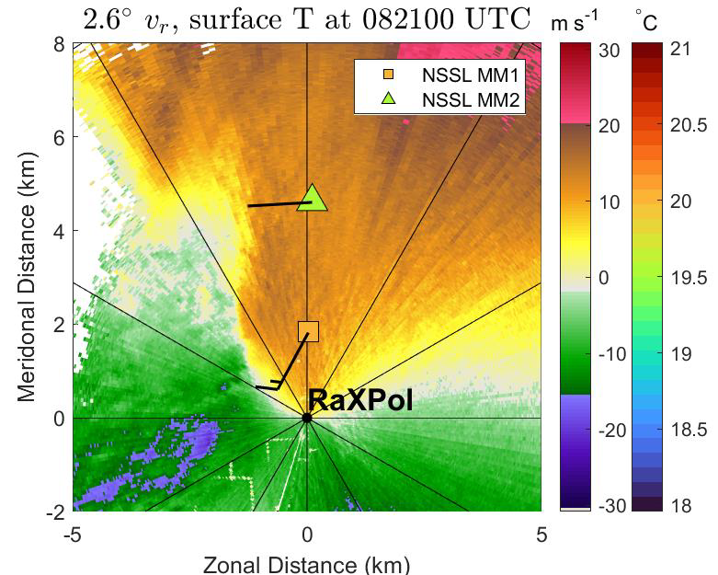
IOP2

Slide 5
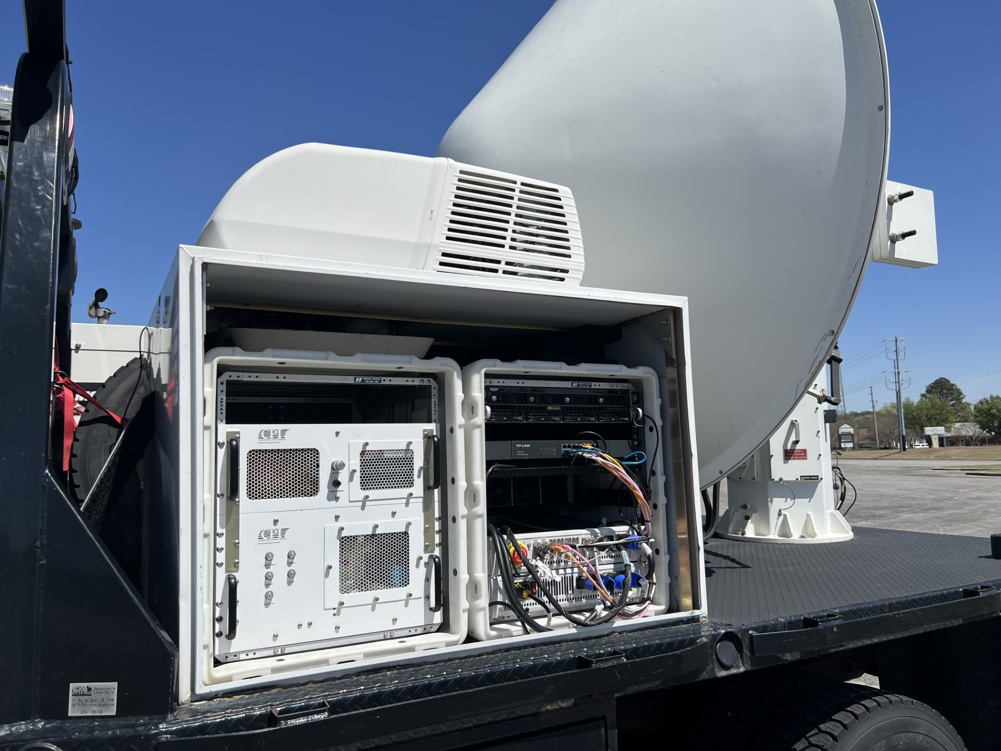
IOPs 3 & 4
☹
IOP3 crew: Morgan Schneider (lead), David Bodine, Laura Shedd, Min-Duan Tzeng
IOP4 crew: Morgan Schneider (lead), Patrick Skinner, Min-Duan Tzeng, Nathan Kuhr
Radar surgery in Florence, AL.

Slide 6
IOP5
Crew: Morgan Schneider (lead), Brandon Cohen, Boonleng Cheong, Min-Duan Tzeng, Dale Sexton
Observing period: 5 April 2023, 1453–1746 UTC
VCP: 15 tilts, 1.0–29.0° every 2.0°, scanning speed 180°/s
Data issues: No major issues.
Noteworthy: Coordinated rapid dual-Doppler observations with SBU SKYLER at a ~10-km baseline

Slide 7
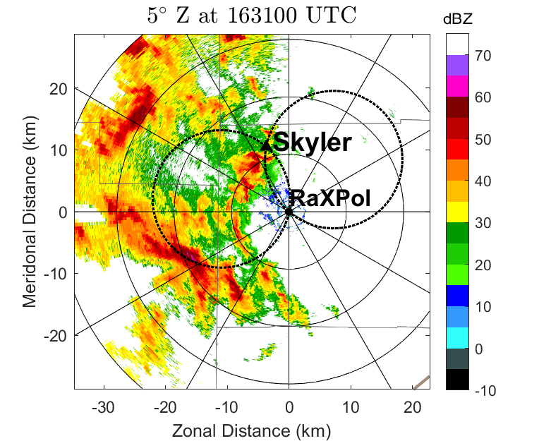
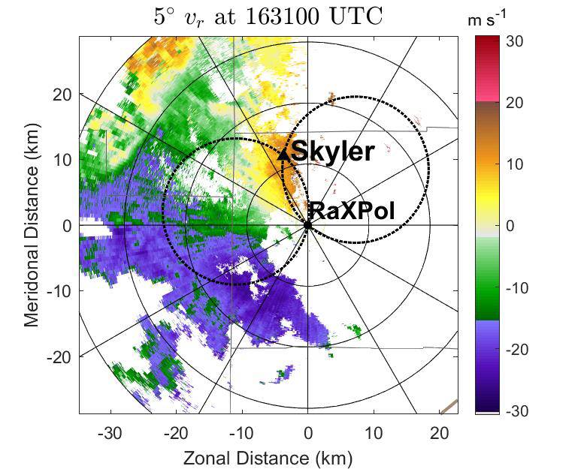
IOP5

Slide 8
Questions?
Email me at morgan.schneider@noaa.gov.
Acknowledgments: Data collection was supported by NOAA award NA21OAR4320204 and VORTEX USA. Thanks to the University of Oklahoma Advanced Radar Research Center for facilitating the use of RaXPol in support of PERiLS.

