Slide 1


UAH MAPNet Instrument Summary
PERiLS Year 2
Preston Pangle (Manager)
Kevin Knupp (PI)

Slide 2
MAPNet -Mobile Atmospheric Profiling Network
A part of the NSF Community Instruments and Facilities Program
3 profiling platforms and a scanning radar
Mobile Doppler Lidar & Soundings (MoDLS)
  Scanning Doppler lidar, 35 channel microwave radiometer, lidar ceilometer, 8-m retractable mast for in-situ surface (PTU, RH, 3D sonic)
Mobile Integrated Profiling System (MIPS)
  915 MHz RWP, 35 Channel Microwave Radiometer, lidar ceilometer, parsivel disdrometer, vertically pointing x-band radar, 10-m mast for in-situ surface (PTU, rain)
Rapidly Deployable Atmospheric Profiling System (RaDAPS)
  915 MHz RWP, 35 Channel Microwave Radiometer, lidar ceilometer, parsivel disdrometer, vertically pointing K-band radar, 6-m mast for in-situ surface (PTU, rain, RH)
Mobile Alabama X-band Radar (MAX)
  Scanning dual-pol Doppler X-band radar, 10-m mast for in-situ surface (PTU, rain, RH)

Slide 3
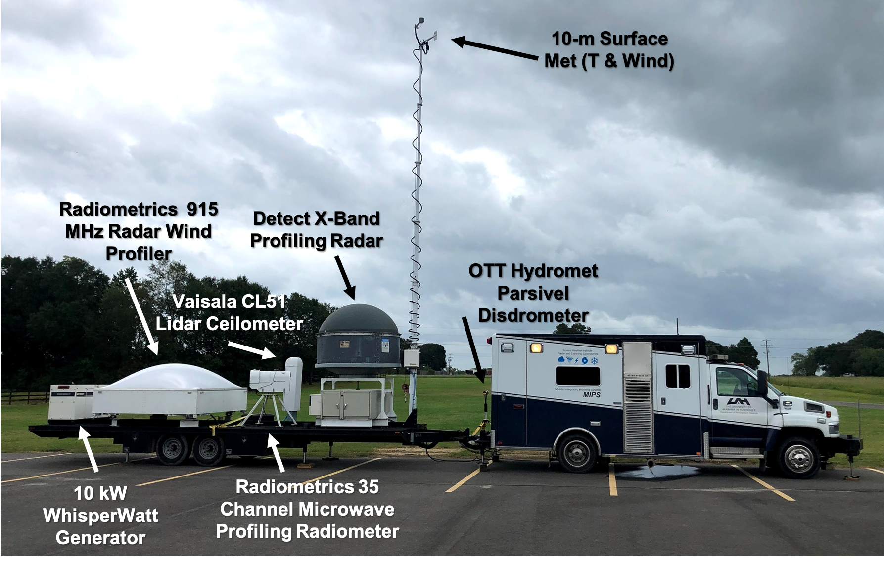
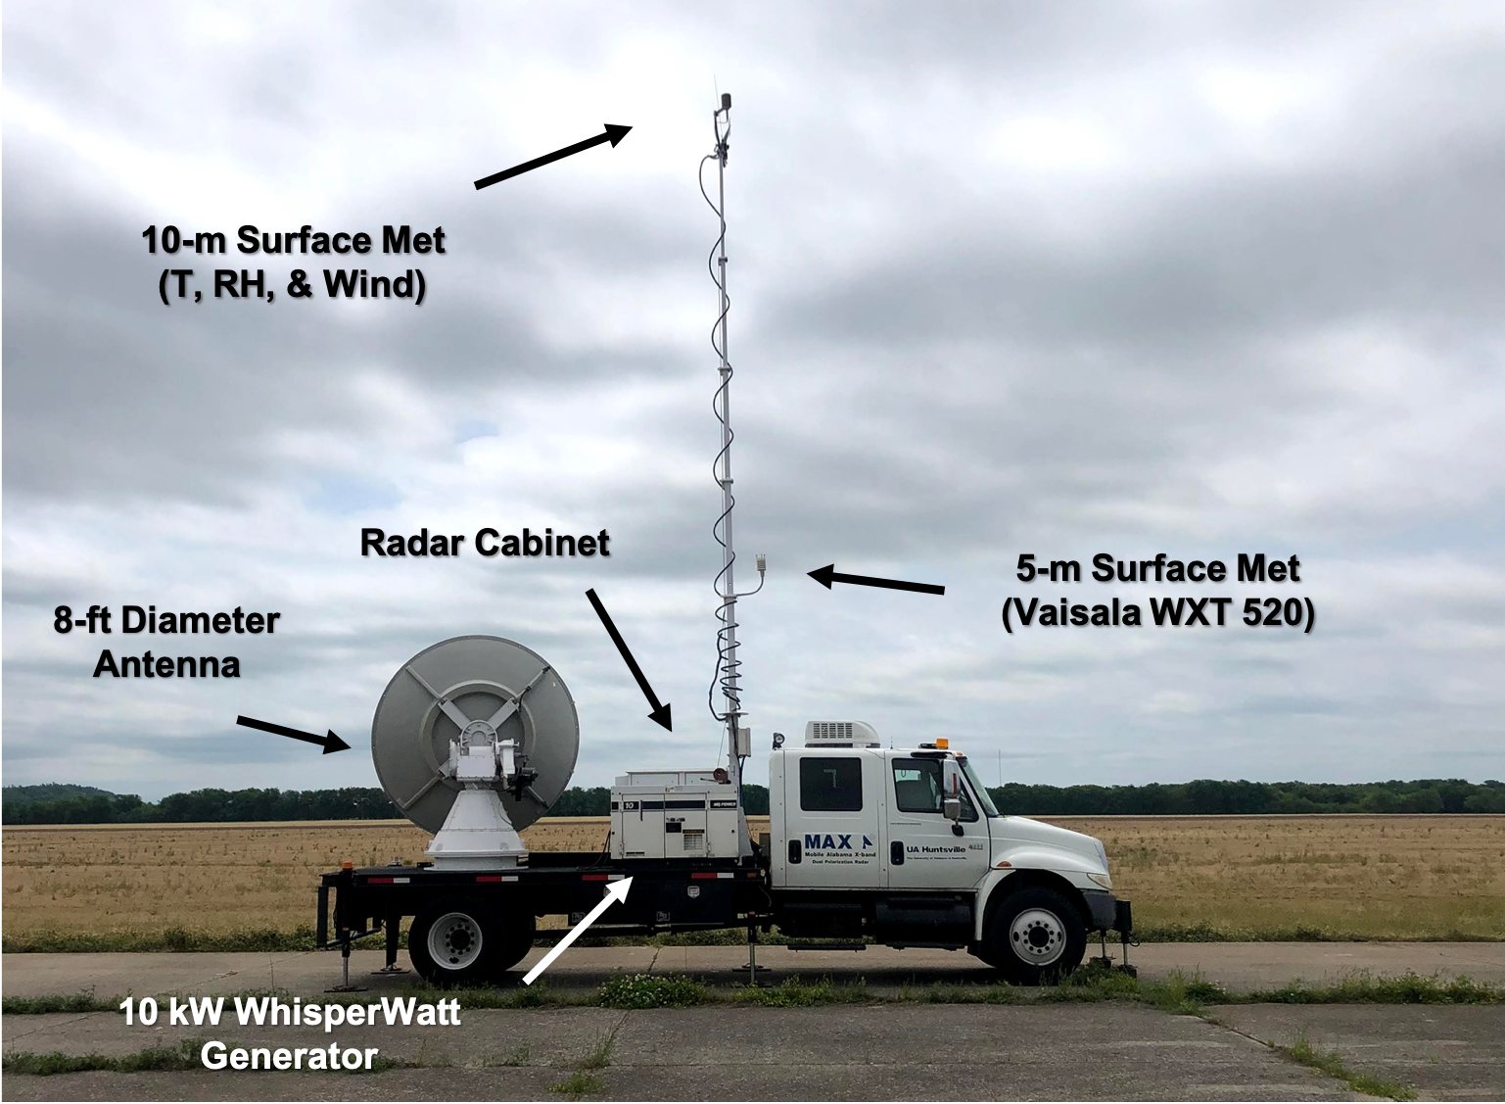
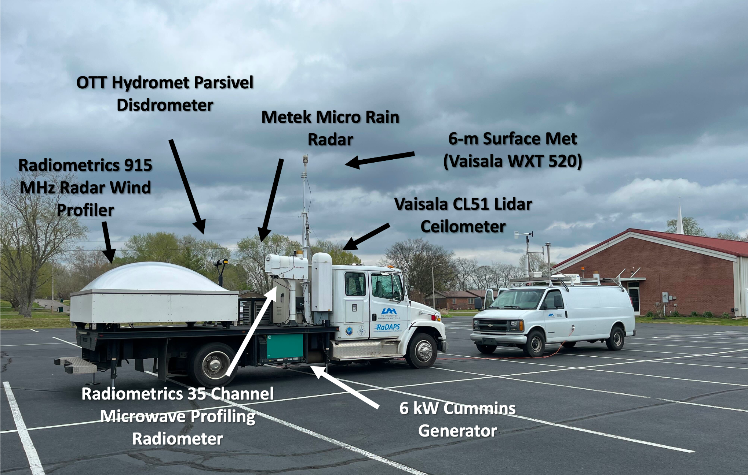
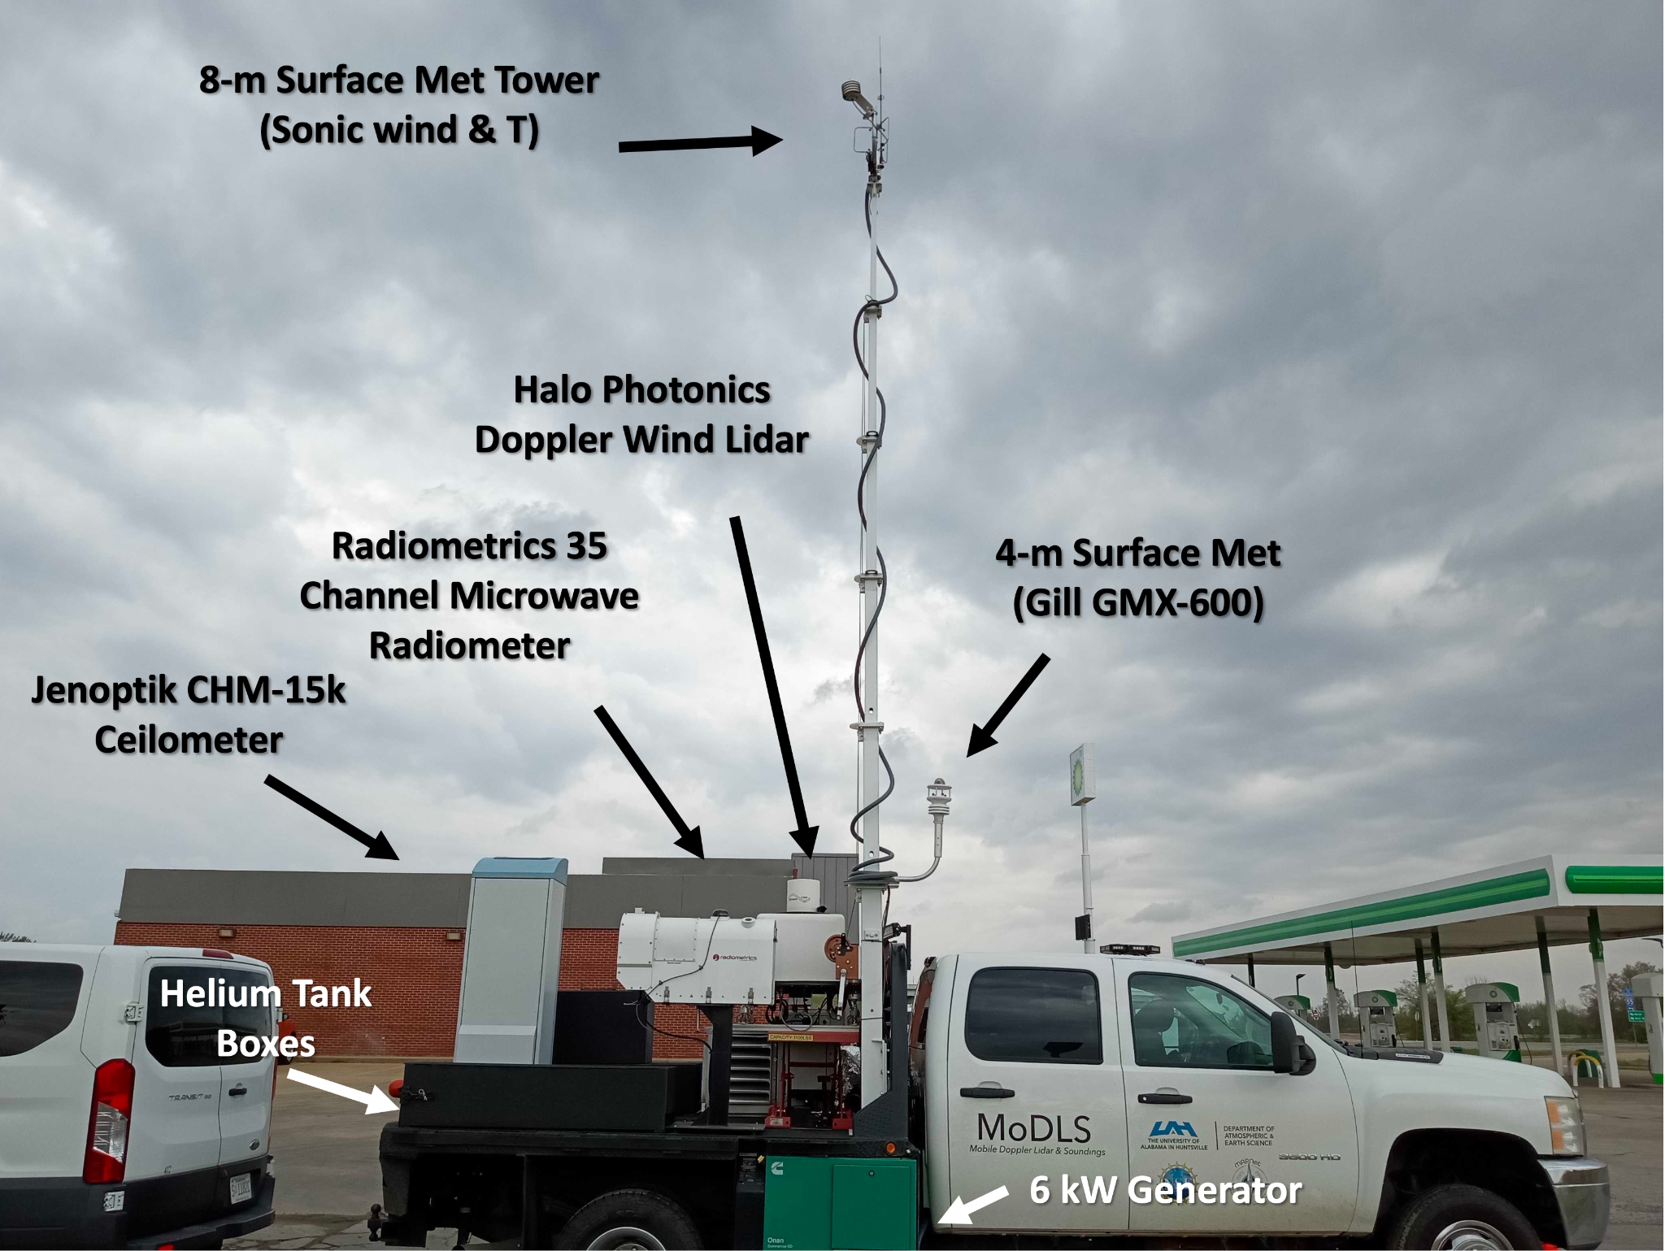
MIPS
MAX
RaDAPS
MoDLS

Slide 4
Deployment Summary
Successful year for MAPNet
All 4 Platforms deployed for all 5 IOPS
Soundings
  Soundings accompanied MIPS (iMet), RaDAPS (iMet), and MoDLS (Windsond)
    Windsonds with MAX for IOP 4
  Release times coordinated with other PIs (1-2 hr launches)
Noteworthy Issues
  MIPS - XPR down due to bad STALO and amp (long lead times)
  RaDAPS – 915 RWP wind data degraded due to manufacturer software issue. Winds quality varies
  MAX – failed EL motor during IOP 4 prevented scans above 1 deg but still operated
More detailed MAPNet IOP summaries are available on the Field Catalog
 | MIPS | RaDAPS | MoDLS | MAX
IOP 1 | Deployed | Deployed | Deployed | Deployed
IOP 2 | Deployed | Deployed | Deployed | Deployed
IOP 3 | Deployed | Deployed | Deployed | Deployed
IOP 4 | Deployed (at SWIRLL) | Deployed | Deployed | Deployed
IOP 5 | Deployed | Deployed | Deployed | Deployed
Deployed
Deployed w/issues
Not Deployed

Slide 5
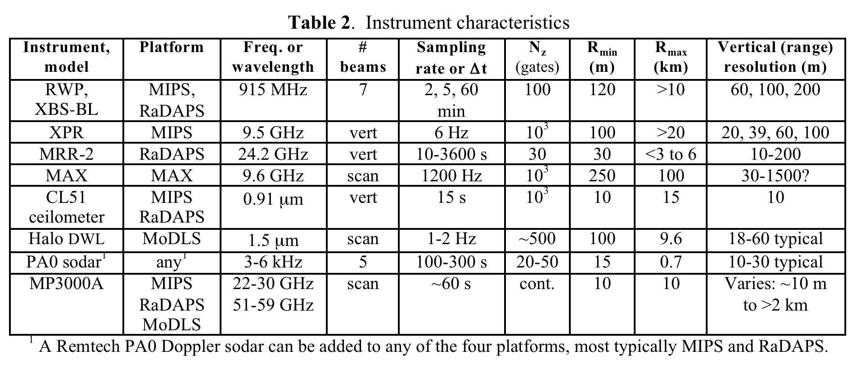

Slide 6
In-Field Operations
MAX – Operated in two modes
  For convection > 50 km range: BL scans focused on low-level BL obs, RHIs over profilers
    BL Scans: 0.7°, 1.3°, 2°, 2.7°, 3.7°, 5°, 7°, 9°; PRF 1200 Hz, Pulse width of 0.8 microseconds
  For convection < 50 km range: faster scan rate, 360 sec update time; shallow, deep, shallow, deep
    Shallow Scan Sequence - 0.7, 1.5, 2.6 3.8, 5; pulse with: 0.4 microseconds
    Deep Scan Sequence - 0.7, 1.5, 2.6, 6, 9; pulse with: 0.4 microseconds
  Bird baths at the end of IOPs when time and precipitation allowed
Wind Profilers used a standard mode
  Averaged winds every 5 minutes and 60 minutes
Lidar – Operated in two modes
  VAD scans every 5 minutes - 15° elevation (8-point) and 60° elevation(6-point)
  vertical stares in between VAD scans
Radiometers
  Zenith-only obs

Slide 7
Data Quality Control
All data were checked for inconsistencies; data points corrected or omitted where necessary
Wind profilers - Software-controlled QC Algorithm used (provides confidence flag for data, ranging 0-1) does a good job; headings verified; no other QC performed
Lidar - Headings were corrected where necessary; VAD scans used to produce wind profiles
Radiometer – No QC to data; LN2 calibrations performed in Feb 2023 prior to IOP 1
Surface data - Removed erroneous data; applied wind heading corrections where necessary

Slide 8
Data Quality Control Cont’d
Soundings
  Verified surface points with surface data from co-located platforms
  Inconsistent height or wind data were corrected or omitted
  Windsond wind data underwent basic smoothing to mask noise produced by noisy GPS (outlined in metadata)
  Recent batches of iMet sondes have seem to show an inconsistent Td bias
    this variation has tested and was within factory specs (5% RH uncertainty); so no QC there
Radar data
  Locations and headings verified
  Zdr corrected using Pyart and available bird baths – files include both corrected and raw Zdr
  No other QC applied

Slide 9
Data Format & Access
All available UAH MAPNet data will be uploaded to EOL in coming weeks
  Metadata - readme and field logs
  Detailed IOP summaries are provided on the EOL catalog
All surface and sounding data provided in CSV text files w/headers
All profiling and radar data provided in netCDF
  Radar data follows CFRadial format
Radiometer lvl2 (T and moisture profiles) data provided; lvl1 (brightness temperatures) can be requested
Additional and “raw” data can be requested
  (preston.pangle@uah.edu or kevin.knupp@nsstc.uah.edu)

Slide 10

Questions or Comments?
Preston Pangle (preston.pangle@uah.edu)
Kevin Knupp (kevin.knupp@nsstc.uah.edu)
More MAPNet Info

