Slide 1
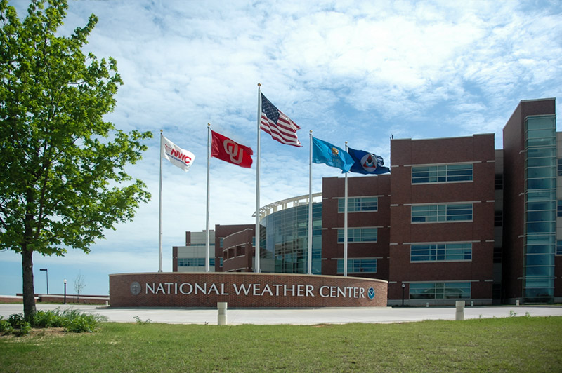
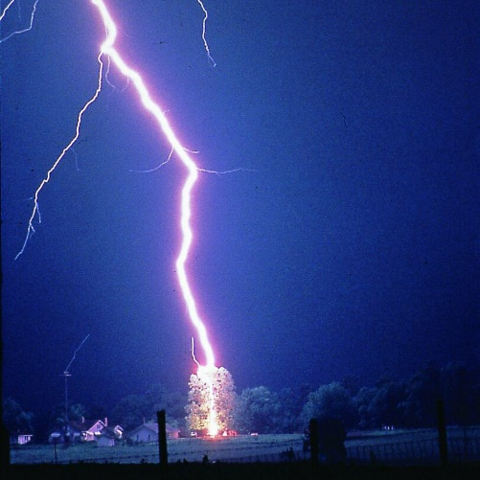
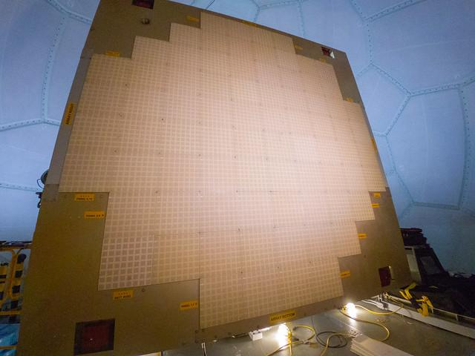
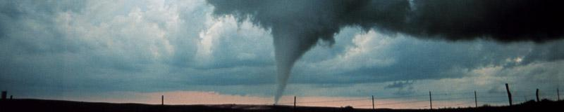
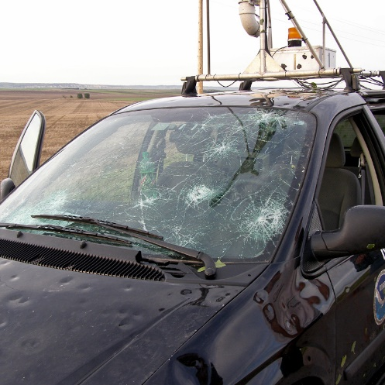
PERiLS 2023: NOXP Data
Addison Alford, Anthony Reinhart, and Ted Mansell
NOAA/OAR/National Severe Storms Laboratory

Slide 2
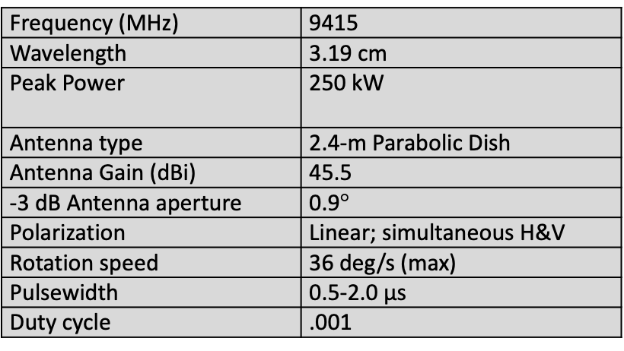
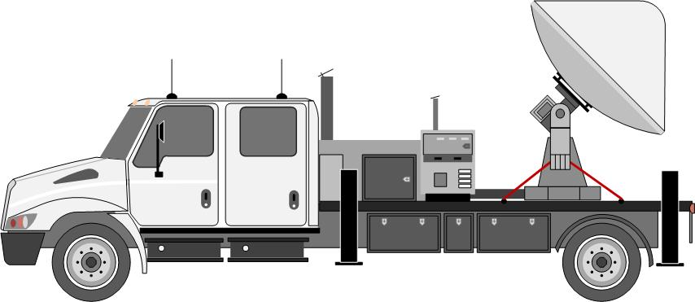
NOXP
The NOAA X-band polarimetric mobile radar (NOXP) has been used in multiple US and international field experiments
Rmax = 77 km
Nyquist 15.6 m s⁻¹
0.5 microsecond pulse
VCP: alternating “low” and “high”
10 min sync
Data are rotation corrected and checked
Converted to cfradial and uploaded to EOL in early November

Slide 3
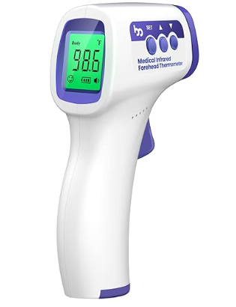
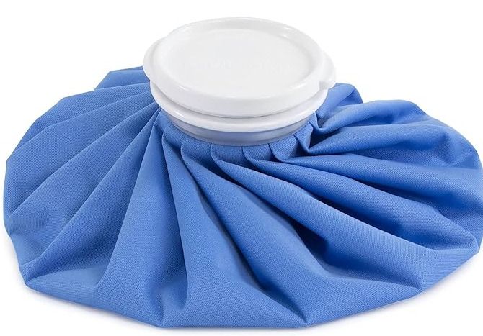
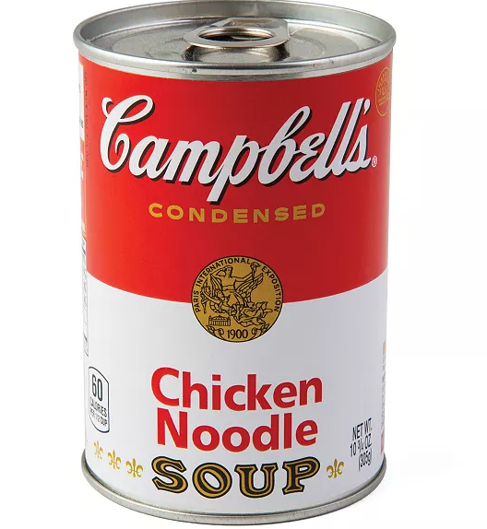
IOPs 1 & 2

Slide 4
IOP 3
Team: Ted Mansell (Lead), Tom Galarneau, Charles Kuster, and Jacob Widanski
Operation Window: 24 March 2023 20:33 to 25 March 2023 02:00 UTC
Notable Obs: Rolling Fork, MS Tornado
No operations issues.

Slide 5
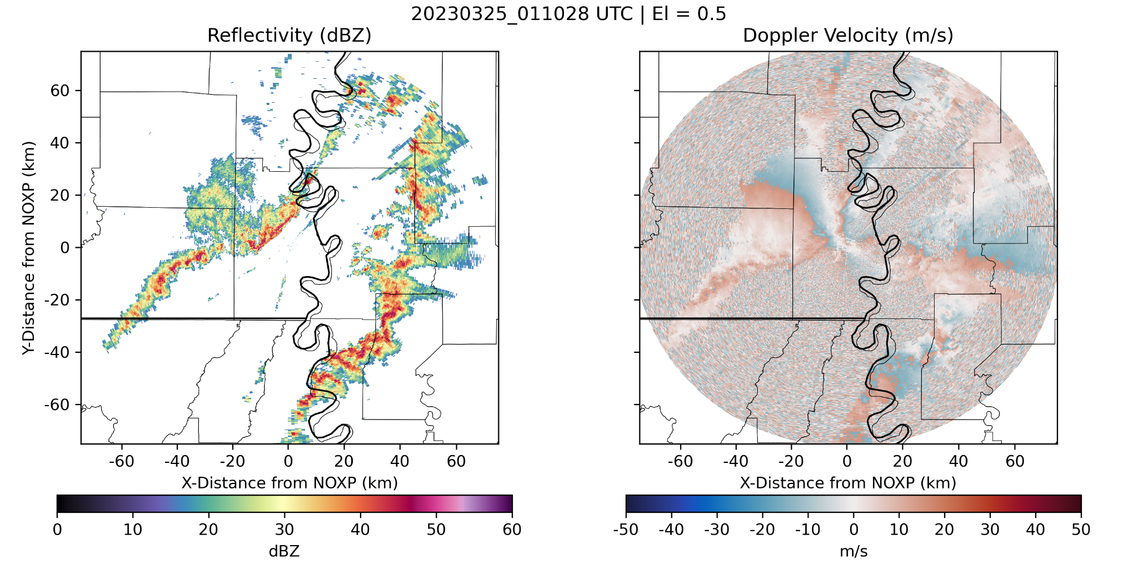
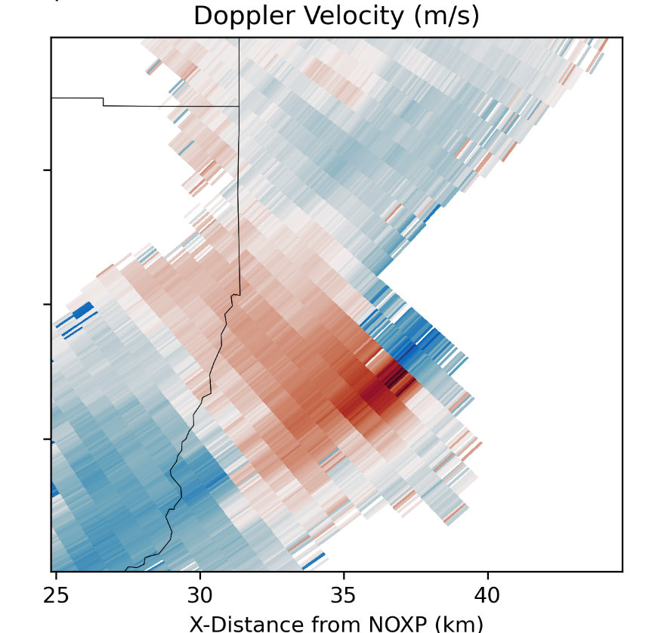
IOP 3
Team: Ted Mansell (Lead), Tom Galarneau, Charles Kuster, and Jacob Widanski
Operation Window: 24 March 2023 20:3 to 25 March 2023 02:00 UTC
Notable Obs: Rolling Fork, MS Tornado
Quick Dealias

Slide 6
IOP 4
Team: Addison Alford (Lead), Tom Galarneau, Thea Sandmael, and Jacob Carlin
Operation Window: 31 March 2023 20:33 to 01 April 2023 08:00 UTC
Notable Obs: Multiple vorticity maxima associated with embedded supercells and linear features.
No operations issues.

Slide 7
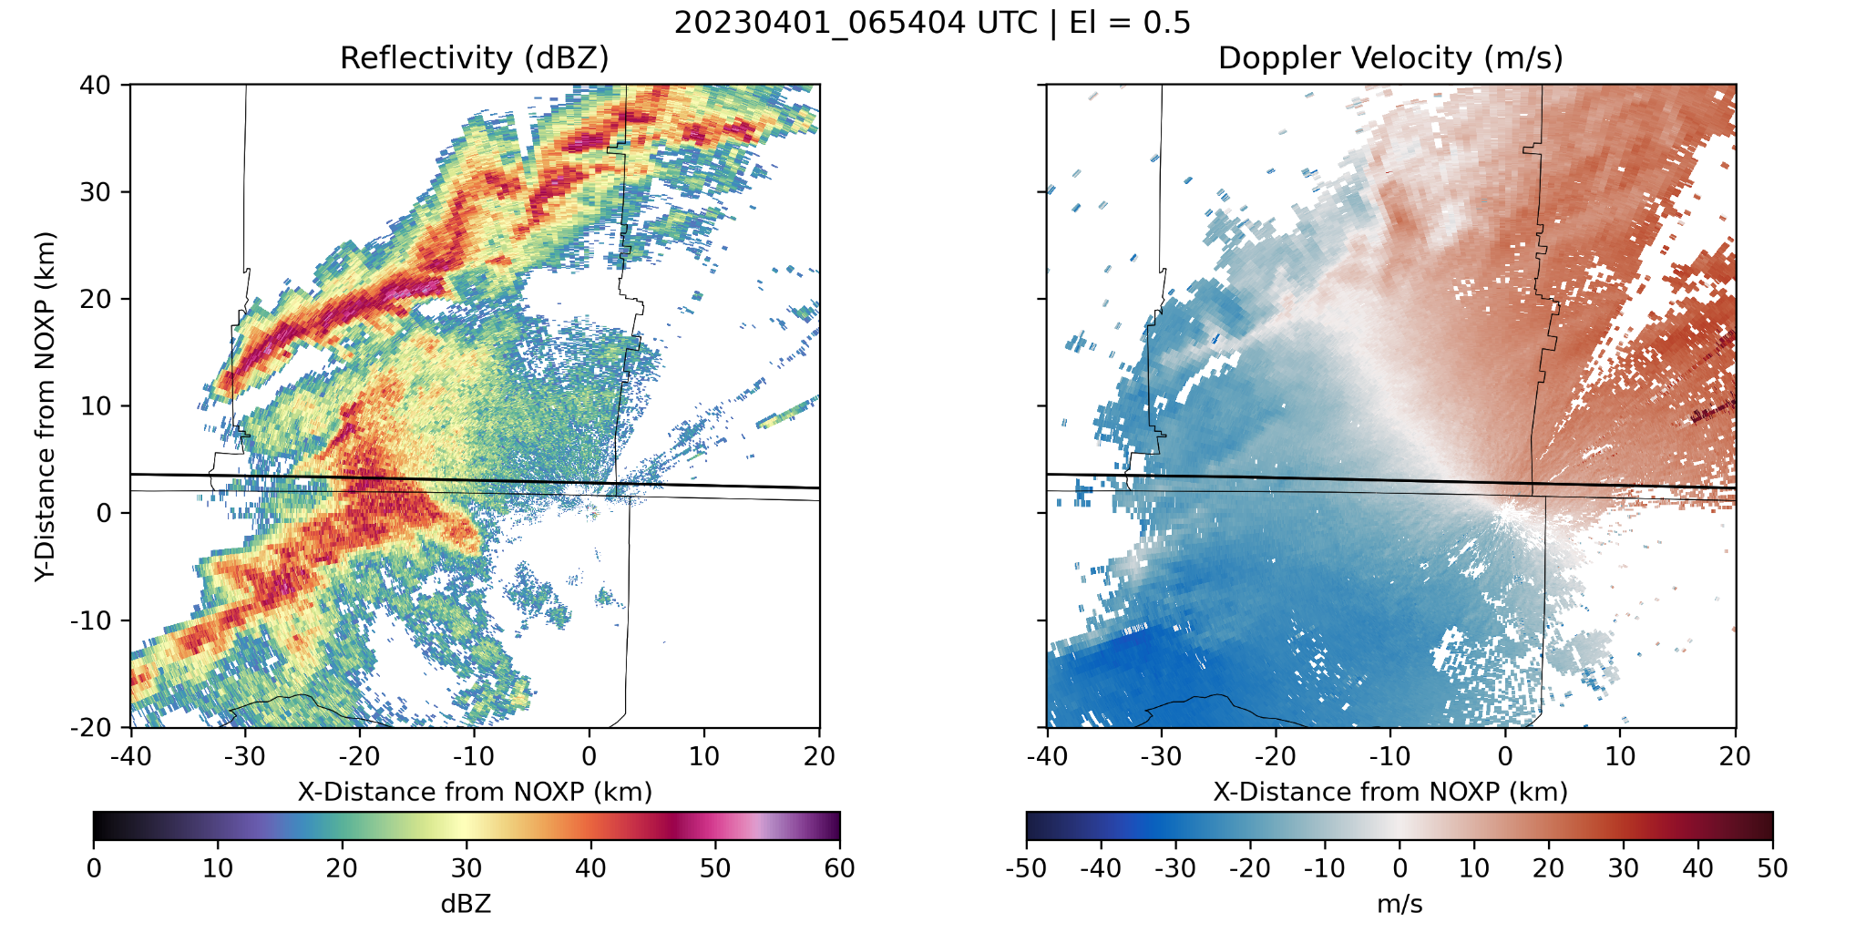
IOP 4
Quick Dealias

Slide 8
IOP 5
Team: Addison Alford (Lead), Thea Sandmael, Jacob Segall, and Quentin Thomas
Operation Window: 05 April 2023 14:39 to 05 April 2023 18:35 UTC
Notable Obs: Weak mesovortex structures.
No operations issues, but were blocked randomly by trucks passing on the highway.

Slide 9
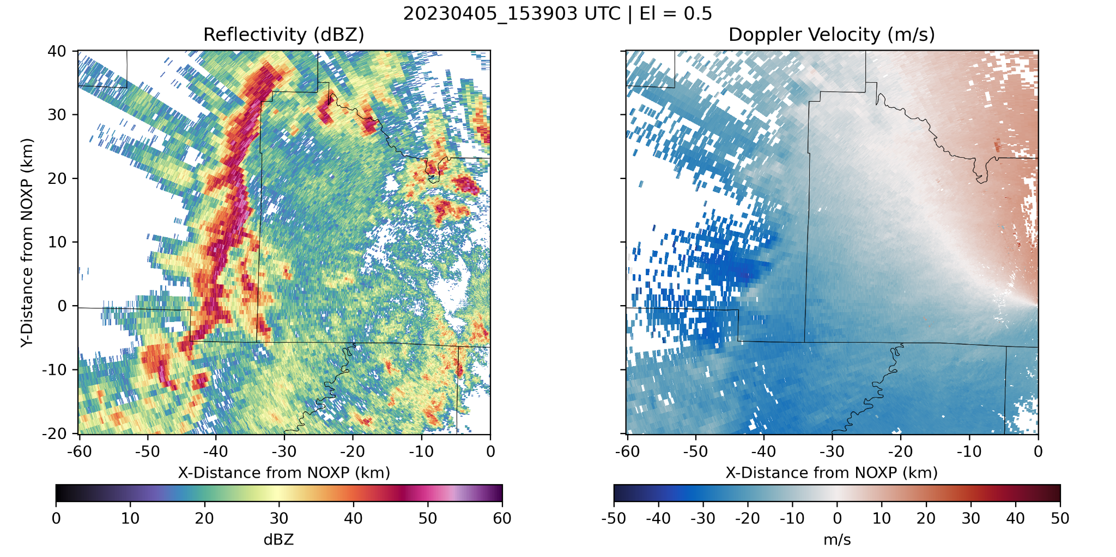
IOP 5
Quick Dealias

Slide 10
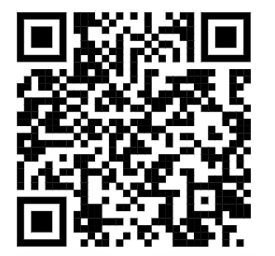
Questions?
Data are available via https://doi.org/10.26023/J1G9-4B6N-180E or the QR code to the right.

